Slide 1
StudyMafia.Org
Acid Base and Salts
Submitted To: Submitted By:
Studymafia.org Studymafia.org

Slide 2
Table Contents
Definition
Introduction
Acids
Bases
Salts
Differences
Conclusion
2
Notes:
SAY: Before we wrap up the course, let’s review what we have learned today.
During this course, we have
<READ the bullets from the slide.>
GO to next slide.

Slide 3
Definition
Acid:- An acid is defined as a substance whose water solution tastes sour, turns blue litmus red, and neutralizes bases.
Base:- A substance is called base if its aqueous solution tastes bitter, turns red litmus blue, or neutralizes acids.
Salt:- Salt is a neutral substance whose aqueous solution does not affect litmus
3
Notes:
SAY: Before we wrap up the course, let’s review what we have learned today.
During this course, we have
<READ the bullets from the slide.>
GO to next slide.

Slide 4
Introduction
Many acids and bases occur naturally in nature, such as citric acid in fruits like orange, lemon, etc, tartaric acid in tamarind, malic acid in apples, and lactic acid in milk and milk products, hydrochloric acid in gastric juices.
Similarly, many bases are found such as lime water. We use many of these acids in our day-to-day life, such as vinegar or acetic acid in the kitchen, boric acid for laundry, baking soda for the purpose of cooking, washing soda for cleaning, etc.
4
Notes:
SAY: Before we wrap up the course, let’s review what we have learned today.
During this course, we have
<READ the bullets from the slide.>
GO to next slide.

Slide 5
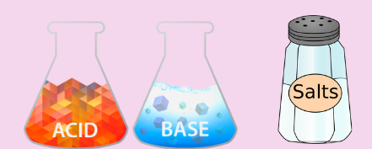
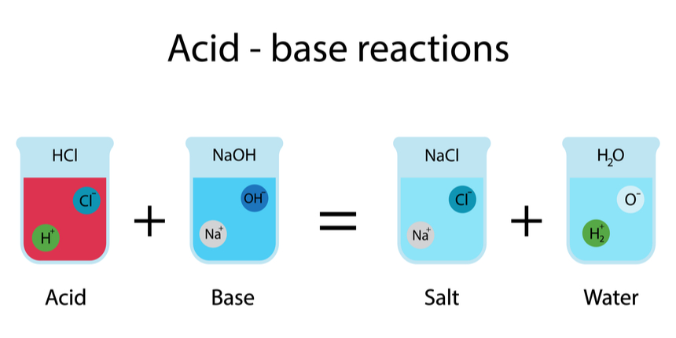
Introduction
5
Notes:
SAY: Before we wrap up the course, let’s review what we have learned today.
During this course, we have
<READ the bullets from the slide.>
GO to next slide.

Slide 6
Acids
The term acid is derived from a Latin word ‘acidus’ or ‘acere’, which means sour. The most common characteristic is their sour taste. An acid is a substance that renders ionizable hydronium ion (H₃O⁺) in its aqueous solution.
It turns blue litmus paper red. These dissociate in their aqueous solution to form their constituent ions, as given by the following examples.
●●●
6
Notes:
SAY: Before we wrap up the course, let’s review what we have learned today.
During this course, we have
<READ the bullets from the slide.>
GO to next slide.

Slide 7
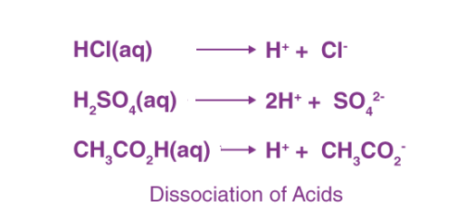
Acids
●●●
7
Notes:
SAY: Before we wrap up the course, let’s review what we have learned today.
During this course, we have
<READ the bullets from the slide.>
GO to next slide.

Slide 8
Acids
Based on their occurrence, they are divided into two types- Natural and mineral acids.
Natural Acids: These are obtained from natural sources, such as fruits and animal products. For e.g. lactic, citric, and tartaric acid etc.
Mineral Acids: Mineral acids are acids prepared from minerals. Examples are Hydrochloric acid (HCl), Sulphuric Acid (H₂SO₄), and nitric acid (HNO₃), etc.
●●●
8
Notes:
SAY: Before we wrap up the course, let’s review what we have learned today.
During this course, we have
<READ the bullets from the slide.>
GO to next slide.

Slide 9
Acids
Inorganic acids –
Inorganic acids are often termed mineral acids. The anhydrous form may be gaseous or solid. An inorganic anhydride is an oxide of metalloid which can combine with water to form an inorganic acid. Example:
Sulphuric acid (H₂SO₄) Phosphoric acid (H₃PO₄) Nitric acid (HNO₃)
●●●
9
Notes:
SAY: Before we wrap up the course, let’s review what we have learned today.
During this course, we have
<READ the bullets from the slide.>
GO to next slide.

Slide 10
Acids
Organic acids –
Organic acids are corrosive and toxic. Corrosivity is a form of toxicity to the tissues that the acid contacts. Organic acids and their derivatives cover a wide range of substances. They are used in nearly every type of chemical manufacture. Example:
Acetic acid Citric acid Formic acid
10
Notes:
SAY: Before we wrap up the course, let’s review what we have learned today.
During this course, we have
<READ the bullets from the slide.>
GO to next slide.

Slide 11
Bases
The most common characteristic of bases is their bitter taste and soapy feel. A base is a substance that renders hydroxyl ion(OH–) in their aqueous solution. Bases turn the colour of red litmus paper to blue.
The bases dissociate in their aqueous solution to form their constituent ions, given in the following examples.
●●●
11
Notes:
SAY: Before we wrap up the course, let’s review what we have learned today.
During this course, we have
<READ the bullets from the slide.>
GO to next slide.

Slide 12
Bases
12
Notes:
SAY: Before we wrap up the course, let’s review what we have learned today.
During this course, we have
<READ the bullets from the slide.>
GO to next slide.

Slide 13
Salts
Salt is an ionic compound that results from the neutralization reaction of acids and bases.
Salts are constituted of positively charged ions, known as cations, and negatively charged ions, known as anions, which can either be organic or inorganic in nature.
These ions are present in a relative amount, thus rendering the nature of the salt neutral.
●●●
13
Notes:
SAY:
The purpose of epidemiology in public health practice is to
discover the agent, host, and environmental factors that affect health;
determine the relative importance of causes of illness, disability, and death;
identify those segments of the population that have the greatest risk from specific causes of ill health; and
evaluate the effectiveness of health programs and services in improving population health.
GO to next slide.

Slide 14
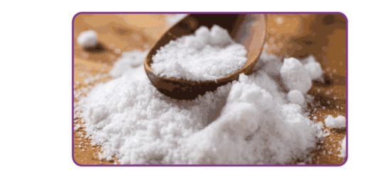
Salts
14
Notes:
SAY:
The purpose of epidemiology in public health practice is to
discover the agent, host, and environmental factors that affect health;
determine the relative importance of causes of illness, disability, and death;
identify those segments of the population that have the greatest risk from specific causes of ill health; and
evaluate the effectiveness of health programs and services in improving population health.
GO to next slide.

Slide 15
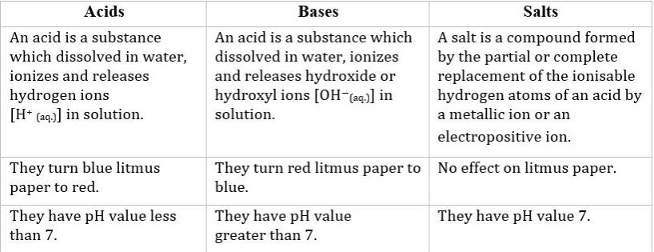
Differences
●●●
15
Notes:
SAY:
The purpose of epidemiology in public health practice is to
discover the agent, host, and environmental factors that affect health;
determine the relative importance of causes of illness, disability, and death;
identify those segments of the population that have the greatest risk from specific causes of ill health; and
evaluate the effectiveness of health programs and services in improving population health.
GO to next slide.

Slide 16
Conclusion
Based on the information we have collected and investigated, we have come to a conclusion that acids and bases are very important to the modern society and in our daily lives.
We come in contact with acids and bases every single day, whether we realize it or not. It is in our body and in our surroundings.
16
Notes:
SAY:
The purpose of epidemiology in public health practice is to
discover the agent, host, and environmental factors that affect health;
determine the relative importance of causes of illness, disability, and death;
identify those segments of the population that have the greatest risk from specific causes of ill health; and
evaluate the effectiveness of health programs and services in improving population health.
GO to next slide.

Slide 17
References
Google.com
Wikipedia.org
Studymafia.org
Slidespanda.com

Slide 18
Thanks To StudyMafia.org

