Slide 1
StudyMafia.Org
Art Integrated Learning(AIL)
Submitted To: Submitted By:
Studymafia.org Studymafia.org

Slide 2
Table Contents
Definition
Introduction
Objectives of AIL
Strategies of AIL
Principles of AIL
Conclusion
2
Notes:
SAY: Before we wrap up the course, let’s review what we have learned today.
During this course, we have
<READ the bullets from the slide.>
GO to next slide.

Slide 3
Definition
Art Integrated Learning (AIL) is a teaching-learning model which is based on learning ‘through the arts’ and ‘with the arts’: it is a process where art becomes the medium of teaching-learning, a key to understanding concepts within any subject of the curriculum.
3
Notes:
SAY: Before we wrap up the course, let’s review what we have learned today.
During this course, we have
<READ the bullets from the slide.>
GO to next slide.

Slide 4
Introduction
Learners explore creatively while building connections between different concepts through various art forms.
Art experiences, both in visual (drawing and painting, clay modelling, pottery, paper crafts, mask and puppet making, heritage crafts etc.) and performing arts (music, dance, theatre, puppetry etc.) lead to a better understanding and construction of knowledge about different concepts.
4
Notes:
SAY: Before we wrap up the course, let’s review what we have learned today.
During this course, we have
<READ the bullets from the slide.>
GO to next slide.

Slide 5
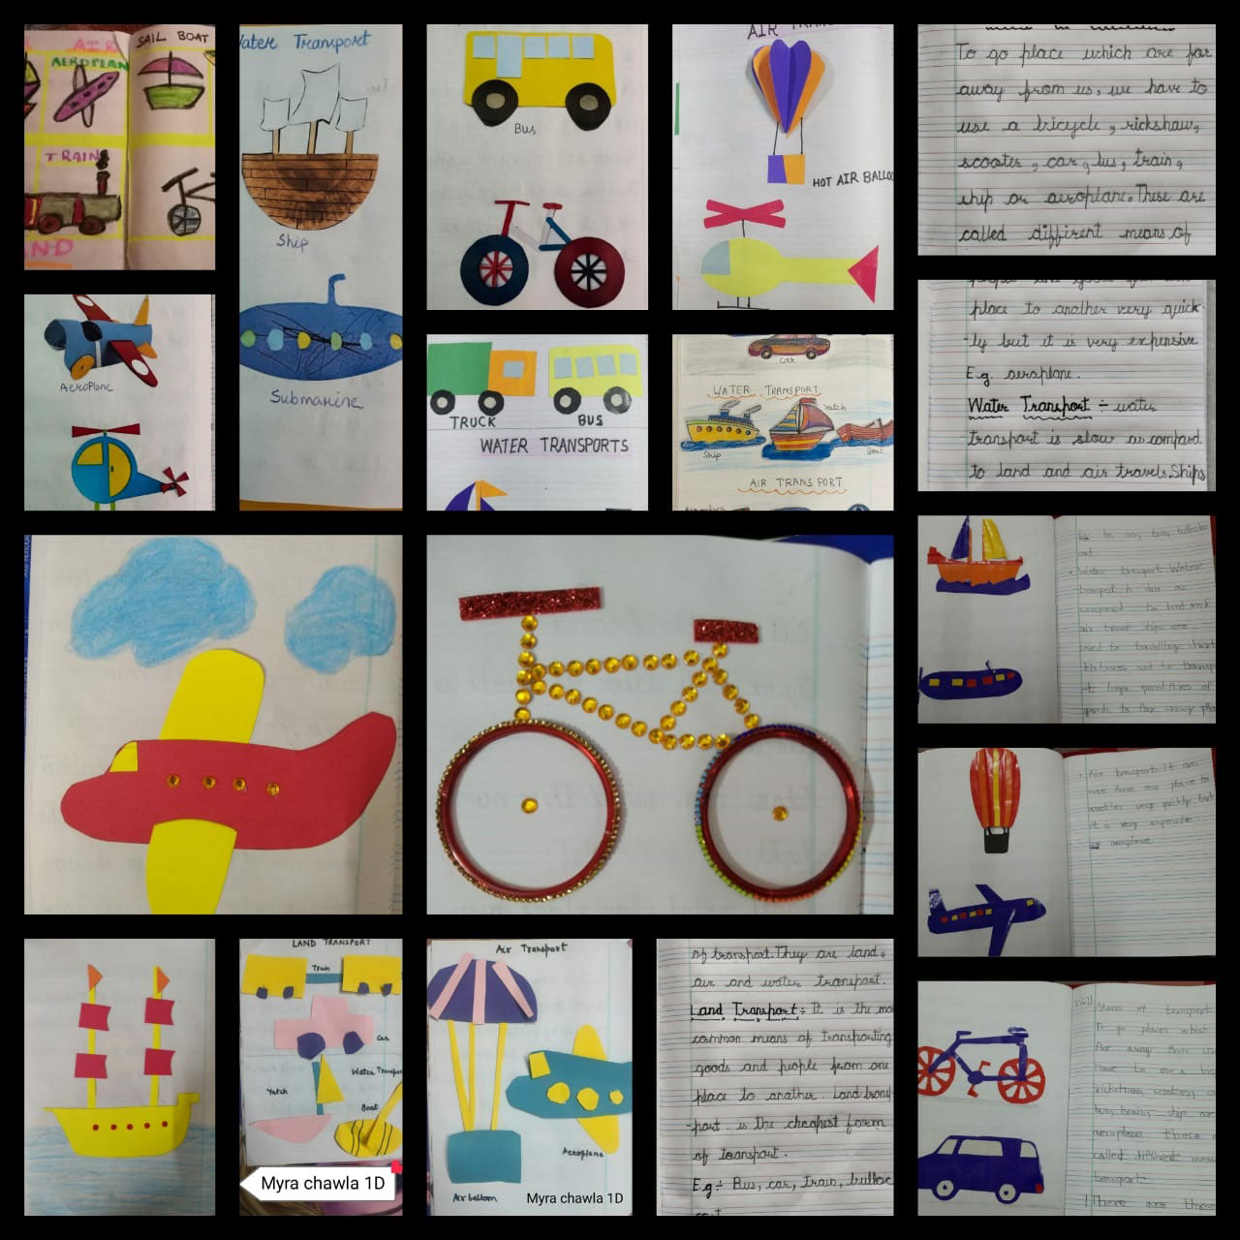
5
Notes:
SAY: Before we wrap up the course, let’s review what we have learned today.
During this course, we have
<READ the bullets from the slide.>
GO to next slide.

Slide 6
Objectives of AIL
Make learning joyful and engaging
Encourage children to be aware of their environment through keen observation and unhindered exploration
Promote sensitivity towards their environment
Allow free emotional expression, communication and creative involvement
Facilitate children to express freely and spontaneously
●●●
6
Notes:
SAY:
The purpose of epidemiology in public health practice is to
discover the agent, host, and environmental factors that affect health;
determine the relative importance of causes of illness, disability, and death;
identify those segments of the population that have the greatest risk from specific causes of ill health; and
evaluate the effectiveness of health programs and services in improving population health.
GO to next slide.

Slide 7
Objectives of AIL
Experience joy and eagerness to learn
Learn to live in an inclusive environment
Discover concepts of Mathematics and Science in the world around them
Be aware of interdisciplinary connections
Enhance observation, curiosity, exploration and creative and free expression
●●●
7
Notes:
SAY:
The purpose of epidemiology in public health practice is to
discover the agent, host, and environmental factors that affect health;
determine the relative importance of causes of illness, disability, and death;
identify those segments of the population that have the greatest risk from specific causes of ill health; and
evaluate the effectiveness of health programs and services in improving population health.
GO to next slide.

Slide 8
Objectives of AIL
Explore and understand body movement and coordination
Develop expressive communication and critical thinking skills
Foster an inquisitive attitude towards learning and knowledge
Understand and regulate their emotions
Create awareness of rich heritage and cultural diversity
8
Notes:
SAY:
The purpose of epidemiology in public health practice is to
discover the agent, host, and environmental factors that affect health;
determine the relative importance of causes of illness, disability, and death;
identify those segments of the population that have the greatest risk from specific causes of ill health; and
evaluate the effectiveness of health programs and services in improving population health.
GO to next slide.

Slide 9
Strategies of AIL
1. Capacity Building
Introducing art as a resource will require re-orienting the school system in the use of it as pedagogical tool. All stakeholders of school education, including the school management need to be oriented to understand the importance and the relevance of this pedagogy.
●●●
9
Notes:
SAY:
The purpose of epidemiology in public health practice is to
discover the agent, host, and environmental factors that affect health;
determine the relative importance of causes of illness, disability, and death;
identify those segments of the population that have the greatest risk from specific causes of ill health; and
evaluate the effectiveness of health programs and services in improving population health.
GO to next slide.

Slide 10
Strategies of AIL
2. Planning of Activities
Once the teacher begins to utilise AIL methodology, she would need to work on the dynamics of planning. AIL would require linking art experience to the subject matter seamlessly and to identify methods and techniques to engage children in group activities.
●●●
10
Notes:
SAY:
The purpose of epidemiology in public health practice is to
discover the agent, host, and environmental factors that affect health;
determine the relative importance of causes of illness, disability, and death;
identify those segments of the population that have the greatest risk from specific causes of ill health; and
evaluate the effectiveness of health programs and services in improving population health.
GO to next slide.

Slide 11
Strategies of AIL
3. Planning of time
Time management at every stage is an important aspect of teachers’ professional competence and productivity. Teachers can sometimes find it challenging to take out time for organizing art experiences, due to paucity of time. This can compromise the creation of a joyful and experiential learning environment.
●●●
11
Notes:
SAY:
The purpose of epidemiology in public health practice is to
discover the agent, host, and environmental factors that affect health;
determine the relative importance of causes of illness, disability, and death;
identify those segments of the population that have the greatest risk from specific causes of ill health; and
evaluate the effectiveness of health programs and services in improving population health.
GO to next slide.

Slide 12
Strategies of AIL
4. Resource Planning
Proper planning of resources adds a novelty to the art integrated experience. Regular research and extensive groundwork by the teacher helps them to create a rich repository of resources which include regional/local resources.
12
Notes:
SAY:
The purpose of epidemiology in public health practice is to
discover the agent, host, and environmental factors that affect health;
determine the relative importance of causes of illness, disability, and death;
identify those segments of the population that have the greatest risk from specific causes of ill health; and
evaluate the effectiveness of health programs and services in improving population health.
GO to next slide.

Slide 13
Principles of AIL
Perception
Perception requires the individual to be a careful observer and an active listener, taking in the subtleties of their surroundings, be it in the classroom or out in nature.
●●●
13
Notes:
SAY:
The purpose of epidemiology in public health practice is to
discover the agent, host, and environmental factors that affect health;
determine the relative importance of causes of illness, disability, and death;
identify those segments of the population that have the greatest risk from specific causes of ill health; and
evaluate the effectiveness of health programs and services in improving population health.
GO to next slide.

Slide 14
Principles of AIL
Practice
One does not become a star overnight. In order to be successful at any endeavor in life, you must practice. Practice helps us to hone our skills, become more proficient, more adept, and better prepared
●●●
14
Notes:
SAY:
The purpose of epidemiology in public health practice is to
discover the agent, host, and environmental factors that affect health;
determine the relative importance of causes of illness, disability, and death;
identify those segments of the population that have the greatest risk from specific causes of ill health; and
evaluate the effectiveness of health programs and services in improving population health.
GO to next slide.

Slide 15
Principles of AIL
Perseverance
Perseverance is good old fashion stick-to-it-ness. That means not giving up when things get difficult or push you beyond your comfort zone. Trust me in that most artists and creative individuals make many mistakes along the way before producing something of true beauty and innovation.
●●●
15
Notes:
SAY:
The purpose of epidemiology in public health practice is to
discover the agent, host, and environmental factors that affect health;
determine the relative importance of causes of illness, disability, and death;
identify those segments of the population that have the greatest risk from specific causes of ill health; and
evaluate the effectiveness of health programs and services in improving population health.
GO to next slide.

Slide 16
Principles of AIL
Patience
Patience and perseverance go hand in hand. Sometimes we feel as though we just have nothing to say so therefore we have no reason to create. When you are stuck in a creative slump the best advice is just to have patience with yourself.
●●●
16
Notes:
SAY:
The purpose of epidemiology in public health practice is to
discover the agent, host, and environmental factors that affect health;
determine the relative importance of causes of illness, disability, and death;
identify those segments of the population that have the greatest risk from specific causes of ill health; and
evaluate the effectiveness of health programs and services in improving population health.
GO to next slide.

Slide 17
Principles of AIL
Passion
In the end it all boils down to this, passion. In whatever you choose to do in life, however your creative spirit manifests, do it from a place of passion. Be excited about your work.
17
Notes:
SAY:
The purpose of epidemiology in public health practice is to
discover the agent, host, and environmental factors that affect health;
determine the relative importance of causes of illness, disability, and death;
identify those segments of the population that have the greatest risk from specific causes of ill health; and
evaluate the effectiveness of health programs and services in improving population health.
GO to next slide.

Slide 18
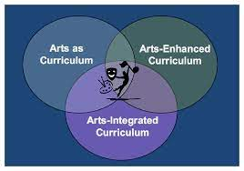

Slide 19
Conclusion
Assessment through art integrated learning helps the facilitator to move away from the traditional paper-pencil or oral and recall method towards a continuous and comprehensive assessment method which can help assess both the learning of the subject as well as the socio-emotional development of the student.
19
Notes:
SAY:
The purpose of epidemiology in public health practice is to
discover the agent, host, and environmental factors that affect health;
determine the relative importance of causes of illness, disability, and death;
identify those segments of the population that have the greatest risk from specific causes of ill health; and
evaluate the effectiveness of health programs and services in improving population health.
GO to next slide.

Slide 20
References
Google.com
Wikipedia.org
Studymafia.org
Slidespanda.com

Slide 21
Thanks To StudyMafia.org

