Slide 1
www.studymafia.org
Seminar
On
Sustainable Development
Submitted To: Submitted By:
www.studymafia.org www.studymafia.org

Slide 2
Table of content
Introduction
Definition
How Sustainability Works
Objectives of sustainable development
Pillars of sustainable development
Goals
Importance of Sustainable Development
Examples of Sustainable Development
What Prevents it From Happening?
Conclusion
References

Slide 3
Introduction
The term “sustainable development” first came to prominence in the world Conservation Strategy (WCS) in 1980.
It achieved a new status with the publication of two significant reports by Brundtalnd on: North and South: a programme for survival and common crisis (1985) and
Our Common Future (1983) and has gained even greater attention since the United Nations Conference on Environment and Development (UNCED) held in Rio de Jenerio in June 1992.

Slide 4
definition
Sustainable development can be defined as an approach to the economic development of a country without compromising with the quality of the environment for future generations.
In the name of economic development, the price of environmental damage is paid in the form of land degradation, soil erosion, air and water pollution, deforestation, etc.
This damage may surpass the advantages of having more quality output of goods and services.

Slide 5
How Sustainability Works
Sustainability encourages businesses to frame decisions in terms of environmental, social, and human impact for the long-term, rather than on short-term gains such as next quarter's earnings report. It influences them to consider more factors than simply the immediate profit or loss involved. Increasingly, companies have issued sustainability goals such as commitment to zero-waste packaging by a certain year, or to reduce overall emissions by a certain percentage.
These companies can achieve their sustainability needs by cutting emissions, lowering their energy usage, sourcing products from fair-trade organizations, and ensuring their physical waste is disposed of properly and with as small a carbon footprint as possible.

Slide 6
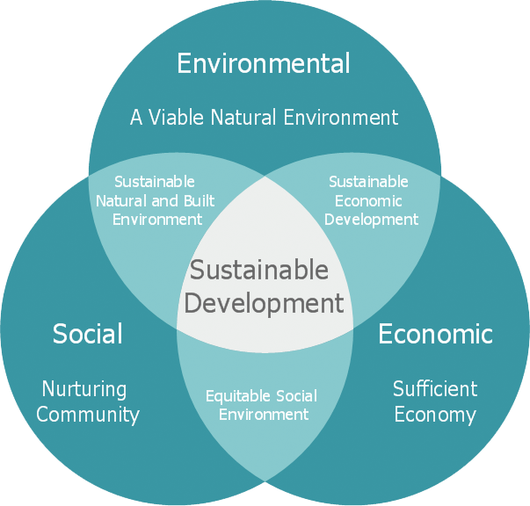
objectives of sustainable development
Economic growth
Environmental protection
Social inclusion

Slide 7
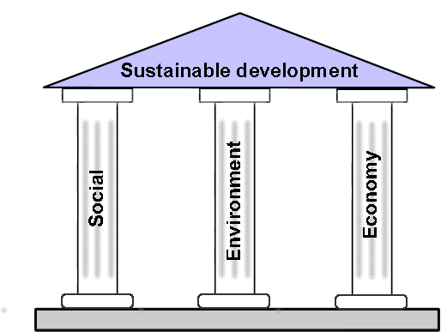
Pillars of sustainable development

Slide 8
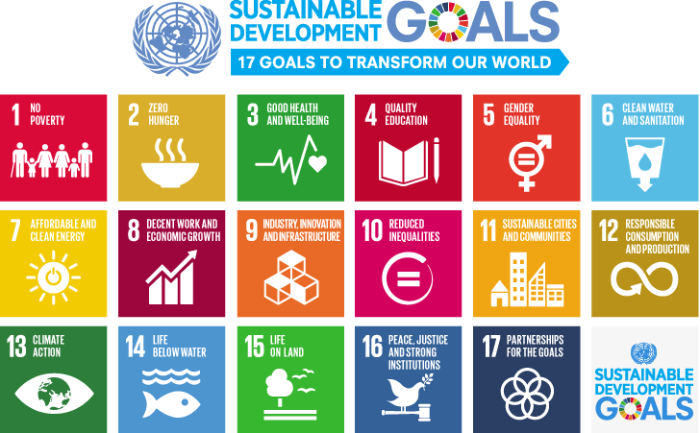

Slide 9
Importance of Sustainable Development
1. Provides Essential Human Needs
The explosion of population means people will have to scramble for the limited life essentials like food, shelter, and water. Adequate provision of these basic needs almost entirely hinges on infrastructure capable of sustaining them for a long time.
If governments insist on utilizing fossil fuel-based sources of energy instead of renewable and sustainable options, the cost and environmental effects of supplying these basic needs would become a tall order.

Slide 10
Importance of Sustainable Development…..
2. Agricultural Requirement
A growing population means agriculture must catch up. Finding ways to feed more than 3 billion people can be staggering. If the same unsustainable cultivation, planting, irrigation, spraying, and harvesting techniques are utilized in the future, they might prove to be financially burdening considering fossil fuel resources are projected to run out.
Sustainable development focuses on sustainable agricultural methods such as effective seeding techniques and crop rotation to promote high yields while maintaining the integrity of the soil, which produces food for a large population.

Slide 11
Importance of Sustainable Development…..
3. Manage Climate Change
Climate change can be mitigated by sustainable development practices. Sustainable development practices seek to reduce the use of fossil-based sources of fuel like oil, natural gas, and coal. Fossil fuel sources of energy are unsustainable since they will deplete in the future and are responsible for the emission of greenhouse gasses.

Slide 12
Importance of Sustainable Development…..
4. Financial Stability
Sustainable development practices have the ability to create more financially sustainable economies across the globe. Developing countries that can’t access fossil fuels can leverage renewable forms of energy to power their economies.
From the development of renewable energy technologies, these countries can create sustainable jobs as opposed to finite jobs based on fossil fuel technologies.

Slide 13
Importance of Sustainable Development…..
5. Sustain Biodiversity
Unsustainable development and overconsumption practices greatly impact biodiversity. The life ecosystem is designed in such a way that species depend on one another for survival. For instance, plants produce oxygen that humans need for respiration.
Humans exhale carbon dioxide that plants need for growth and production. Unsustainable development practices like emission of greenhouse gasses in the atmosphere kill many plant species resulting in the reduction of atmospheric oxygen.

Slide 14
Examples of Sustainable Development
Wind Energy
Wind energy is energy harnessed from the motion of wind using wind turbines or windmills. Wind energy is renewable, which means it’s never-ending and can be used to substitute energy at the grid. This makes it a good sustainable development practice.

Slide 15
Examples of Sustainable Development…..
Solar Energy
This is energy harnessed from the sun using solar panels. It’s advantageous since it’s absolutely free and its supply is infinite. These factors make it beneficial to consumers and good for Mother Nature because it doesn’t contribute to the emission of greenhouse gasses.

Slide 16
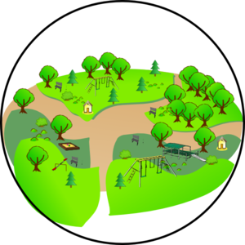
Examples of Sustainable Development…..
Green Space
Green spaces are locations where plants and animals are left to flourish. Parks also fall into the category of green spaces. Green spaces provide people a remarkable opportunity to take pleasure in outdoor recreation, more so in big cities, where resting space is hard to come by.

Slide 17
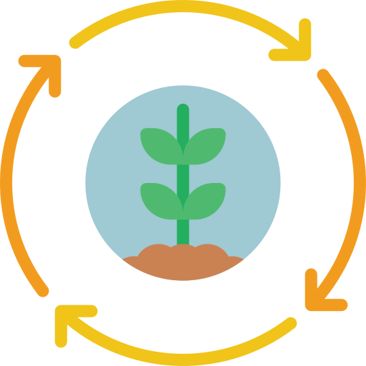
Examples of Sustainable Development…..
Crop Rotation
Crop rotation, in contrast, is defined as “the successive planting of different crops on the same land to improve soil fertility and help control insects and diseases.” This way of farming is not a new practice, but rather a more ancient way of farming chemical-free, whilst maximizing the long-term growth potential of land.

Slide 18
What Prevents Sustainable Development From Happening?
The first is that for many aspects of development, using sustainable methods and materials is expensive. While the long-term cost of sustainability does prove to be less expensive than traditional development, the creation of a sustainable project may be far more expensive in the first phase.
The second major issue is that there is not a generally accepted need for sustainable development. This is an education issue that may take many years to resolve.

Slide 19
Conclussion
Sustainable development is largely about people, their well-being, and equity in their relationships with each other, in a context where nature-society imbalances can threaten economic and social stability.
Because climate change, its drivers, its impacts and its policy responses will interact with economic production and services, human settlements and human societies, climate change is likely to be a significant factor in the sustainable development of many areas (e.g., Downing, 2002).
Simply stated, climate change has the potential to affect many aspects of human development, positively or negatively, depending on the geographic location, the economic sector, and the level of economic and social development already attained (e.g., regarding particular vulnerabilities of the poor, see Dow and Wilbanks, 2003

Slide 20
references
Google.com
Wikipdeia.org
Studymafia.org

Slide 21
Thanks

