Slide 1
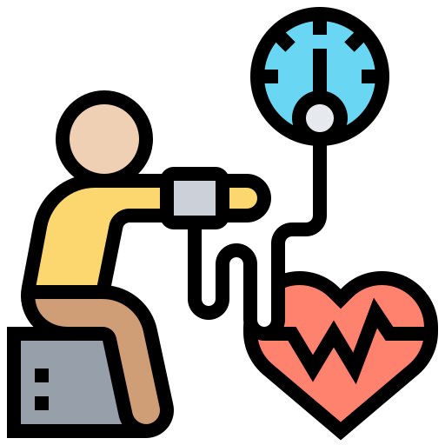
www.studymafia.org
Seminar
on
HYPERTENSION
Submitted To: Submitted By:
www.studymafia.org www.studymafia.org

Slide 2
Table Of Content
Introduction
Definition
Types of Hypertension
Risk Factors
Cause
Symptoms
Complications
Treatment
Conclusion

Slide 3
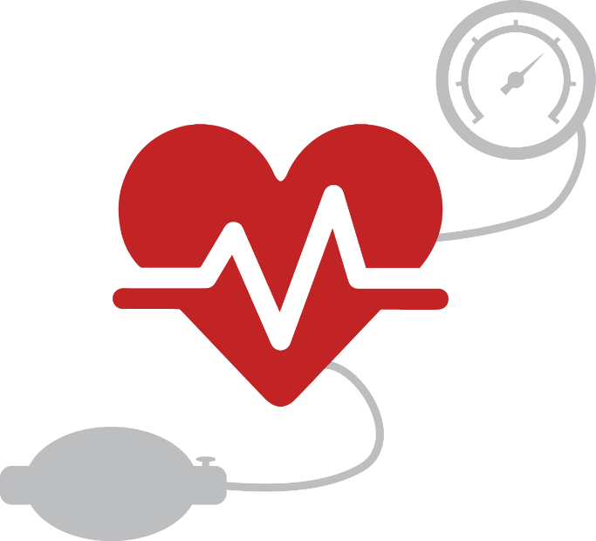
Introduction
Hypertension is a serious medical condition and can increase the risk of heart, brain, kidney and other diseases. It is a major cause of premature death worldwide, with upwards of 1 in 4 men and 1 in 5 women – over a billion people ­– having the condition.
The burden of hypertension is felt disproportionately in low- and middle-income countries, where two thirds of cases are found, largely due to increased risk factors in those populations in recent decades.

Slide 4
Definition
Hypertension, also known as high or raised blood pressure, is a condition in which the blood vessels have persistently raised pressure. Blood is carried from the heart to all parts of the body in the vessels.
Each time the heart beats, it pumps blood into the vessels. Blood pressure is created by the force of blood pushing against the walls of blood vessels (arteries) as it is pumped by the heart. The higher the pressure, the harder the heart has to pump.

Slide 5
Types of Hypertension
Primary, or essential, high blood pressure is the most common type of high blood pressure. For most people who get this kind of blood pressure, it develops over time as you get older.
Secondary high blood pressure is caused by another medical condition or use of certain medicines. It usually gets better after you treat that condition or stop taking the medicines that are causing it.

Slide 6
Risk Factors
Age
Ethnicity
Family history
Genetic factors
Lower education & socioeconomic status
High weight
Low physical activity
Tobacco use
Psychosocial stressors
Sleep apnea
Dietary factors such as:
Dietary fats
High sodium intake
Low potassium intake
Excessive alcohol intake

Slide 7
BP Classification | SBP mmHg | DBP mmHg | Lifestyle Modification | Initial Drug Therapy Without With Compelling Compelling Indication Indication
Normal | < 120 | and <80 | Encourage
Prehypertension | 120-139 | or 80-89 | Yes | No antihypertensive drug indicated | Drugs for compelling indications
Stage 1 hypertension | 140-159 | or 90-99 | Yes | Antihypertensive drugs indicated | Drugs for compelling indications. Other antihypertensive drugs as needed
Stage 2 hypertension | ≥ 160 | or ≥ 100 | Yes | Antihypertensive drugs indicated. Two drug combination for most.

Slide 8
CAUSE
The underlying cause of hypertension is not known in 90% of the cases
In 5-10% of the rest of the cases, hypertension is secondary to a variety of known diseases such as chronic kidney disease
Some known causes include sleep apnea, drug induced causes, chronic kidney disease, renovascular disease, chronic steroid therapy, and thyroid or parathyroid disease

Slide 9
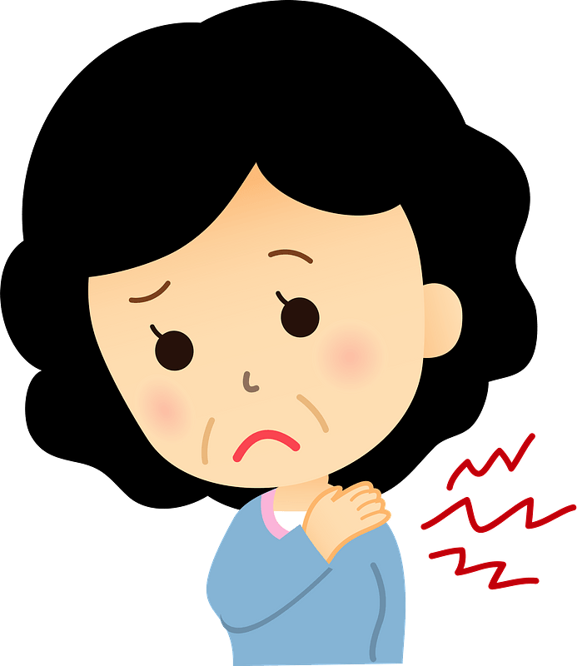
SYMPTOMS
“Silent killer”
Usually no symptoms until it reaches an advanced state
When a severe stage is reached, strenuous exercise and other forms of stress may cause:
Headache
Visual disturbances
Vomiting
Convulsions
It may continue to be asymptomatic

Slide 10
LABORATORY DIAGNOSIS TESTS
Most people are not aware they have hypertension until they have a routine medical check up with their physician because lack of symptoms

Slide 11
COMPLICATIONS
Hypertension imposes an afterload on the heart, resulting in increased left ventricular wall thickness & reduced early diastolic filling
There is a strong correlation between left ventricular mass and CVD morbidity.
Duration of hypertension promotes the presence & extent of coronary calcium which is a potential predictor of sudden coronary death

Slide 12
COMPLICATIONS
Hypertension is also associated with impaired cognitive function & a thickening & stiffening of medium & small blood vessels
Can also lead to retinopathy & nephropathy

Slide 13
Who is most likely to have high blood pressure?
You are more likely to have high blood pressure if you:
Have family members who have high blood pressure, cardiovascular disease or diabetes.
Are African American.
Are over age 55.
Are overweight.
Don’t get enough exercise.
Eat foods high in sodium (salt).
Smoke.
Are a heavy drinker (more than two drinks a day in men and more than one drink a day in women).

Slide 14
What medications are used to treat Hypertension?
Angiotensin-converting enzyme (ACE) inhibitors block the production the angiotensin II hormone, which the body naturally uses to control blood pressure. When angiotensin II is blocked, your blood vessels don’t narrow. Examples: lisinopril (brand name Zestril®), enalapril (Vasotec®), captopril (Capoten®).
Angiotensin II receptor blockers (ARBs) block this same hormone from binding with receptors in the blood vessels. ARBs work the same way as ACE inhibitors to keep blood vessels from narrowing. Examples: metoprolol (brand names Lopressor®; Toprol® XL), valsartan (Diovan®), losartan (Cozaar®).

Slide 15
What medications are used to treat Hypertension?
Calcium channel blockers prevent calcium from entering the muscle cells of your heart and blood vessels, allowing these vessels to relax. Examples: amlodipine (brand name Norvasc®), nifedipine (Procardia®), diltiazem (Cardizem®; Dilacor® XR; Tiazac®).
Diuretics (water or fluid pills) flush excess sodium from your body, reducing the amount of fluid in your blood. Diuretics are often used with other high blood pressure medicines, sometimes in one combined pill. Examples: indapamide, hydrochlorothiazide, chlorothiazide.

Slide 16
TREATMENT WITH LIFESTYLE MODIFICATIONS
Lose weight if overweight
Limit alcohol intake
Reduce sodium intake to less than 2.3 g/day
Perform aerobic physical activity for 30 min/day
Eat diet rich in fruits, vegetables, low fat dairy products
Reduce saturated fat & cholesterol
Stop smoking

Slide 17
EFFECTS OF DISEASE ON EXERCISE
Headaches, visual disturbances, vomiting, convulsions, chest paints, & discomfort
In hypertensive people, normal blood pressure response to exercise are exaggerated
Diastolic blood pressure may slightly rise as a result of impaired vasodilatory response

Slide 18
EFFECTS OF DISEASE ON EXERCISE
Studies have documented a consistent 10 to 20 mm hg reduction in SBP 1-3 hours following exercise in those with hypertension
Untreated hypertension may impair exercise tolerance, performance, or both.

Slide 19
Can high blood pressure affect pregnancy?
Chronic hypertension: High blood pressure which is present prior to pregnancy.
Chronic hypertension with superimposed preeclampsia: Preeclampsia, which develops in someone who has chronic hypertension (high blood pressure before pregnancy).
Gestational hypertension: High blood pressure in the latter part of pregnancy, but no other signs or symptoms of preeclampsia are present. Some women will later develop preeclampsia, while others probably have high blood pressure (chronic hypertension) before the pregnancy.

Slide 20
What if lifestyle changes don’t help lower my blood pressure?
If diet, exercise and other lifestyle changes don’t work to lower your blood pressure, your healthcare provider prescribe hypertension medications.
Your provider will take into account these drugs’ effect on other conditions you may have, such as heart or kidney disease, and other drugs you’re taking.
You might need to take hypertension medicine from now on. Be sure to follow your provider’s dosing directions exactly.

Slide 21
SUMMARY
Hypertension is blood pressure that is higher than normal
Hypertension leads to many severe heart problems and other conditions
Those with hypertension are usually asymptomatic until it has reached an advanced stage
Most people with hypertension can participate in moderate aerobic exercise
Treatment can include medications and lifestyle changes

Slide 22
Conclusion
Hypertension is a very important disorder in aged people and is associated with higher risk of cardiovascular morbidity and mortality.
The fact of reducing blood pressure values decreases the risk for cardiac death as well as neurological, metabolic, and musculoskeletal system sequelae in aged people.
Therefore, the aim of the antihypertensive treatment must be to reduce cardiovascular risks and to maintain an adequate quality of life and good functional capacity in these patients.

Slide 23
REFERENCES
Studymafia.org
Google.com
Wikipedia.org

Slide 24
Thanks

