Slide 1
www.studymafia.org
Seminar
On
STAAD.PRO
Submitted To: Submitted By:
www.studymafia.org www.studymafia.org
Notes:
1
1

Slide 2
CONTENTS
INTRODUCTION TO STAAD.Pro
HISTORY OF STAAD.Pro
STRUCTURE
TYPES OF STRUCTURE
STAAD WINDOW
TOOLS USED
VARIOUS TYPES OF CURSORS
PAGE CONTROL IN VARIOUS MODES
MODEL GENERATION
WIZARD
ASSIGNING PROPERTY
SUPPORTS
ASSIGNING LOADS
ANALYSIS
DESIGN
ADVANTAGES OF STAAD.Pro
CONCLUSION

Slide 3
INTRODUCTION TO STAAD.Pro
STAAD.Pro is a structural analysis design program software.
It includes a state of the art user interface, visualization tools and international design codes.
It is used for 3D model generation, analysis and multi-material design.
The commercial version of STAAD.Pro supports several steel , concrete and timber design codes.
It is one of the software applications created to help structural engineers to automate their tasks and to remove the tedious and long procedures of the manual methods.

Slide 4
HISTORY OF STAAD.Pro
STAAD.Pro was originally developed by Research Engineers International in Yorba Linda, CA.
In late 2005, Research Engineer International was bought by Bentley Systems.

Slide 5
STRUCTURE
A STRUCTURE can be defined as an assemblage of elements. STAAD is capable of analyzing and designing structures consisting of both frame, and Finite elements. Almost any type of structure can be analyzed by STAAD.
Frame elements – Beam elements – 2 nodes
Finite elements – 1.) Plate – 3 or 4 nodes
2.) Solid – 4 to 8 nodes
In case of STAAD
Node becomes Joint it has a number and xyz coordinates
Beam becomes Member it has a number and nodes at its ends
Plate becomes Element it has a number and node at its corners

Slide 6
TYPES OF STRUCTURE
A TRUSS structure consists of truss members which can have only axial member forces and no bending in the members
A PLANE structure is bound by a global X-Y coordinate system with loads in the same plane
A SPACE structure, which is a three dimensional framed structure with loads applied in any plane, is the most general.
A FLOOR structure is a two or three dimensional structure having no horizontal (global X or Z) movement of the structure [FX, FZ & MY are restrained at every joint]. The floor framing (in global X-Z plane) of a building is an ideal example of a FLOOR structure. Columns can also be modelled with the floor in a FLOOR structure as long as the structure has no horizontal loading. If there is any horizontal load, it must be analyzed as a SPACE structure.

Slide 8
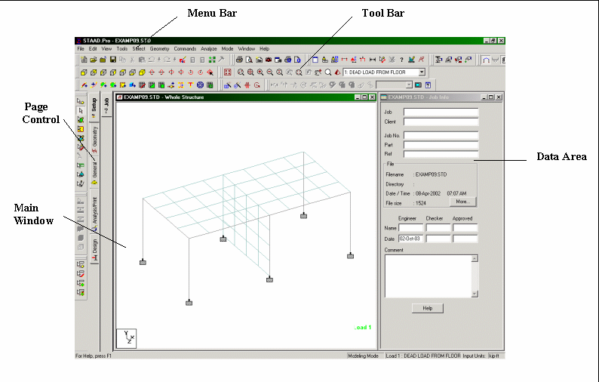
GETTING STARTED
STAAD WINDOW

Slide 9
TOOLS USED

Slide 10
VARIOUS TYPES OF CURSORS
Nodes cursor
Beam cursor
Plates cursor
Surface cursor
Solids cursor
Geometry cursor

Slide 11
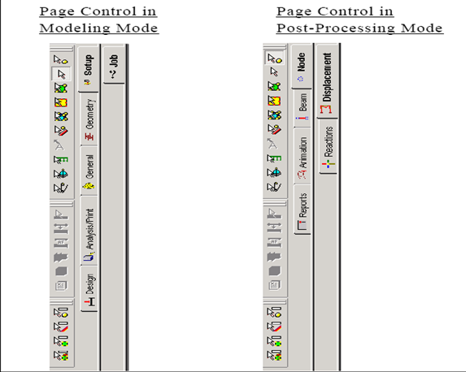
PAGE CONTROL IN VARIOUS MODES

Slide 12
Model generation and analysis
Input Geometry –Nodes, Beams, Plates
Input Properties
Input Specs, Constant, Supports
Input Loading System
Specify Analysis Type
Run Analysis
View and Verify Results
Design
Verify

Slide 13
MODEL GENERATION
There are basically 3 methods of generating a model
Snap node method
Coordinate method
Copy paste method
Out of these three methods most commonly used is copy paste method
By using these three methods a structure of any geometry can be created
STAAD.Pro also contains a command wizard which is its library of structures such as frames , trusses are present which can be merged with the STAAD.Pro model

Slide 14
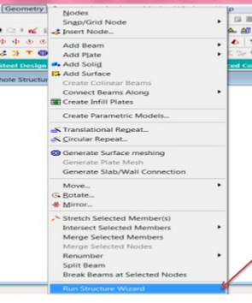
WIZARD

Slide 15
ASSIGNING PROPERTY
Assigning a property means to provide dimensions such as width, thickness etc to beams columns slabs etc

Slide 16
SUPPORTS
There are three types of supports provided to a structure
Fixed support
Pinned support
Roller support
2. There are options provided in Staad for pinned and fixed supports while roller support has to be created by releasing the Fx and Mz components using fixed but.

Slide 17
ASSIGNING LOADS
Any structure is subjected to basically these types of loads-
1. Dead load
2. Live Load
Dead load includes the self weight of the structure while live load consists of superimposed load.
In addition to a structure is also subjected to wind and seismic or earthquake forces
While designing a structure subjected to wind and earthquake forces we also have to provide definitions along with various load cases

Slide 18
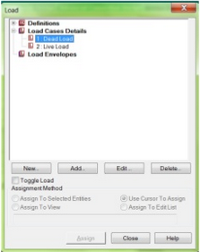
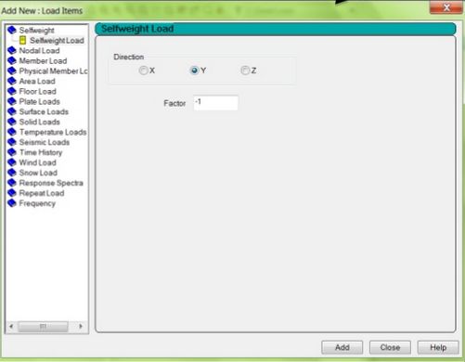
After creating various load cases we have to assign them to the structure . For this we have to first select that part of the structure on which load has to be assigned and then assign it to that part

Slide 19
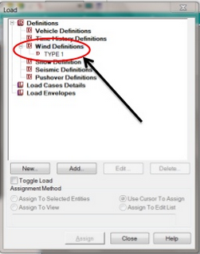
Continued…
In case of structures subjected to wind and earthquake forces wind and seismic definitions need to be provided.
After providing these definitions only the load cases should be entered.

Slide 20
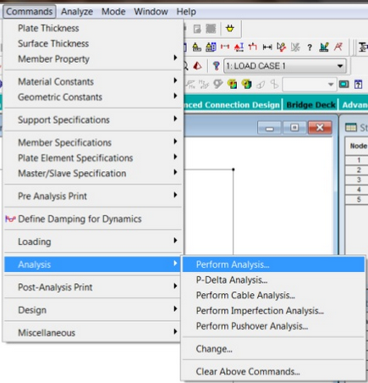
ANALYSIS
After all the above stated steps a structure has to be analyzed.
Analysis of a structure means to find out the reactions and displacements and deflections at various nodes of a structure.
After analysis we are able to see shear moment and deflection for each member.

Slide 21
After performing analysis another window which contains a report of analysis gets opened . This window shows the warnings and errors which might have occurred.

Slide 22
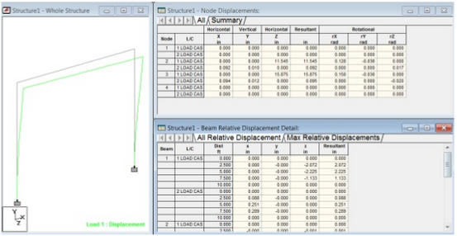
Continued…
In the post processing mode we are able to see the reactions, displacements, deflections, shear force and bending moments for various members

Slide 23
DESIGN
After analysis a structure has to be designed to carry loads acting on it considering a certain factor of safety .
In India structures are designed by using various Indian codes for both concrete and steel structures.
The design in STAAD.Pro supports over 70 international codes and over 20 U.S. codes in 7 languages.
After designing the structure it is again analyzed and results of analysis for each beam and column is shown in the output file

Slide 24
ADVANTAGES OF STAAD.Pro
Following are the advantages of STAAD.Pro
Covers all aspects of structural engineering
Broad spectra of design codes
International codes
Quality assurance
Reports and documentation

Slide 25
CONCLUSION
Staad pro is widely used by most of the organization for their construction needs.
Unfortunately, well skilled staad pro engineers are very hard to search.
If we believe in the prediction of the industry experts then those students who will be getting trained on staad pro in the current and upcoming two years will have bright and successful career ahead in the real estate and construction domain
By attending this training in STAAD.Pro we were able to learn various features of STAAD.Pro which will be very helpful in the near future

Slide 26
Thank you

