Slide 1
www.studymafia.org
Seminar
On
Water Resources
Submitted To: Submitted By:
www.studymafia.org www.studymafia.org
Notes:
1
1

Slide 2
Content
Introduction
Sources of Fresh water
Uses Of Water
Importance of Water Resources
Distribution of water on Earth
Technologies Used to Provide Fresh Water
How do people use Water Resources?
Conclusion
References

Slide 3
About Water
97% of the water on the Earth is salt water. However, only 3% percent is fresh water; slightly over 2/3 of this is frozen in glaciers and polar ice caps.
The remaining unfrozen freshwater is found mainly as groundwater, with only a small fraction present above ground or in the air.
Fresh water is a renewable resource

Slide 4
Sources of Fresh water
1. Surface water
2. Frozen water
3. Ground water
4. Rain water

Slide 5
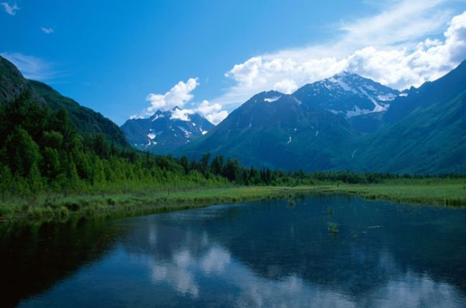
Surface water
Surface water is water in a river, lake or fresh water wetland. Surface water is naturally replenished by precipitation and naturally lost through discharge to the oceans and evaporation.

Slide 6
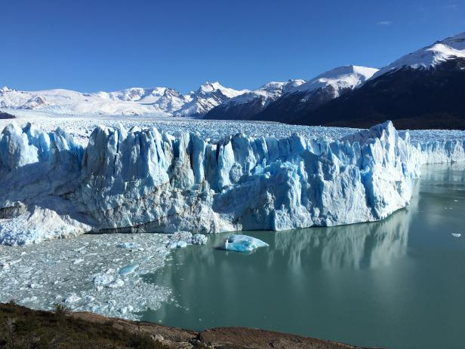
Frozen water
Several schemes have been proposed to make use of icebergs as a water source, however to date this has only been done for novelty purposes. The Himalayas, which are often called "The Roof of the World", contain some of the most extensive and rough high altitude areas on Earth as well as the greatest area of glaciers and permafrost outside of the poles

Slide 7
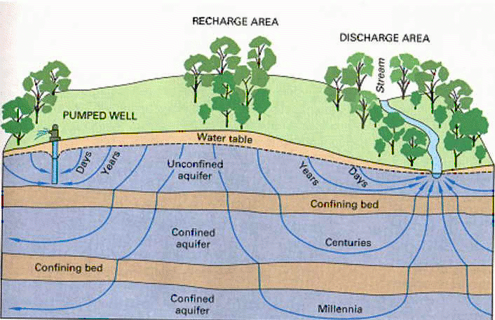
Ground water

Slide 8
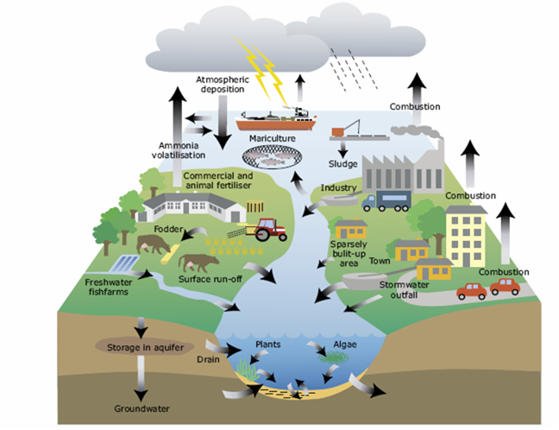
Rain water

Slide 9
Uses Of Water
Environment
Activities
Industrial
Agriculture
Household
Recreational

Slide 10
Importance of Water Resources
Below mentioned is the importance of water resources in points:-
It is significant since life cannot survive without it.
Agricultural, commercial, household, leisure, and environmental activities all use water in some way.
Almost all of these human uses necessitate the use of freshwater.
Freshwater makes up just 2.5 percent of the Earth's total water, and over two-thirds of it is frozen in ice caps and glaciers.
In several regions of the world, water demand currently exceeds availability, as well as many other areas, are prepared to face this deficit in the near future.
Irrigation in agriculture is expected to account for 70% of global water consumption.

Slide 11
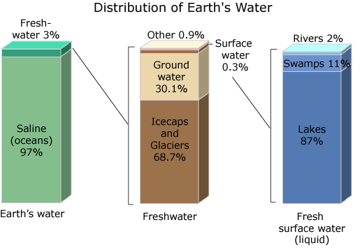
Distribution of water on Earth

Slide 12
Technologies Used to Provide Fresh Water
Reclaimed Water
The method of turning wastewater into water that can be recycled and reused for other purposes is known as water reclamation (also known as wastewater reuse. Irrigating gardens and farm areas, as well as replenishing surface and groundwater, are examples of reuse (i.e., groundwater recharge).
Desalination
Desalination is a man-made process that converts saline water (usually seawater) to freshwater. Reverse and distillation osmosis is the most popular desalination method.
Desalination is actually more costly than most alternative water sources, and it only covers a small portion of overall human consumption. In arid regions, it is normally only economically feasible for greater uses (including certain household and industrial applications).

Slide 13
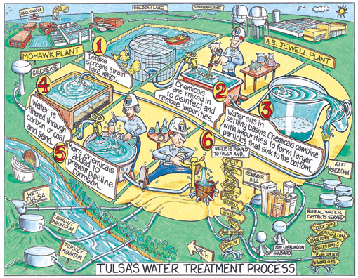
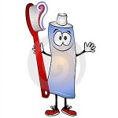
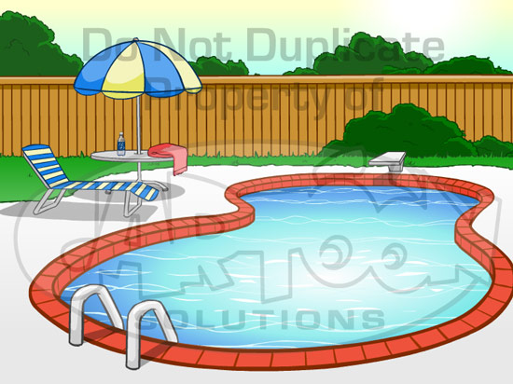
How do people use Water Resources?
Divide
Household
Personal Use
Recreational activities
Washing dishes
Fill the car with water
Watering the plants
Putting out the fire
Give water for the cows
Watering the grass
Washing the car
Washing the teeth
Drinking water
Take a shower
Going to the bathroom
Walk in the pool for recovering health
Go to the pool.
Go to the beach.
Walk in the pool for recovering health.
Skiing in the mountains.
Fish in the lakes.
Play with a ball in the river.
Surfeit in the ocean.
Picture:
Picture:
Picture:

Slide 14
Proposals: How to conserve water
If you want to learn how to conserver water and protecting the environment, learning to conserve water is a great way to make a positive impact. A four-minute shower may not sound like much, but in reality can cost up to 40 gallons. But don't worry--there are ways to change water-hogging household habits into leaner, greener activities.
Water Conservation Tips
Run your dishwasher for only full loads.
Turn off the tap when you brush your teeth.
Check your faucets and toilets for leaks.
Take shorter showers.
Water your lawn in the morning.
Use a cover on your pool.
Wash your car with a nozzle on the hose.

Slide 15
Conclusion
Our water resources, irregularly distributed in space and time, are under pressure due to major population change and increased demand.
Access to reliable data on the availability, quality and quantity of water, and its variability, form the necessary foundation for sound management of water resources.

Slide 16
References
www.google.com
www.wikipedia.com
www.studymafia.org

Slide 17
THANKS

