Slide 1
www.studymafia.org
Seminar
On
FTTH
Submitted To: Submitted By:
www.studymafia.org www.studymafia.org

Slide 2
Content
What is FTTH?
Why FTTH?
Where is the fiber?
What’s In It For Contractors?
Conclusion

Slide 3
What is FTTH?
Fiber to the Home or simply FTTH is a technology that uses optical fiber directly from the central point to the residential premises (as shown in the following image). It provides uninterrupted high-speed internet service. Here, “H” includes both home and small business.

Slide 4
Why FTTH?
Enormous information carrying capacity
Easily upgradeable
Easy to install
Allows fully symmetric services
Covers very long distances
Strong, flexible, and reliable
Safe and secure
Lower cost

Slide 5
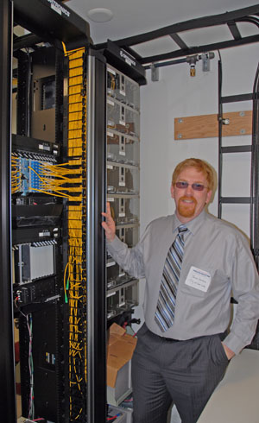
Who Competes With Telcos In Implementing FTTx?
Municipalities
Utilities
CLECs
Private companies
Battleground for telcos and CATV companies
Notes:
Besides the telcos, several other groups are attempting to install FTTH.
Municipalities: Some of the first FTTH systems were installed by cities - progressive ones like Palo Alto did it at the request of their high-tech citizens, some did it to entice businesses to move there, like Anaheim, some did it (or are trying to) because they were not pleased with the service of telcos or CATV companies. The latter often found the telcos or CATV companies to be formidable opponents who did not always play fair! Most municipal FTTx projects use rights of way available to the city through city-owned utilities.
Utilities: Owning rights of way to the home convinced some utilities to try FTTH or FTTC. Ethernet over power lines is becoming a option for power companies who can use power lines for the final connection to the home. FTTx is even becoming real for rural customers through rural electrical cooperatives.
CLECs (Competitive Local Exchange Carriers) install their own networks and can then sell connections to anyone they pass, but mostly focus on businesses which spend much more money on communications than households.
Private companies: There are private companies that will build municipal FTTH networks under an agreement with the city, similar to CATV agreements. In addition, some contractors building large subdivisions or apartments are installing FTTH with the assumption that they can connect with telecommunications companies for services to resell.
FTTH is a considered a battleground by telcos and CATV companies: Whenever a city or private company proposes to install FTTH, they can expect to have to deal with the legal, advertising and technical staff of the current telco or CATV company. Cities have found themselves in court or in battles where they are outspent by 100 to 1 in advertising in an attempt by the local telcos and CATV companies to defeat competitive systems.
Photo: James Hettrick, Loma Linda, CA, which runs its own FTTH network.

Slide 6
Where is the fiber?
Where is the bulk of telephone cabling?
10% is long distance
10% is local loop (metropolitan)
80% is subscriber loop
Long distance and local loop are virtually all fiber
Is FTTx just completing the system?
Notes:
Where is the bulk of telephone cabling? It may not be where you think!
Only 10% is in long distance networks, which were the first links converted to fiber - years ago.
Another 10% is local loop (metropolitan) connecting central offices and switches - now mostly converted to fiber too.
Fully 80% of all telco cabling is subscriber loop - the “last mile” that connects the end user to the system.
After 20 years of fiber optic installations, virtually all long distance and local loop connections are already fiber. Only the “last mile” is still copper, and much of it is very old and incapable of carrying modern high bandwidth digital signals.
Is FTTH just completing the system to make it all fiber?

Slide 7
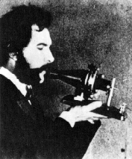
Why FTTx? Why Now?
Telcos are suffering with aging copper cable plants
Telcos are losing broadband customers to CATV and landline customers to cell phones and VoIP
New services are becoming available to enhance revenue - and customers demand them
Regulations changed sharing issues
New technology (PON) and cheaper components makes FTTx cheaper
Notes:
We recognize five changes in the current telco environment that are affecting attitudes toward FTTH:
Telcos are losing broadband customers to CATV
Telcos are losing landline customers to cell phones and VoIP
New services are becoming available
Fiber optic components are getting less expensive
Regulations changed sharing issues
New Technology makes FTTH cheaper - comparable in cost to copper solutions, lower in cost per bandwidth and with lower operating expenses.
We’ll look at each of these in more detail. Read on…

Slide 8
Who Wants FTTx?
Homeowners: for high speed Internet access and video downloads
Home Builders: FTTx adds value (and profit) to their homes
Hardware Providers
Service Providers: IPTV, HDTV, video on demand
Notes:
Who Wants FTTx?
Homeowners: for high speed Internet access and video downloads
Home Builders
FTTx adds value to their homes
FTTx provides a reason to provide structured cabling inside the home
These two reasons can add $7,500 to $15,000 to the value of a home!
Hardware Providers who want to sell equipment to build the networks and install in the homes as well as structured cabling companies who participate in a market that is about $2500 per home!
Service Providers: IPTV, HDTV, video on demand, etc. Those who want to offer video services are most happy with FTTx as nothing provides the same bandwidth!

Slide 9
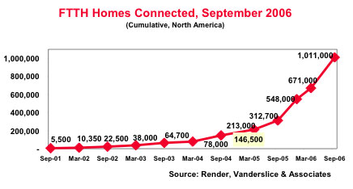
FTTx is gaining momentum
US: 6 million homes passed (Jan, ‘06)
1,000,000 connected
Still a drop in the bucket!
Data from Render, Vanderslice and Associates, 2006
Notes:
FTTH is gaining momentum
RVA estimates that one million homes were connected with fiber, as of September, 2006 of 6 million homes passed, still a very small number compared to the 100 million or so subscriber lines. Verizon estimates 5,000,000 new FTTH connections for the year.
It should be noted that the US is not a leader in FTTx deployments. Approximately 80% of all worldwide FTTx connections are in Japan as of mid-2006 and China and Korea are actively developing FTTx programs. Europe, where DSL works over most of their short urban lines, is not aggressively pursuing FTTx.
However the pace is increasing, with operating companies hiring personnel for FTTx installations at a growing rate, indicating a strong commitment to FTTx.

Slide 10
What’s In It For Contractors?
Contractors are doing FTTx installs for Verizon and others
While few electrical contractors do residential electrical, homes with structured cabling offer double the work and potential profit!
FTTx will affect the commercial fiber market - fiber is cheaper!
Notes:
What’s In It ForContractors?
Contractors are doing FTTx installs for Verizon and others in many parts of the country.
While few electrical contractors do residential electrical, homes with structured cabling offer double the work and potential profit! There is about $2500 in structured cabling in a new home in CA. Contractors can increase their revenue by doing hardware installs too.
FTTx will affect the commercial fiber market - fiber is cheaper! Bosses being asked for budget for an upgrade to expensive new copper cabling will wonder why they are installing more copper when the phone companies are using fiber!

Slide 11
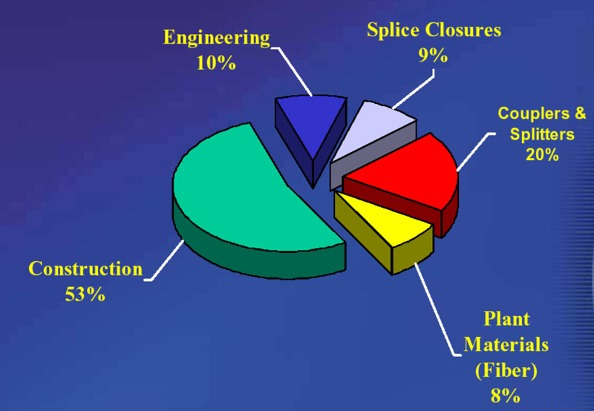
FTTx Cost Breakdown
Notes:
One estimate by Optical Solutions shows this breakdown on the cost of a FTTH network. Cost decisions are interactive. For example, one wonders if the splitters and WDMs are worth the savings in fiber, but adding more fiber would increase installation and thereby construction costs, so it is assumed that they do indeed save costs. Once cannot overemphasize the importance of labor costs - it is the dominant factor - and anything that reduces labor, like preterminated cabling, deserves consideration.

Slide 12
FTTx Architectures
Home run - fiber from CO to every home
Active star - local switch then fiber to every home
Passive optical network (PON) - use splitter near customer share fiber to CO
WDM PON - PON but with each customer having a specified wavelength
All based on standard SM fiber
Notes:
FTTH Architectures
Home run - fiber from CO to every home, offers the most flexibility but at the highest cost as no electronics are shared. A good solution for small developments or rural connections.
Active star - local switch then fiber to every home, highly flexible, but simply moves the electronics closer to the home, saving only a small amount in cabling costs. Think of it as fiber to the curb with the curb to home on fiber too.
Passive optical network (PON) - use splitter near customer share fiber to CO. Not only does it share fiber, it shares electronics, using one transmitter at the CO for up to 32 homes, greatly reducing connection costs. Basic PON architectures are widely used because they are usually the least expensive way of implementing FTTH.
WDM PON - PON but with each customer or location having a specified wavelength. Again highly flexible, but more expensive and harder to manage.
All FTTH networks are based on standard SM fiber(ITU G.652), also called dispersion unshifted or non-dispersion shifted fiber. The only fiber option normally considered is to use low-water vapor fiber that removes the water peak at 1400 nm.

Slide 13
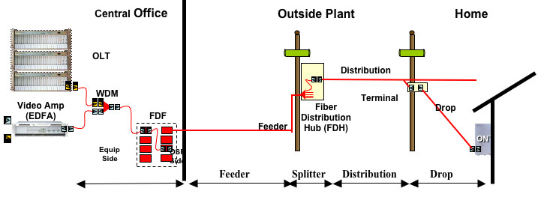
FTTP BPON Architecture (Verizon)
Notes:
Here is the architecture being used by Verizon for triple play services.
First the acronyms:
EDFA = erbium doped fiber amplifier
WDM = wavelength division multiplexing
FDF = fiber distribution frame
FDH = fiber distribution hub
ONT = optical network terminal
OLT = optical line terminal
The concept is to use WDM ( wavelength division multiplexing) to send bi-directional signals at different wavelengths on only one fiber. Current systems use:
1490 nm for TDM (time division multiplexed) digital voice and data from the CO to the home
1310 nm for TDM (time division multiplexed) digital voice and data from the home to the CO
1550 nm for analog video to the home
Downstream, each home has a digital address and only receives information specifically addressed to it. Upstream, it has a TDM time slot for sending data back to the system. This ensures each home receives only the data specific for its usage.
Signals are distributed to a neighborhood on one fiber, then split with a passive coupler in the FDH to individual fibers going to each house.
If sufficient fibers are already in place, the video can be sent on a separate fiber, so each home is connected with two fibers. While this means WDM is not needed, a second set of splitters is needed in addition to the additional fibers.
Supposedly Verizon, AT&T (SBC and Bellsouth) have agreed to make this single fiber version a standard architecture.

Slide 14
Conclusion
No one can deny that the FTTH has completely transformed the way of communication in recent years.
It is going on the path to becoming a norm. If you have a query regarding the FTTH, then tell us in the comment section.

Slide 15
Reference
www.google.com
www.wikipedia.com
www.studymafia.org

Slide 16
THANKS

