Slide 1
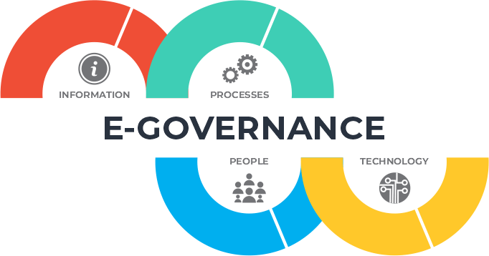
www.studymafia.org
Seminar
On
e-governance
Submitted To: Submitted By:
www.studymafia.org www.studymafia.org

Slide 2
Content
What is e-governance?
Models of E-governance
Goals of E-Governance
Types of E-Governance
Advantages of E-Governance
Disadvantages of E-Governance
Conclusion

Slide 3
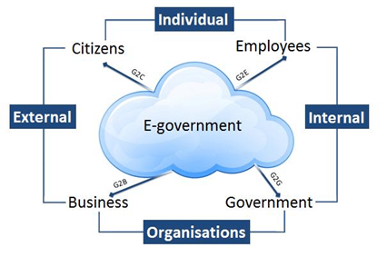
What is e-governance?
E-governance can be defined as the process to integrate the ICT (Information and Communications Technology) for carrying out the daily operations of governance.
The main aim of this technology is to boost the ability of government for addressing the requirements for normal public.

Slide 4
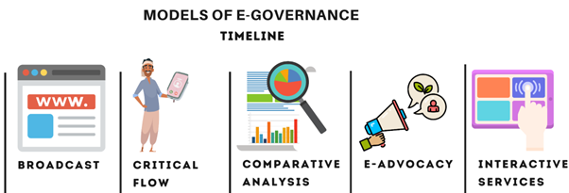
Models of e-Governance

Slide 5
Goals of E-Governance
Creating a better business environment
Strengthening good governance and broadening public participation
Improving the productivity and efficiency of government agencies
Efficiency gains
Improving the quality of life for disadvantaged communities

Slide 6
Types of E-Governance

Slide 7
Advantages of E-Governance
Speed
Saving Costs
Transparency
Accountability

Slide 8
Disadvantages of E-Governance
Loss of Interpersonal Communication
High Setup Cost and Technical Difficulties
Illiteracy
Cybercrime/Leakage of Personal Information

Slide 9
Conclusion
Many nations have successfully implemented the e-governance. It can only be applied if the government of the respective country is ready to apply it. Also, it improves the quality of work between the two.

Slide 10
Reference
www.google.com
www.wikipedia.com
www.studymafia.org

Slide 11
THANKS

