Slide 1
www.studymafia.org
Seminar
On
Genomic Library
Submitted To: Submitted By:
www.studymafia.org www.studymafia.org

Slide 2
Content
Introduction
What is genomic library?
Construction of Genomic Library
Importance of Genomic Library
What are the uses of Genomic Library?
Problem in Genome Library
Future
Conclusion

Slide 3
Intorduction
A genomic library is a collection of the total genomic DNA from a single organism. The DNA is stored in a population of identical vectors, each containing a different insert of DNA. In order to construct a genomic library, the organism's DNA is extracted from cells and then digested with a restriction enzyme to cut the DNA into fragments of a specific size.

Slide 4
What is genomic library?
“A genomic library is a collection of bacteria which have been genetically engineered to hold the entire DNA of an organism”.

Slide 5
Construction of Genomic Library
Isolation of target DNA
Restriction Fragments
Cloning the fragments in vector
Screening of Genomic library

Slide 6
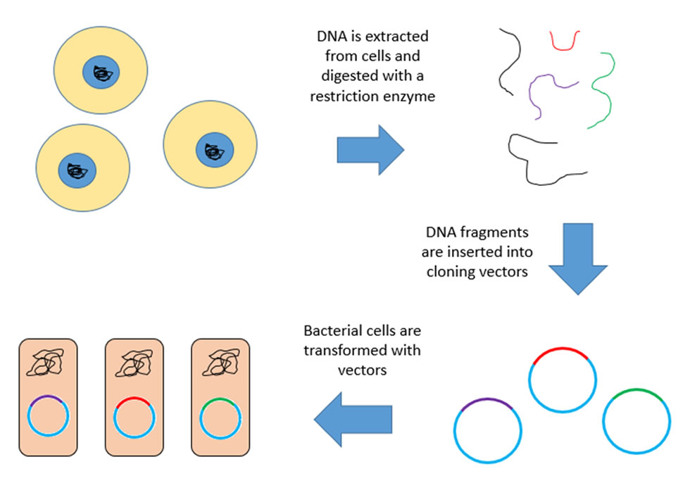
Construction of Genomic Library….

Slide 7
Importance of Genomic Library
Used to create a genomic map and to identify the locations of specific genes.
Used to study the genetic variations such as mutations (Cancer).
It is the first step in any DNA sequencing projects.

Slide 8
What are the uses of Genomic Library?
They can map the genome, identifying the locations of specific genes.
Helps to develop tests which can be used to locate genetic variationsϖ including mutations
Genomic library construction is the first step in any DNA sequencingϖ projects.

Slide 9
Problem in Genome Library
Problem in Genome Library
The gene may be cut internally with the restriction enzyme used, therefore a singleθ required sequence is not obtained. The gene of interest obtained by the restriction enzyme may be larger than the vector.

Slide 10
The Future of Genomic Libraries
Genomic library construction remains an important technique in molecular biology. These resources are critical for analysis of gene function and for detection of related genes from different sources. Genomic libraries are currently in use to find novel natural products, such as antimicrobials.
They are also being used to uncover and optimize new biochemical pathways, such as those needed for production of biofuels and other complex chemicals. In addition, genomic libraries remain an essential tool for assembling the vast amount of sequence information that is produced from NGS.

Slide 11
Conclusion
In conclusion, genomic libraries serve as indispensable tools for a wide range of applications, including gene mapping, functional genomics, comparative genomics, and the discovery of novel genes and regulatory elements. They facilitate the exploration of genetic diversity, evolutionary relationships, and the molecular basis of biological processes.
As technologies continue to advance, genomic libraries will remain fundamental in advancing our understanding of genetics and contributing to advancements in fields such as medicine, agriculture, and biotechnology.

Slide 12
Reference
www.google.com
www.wikipedia.com
www.studymafia.org
Seminarppt.com

Slide 13
THANKS

