Slide 1
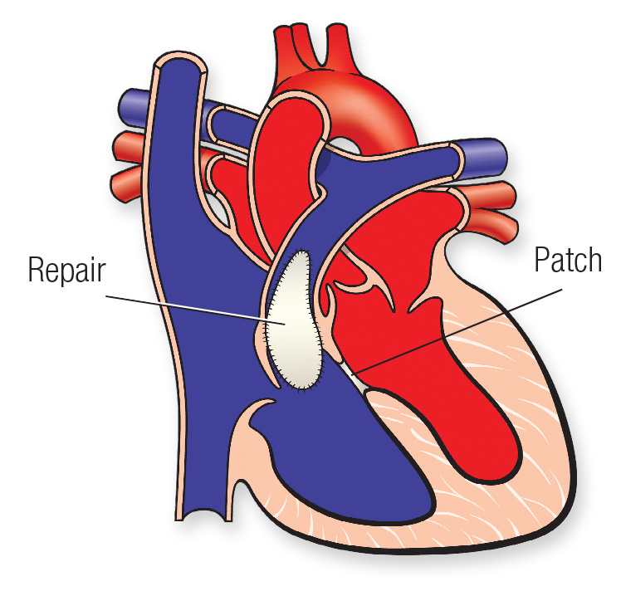
www.studymafia.org
Seminar
On
Tetralogy of Fallot
Submitted To: Submitted By:
www.studymafia.org www.studymafia.org

Slide 2
Content
What Is Tetralogy of Fallot?
Healthy Heart Blood Flow
Symptoms
Etiology
“Tet Spell”

Slide 3
What Is Tetralogy of Fallot?
The main function of your heart is to pump blood through the rest of your body. This blood gives your body nutrients and oxygen.

Slide 4
Healthy Heart Blood Flow
Deoxygenated blood from the body enters the RA
At the same time, oxygen rich blood leaves the lungs to flow into the LA
Blood in the RA enters the RV through the tricuspid valve
At the same time, blood flows from the LA to the LV through the mitral valve

Slide 5
Blood Flow cont.
Blood in the RV is pumped through the PA to the lungs
At the same time, LV pumps blood out the aorta to supply the body with oxygen rich blood
As seen in ToF, structural defects lead to the circulation of oxygen-poor blood

Slide 6
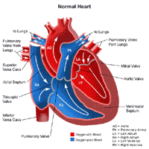

Slide 7
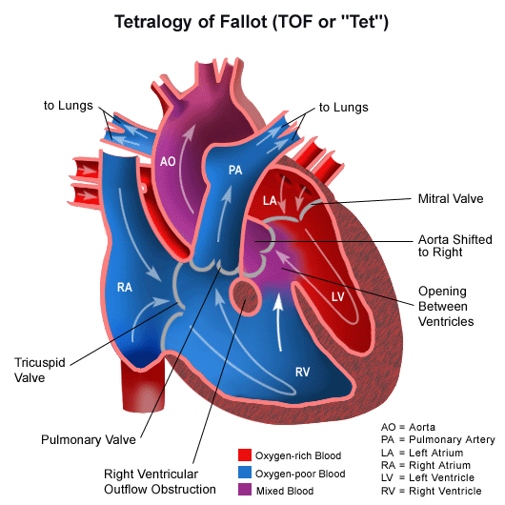
ToF
4 anatomic malformations:
-Right Ventricular
Hypertrophy
-Pulmonary Valve
Stenosis
-Transposition of
the aorta
-Ventricular Septal
Defect

Slide 8
Symptoms
Loss of consciousness (fainting)
Clubbing of fingers and toes — an abnormal, rounded shape of the nail bed
Poor weight gain
Tiring easily during play or exercise
Irritability
Prolonged crying
A heart murmur

Slide 9
ToF
RVH
-secondary to PA Stenosis
-Increased P on RV leads to RVH
Transposition of Aorta
-aorta is displaced
VSD
-”hole in the heart”
-mixing of oxygenated and unoxygenated blood
-cyanosis
PVS
-more severe, less blood transported to the lungs and more deoxygenated blood will pass through VSD to aorta to be circulated throughout the body

Slide 10
Etiology
Theory: destruction of the neuronal crest cells during embryogenesis
In the laboratory setting, destruction of these cells reproduced results displayed with certain cardiac malformations.

Slide 11
Clinical Presentation
Clinical presentation is directly related to the degree of pulmonary stenosis.
Severe stenosis results in immediate cyanosis following birth. Mild stenosis will not present until later.
Growth is retarded – insufficient oxygen and nutrients
SOA on exertion

Slide 12
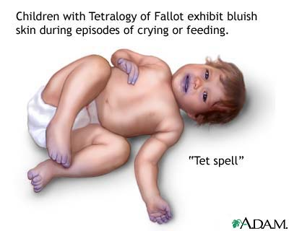
“Tet Spell”
“Tet spells” at 2-3yo, child becomes cyanotic, may experience syncope

Slide 13
Prevention
Get proper prenatal care. Regular checkups with a healthcare team during pregnancy can help keep mom and baby healthy.
Take a multivitamin with folic acid. Taking 400 micrograms of folic acid daily has been shown to reduce birth defects in the brain and spinal cord. It may help reduce the risk of heart defects as well.
Don't drink or smoke. These lifestyle habits can harm a baby's health. Also avoid secondhand smoke.

Slide 14
Prevention…..
Get a rubella (German measles) vaccine. A rubella infection during pregnancy may affect a baby's heart development. Get vaccinated before trying to get pregnant.
Control blood sugar. If you have diabetes, good control of your blood sugar can reduce the risk of congenital heart defects.
Manage chronic health conditions. If you have other health conditions, including phenylketonuria, talk to your healthcare team about the best way to treat and manage them.

Slide 15
Conclusion
With medical advances, the outlook for babies with tetralogy of Fallot is better than it was in the past. Most babies who have surgery today to fix tetralogy of Fallot will have active lives.
They’ll need to have regular check-ups with a cardiologist, a provider who specializes in the heart.

Slide 16
Reference
www.google.com
www.wikipedia.com
www.studymafia.org

Slide 17
Thanks

