Slide 1
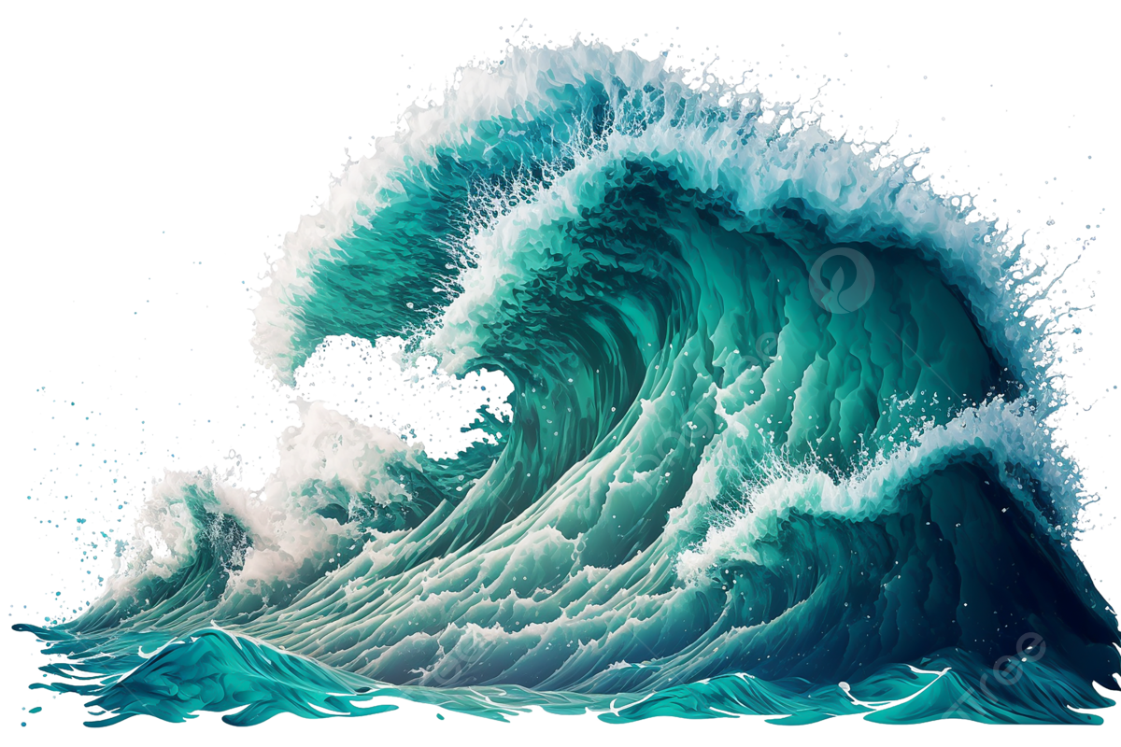
www.studymafia.org
Seminar
On
Tsunami
Submitted To: Submitted By:
www.studymafia.org www.studymafia.org
Notes:
1
1

Slide 2
Content
Overview
What Are Tsunamis?
Why Talk About Tsunamis?
Causes Of Tsunami
Types
Characteristics of tsunamis
Tsunamis Facts
Positive effects?
Conclusion

Slide 3
Overview
In this unit, find out what a tsunami is, what causes a tsunami, and signs and forewarnings of an impending tsunami.
Knowledge of tsunamis can be shared at school, through legends, stories, and experiences. When the experience of past tsunamis is remembered, loss of life and property can be prevented.

Slide 4
What Are Tsunamis?
Tsunamis are ocean waves produced by earthquakes or underwater landslides.
The word is Japanese and means "harbor wave," because of the devastating effects these waves have had on low-lying Japanese coastal communities.
A tsunami is actually a series of waves that can travel at speeds averaging 450 (and up to 600) miles per hour in the open ocean.
As the waves approach the coast, their speed decreases and their amplitude increases. Unusual wave heights have been known to be over 100 feet high. However, waves that are 10 to 20 feet high can be very destructive and cause many deaths or injuries.

Slide 5
Why Talk About Tsunamis?
The Tsunami last year on 26th December devastated lives
around the Indian Ocean claiming thousands of lives,
millions as injured, numerous as unsheltered and
uncountless lost their family and loved ones.
Twenty-four tsunamis have caused damage in the United States and its territories during the last 204 years.
Just since 1946, six tsunamis have killed more than 350 people in the U.S. alone.
Tsunamis can travel upstream with damaging waves extending farther inland than the immediate coast.
A tsunami can occur during any season of the year and at any time, day or night.

Slide 6
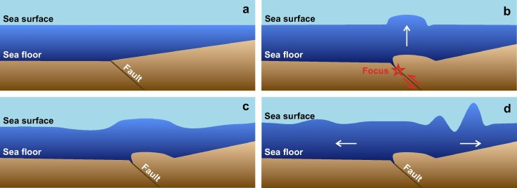
The tsunami phenomenon

Slide 7
Causes Of Tsunami
Tsunamis are most often generated by earthquake-induced movement of the ocean floor.
Landslides, volcanic eruptions, and even meteorites can also generate a tsunami.
Areas Prone to Tsunami
The Indian coastline from Gujrat to West Bengal.
The continent of Australia.
Other countries like Sri Lanka, Japan, Indonesia, Thailand,
Philippines, Malaysia, Oman, Yemen, etc. in the Indian
Ocean, Bay of Bengal & Arabian Sea.
Then there are other countries like Cuba, Peru, U.S. Canada,
Russia, Madagascar, etc.

Slide 8
Characteristics of Tsunami
It radiates in all directions from the point of origin and covers the entire ocean.
It generally consists of a series of waves, with periods ranging from minutes to hours.
These are the waves generated by tremors and not by earthquakes themselves.
There is no season for tsunamis and not all tsunamis act the same. It cannot be predicted where, when and how destructive it will be. A small tsunami in one place may be very large a few miles away.

Slide 9
Types of Tsunami
Local Tsunami
A local tsunami is one that causes damage in close proximity to the event that triggered the tsunami.
The underwater occurrence, which is typically an earthquake that triggers a local tsunami, occurs within 100 kilometres (just over 60 miles) of the land damage that results.

Slide 10
Types of Tsunami
Regional Tsunami
A regional tsunami is described as one that causes damage between 100 and 1,000 kilometres from the source of the tsunami. Outside the 1,000-kilometer perimeter, more contained damages will occur in some cases.
Regional tsunamis have a significantly longer warning time than local tsunamis, arriving between one and three hours after the triggering incident.

Slide 11
Types of Tsunami
Distant Tsunami
A distant tsunami, also known as a Teletsunami or ocean-wide tsunami, is caused by a strong and devastating occurrence that occurs more than 1,000 kilometres away from landfall.
A distant tsunami may appear to be a local tsunami at first, but it spreads through vast swaths of the ocean basin.

Slide 12
Tsunamis Facts
A tsunami can reach speeds of 500 miles per hour, which is almost the speed of a jet airplane.
Because of their speed, a tsunami could cross the Pacific Ocean in only one day.
As a tsunami nears the shore, it slows down, but it gains more height and energy.
The top of a tsunami wave actually moves faster than the bottom. This is what causes them to rise so high.
If a person is swept up in a tsunami, the best thing they can do is grab onto something that floats, not to try to swim.

Slide 13
Positive effects?
Over time, properties that have been destroyed will be fully replaced, and probably by better and newer substitutes, so at the end of the reconstruction process, the countries will probably be wealthier.
As plate tectonics move, it naturally cycles materials from the mantle of the earth. Without movement that allows earthquakes and tsunamis, we wouldn’t have certain plants or animals that hold an important role in our ecosystem.

Slide 14
Conclusion
Tsunamis are destructive due to their volume and speed. They become more dangerous when they return from the sea carrying people, objects, and debris with them. Therefore, people are advised to stay out of the tsunami hazard zones until the conditions come under control.

Slide 15
REFERENCE
www.google.com
www.wikipedia.com
www.studymafia.org

Slide 16
THANKS

