Slide 1
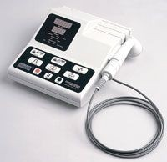
www.studymafia.org
Seminar
On
Ultrasound
Submitted To: Submitted By:
www.studymafia.org www.studymafia.org

Slide 2
Outline
What is Ultrasound imaging?
Why Ultrasound?
Common Uses
History
Properties of Ultrasound
Equipment
How does the procedure work?
Benefits and Risks

Slide 3
What is General Ultrasound Imaging?
Ultrasound imaging, also called sonography, involves exposing part of the body to high- frequency sound waves to produce pictures of the inside of the body.
Ultrasound examinations do not use ionizing radiation (as used in x-rays).
Because ultrasound images are captured in real- time, they can show the structure and movement of the body's internal organs, as well as blood flowing through blood vessels.

Slide 4
Why Ultrasound
Ultrasound (US) is the most widely used
imaging technology worldwide
Popular due to availability, speed, low cost, patient-friendliness (no radiation)
Applied in obstetrics, cardiology, inner medicine, urology,...
Ongoing research to improve image quality, speed and new application areas such a intra- operative navigation, tumour therapy,...

Slide 5
What are some common uses of the procedure?
Ultrasound examinations can help to diagnose a variety of conditions and to assess organ damage following illness.
Ultrasound is used to help physicians evaluate symptoms such as:
pain
swelling
infection
hematuria (blood in urine)

Slide 6
Ultrasound is a useful way of examining many of the body's internal organs, including but not limited to the:
heart and blood vessels, including the abdominal aorta and its major branches
Liver
Gallbladder
Spleen
Pancreas
Kidneys
Bladder
Uterus, ovaries, and unborn child (fetus) in pregnant patients
Eyes
Thyroid and parathyroid glands
Scrotum (testicles)
brain in infants
hips in infants

Slide 7
Ultrasound is also used to:
guide procedures such as needle biopsies, in which needles are used to extract sample cells from an abnormal area for laboratory testing.
image the breasts and to guide biopsy of breast cancer
diagnose a variety of heart conditions and to assess damage after a heart attack or diagnose for valvular heart disease.

Slide 8
Doppler ultrasound images can help the physician to see and evaluate:
blockages to blood flow (such as clots).
narrowing of vessels (which may be caused by plaque).
tumors and congenital vascular malformation.
With knowledge about the speed and volume of blood flow gained from a Doppler ultrasound image, the physician can often determine whether a patient is a good candidate for a procedure like angioplasty.

Slide 9
Applications of ultrasound:
Few applications of ultrasound are mentioned below and it is used for examining the following things:
Extremities like connective tissues, muscles, joints, and vessels
Neck: vessels, abscesses, thyroid gland, and lymph nodes
Chest: heart (echocardiography), wall, pleura, mediastinal tumors, and disorders of lungs which are situated in peripheral area of lungs
Abdomen, small pelvis, and retroperitoneum: fluid-containing structures, parenchymatous organs, gastrointestinal tract, great vessels, lymph nodes, abnormal fluid collections, and tumors
Spine in infants
Hips in infants
Brain in infants
Eyes
Unborn child fetus in pregnant women

Slide 10
History
1877: Lord Raleigh - "Theory of Sound"
1880: Pierre & Jacques Curie - Piezoelectric effect
1914: Langevin - First Ultrasound generator using piezoelectric effect
1928: Solokov - Ultrasound for material testing

Slide 11
1942: Dussik - First application of Ultrasound in medical diagnostics
Shortly after WWII, researchers in Japan began to explore medical diagnostic capabilities of ultrasound.
... different medical applications (gall stones, tumours)
End of 1960's: Boom of Ultrasound in medical diagnostics

Slide 12
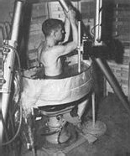
Pan-Scanner - The transducer rotated in a semicircular arc
around the patient (1957)

Slide 13
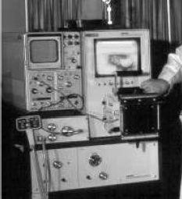
Scan converter allowed for the first time to use the upcoming computer technology to improve US

Slide 14
Early 1970s
Gray scale static images of internal organs
Mid 1970s
Real-time imaging
Early 1980s
Spectral Doppler
Color Doppler
Also produced was a hand-held “contact” scanner for clinical use.

Slide 15
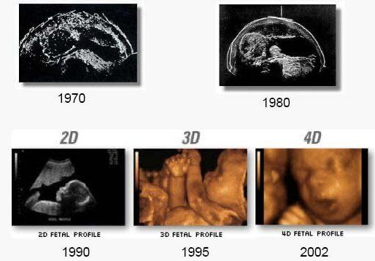
Development of the B-mode Ultrasound image quality

Slide 16
Properties of Ultrasound
The frequencies of medical Ultrasound waves are several magnitudes higher than the upper limit of → human hearing.
Approximate frequency ranges of sound

Slide 17
Although ultrasound is better known for its diagnostic capabilities, it was initially used for therapy rather than diagnosis.
In the 1940s, ultrasound was used to perform services similar to that of radiation or chemotherapy now.
Ultrasonic waves emit heat that can create disruptive effects on animal tissue and destroy malignant tissue.

Slide 18
Common Sound Frequencies
Sound | Frequency
Adult audible range | 15 – 20’000 Hz
Range for children's hearing | Up to 40’000 Hz
Male speaking voice | 100 – 1’500 Hz
Female speaking voice | 150 ‘ 2’500 Hz
Standard pitch (Concert A) | 44 0 Hz
Bat | 50’000 – 200’000 Hz
Medical Ultrasound | 2.5 – 40 MHz
Maximum sound frequency | 600 MHz
Common sound frequencies and frequency ranges

Slide 19
Physics of the method
Longitudinal mechanical waves
Needs elastic medium
Transducer needs to be in contact with skin
Component resolution
– 3 MHZ ->1.1 mm
– 10 MHZ -> .3 mm
Wave velocity
– Fat -> 1450 m/s
Muscle ->1580 m/s

Slide 20
Principles of Ultrasound
Its Components
Operations
Applications

Slide 21
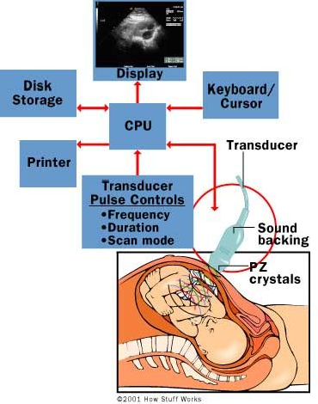
Ultrasound Parts

Slide 22
The Ultrasound Machine
A basic ultrasound machine has the following parts:
Transducer probe - probe that sends and receives the sound waves
Central processing unit (CPU) - computer that does all of the calculations and contains the electrical power supplies for itself and the transducer probe
Transducer pulse controls - changes the amplitude, frequency and duration of the pulses emitted from the transducer probe
Display - displays the image from the ultrasound data processed by the CPU
Keyboard/cursor - inputs data and takes measurements from the display
Disk storage device (hard, floppy, CD) - stores the acquired images
Printer - prints the image from the displayed data

Slide 23
Equipment
Ultrasound scanners consist of a console containing a computer and electronics, a video display screen and a transducer that is used to do the scanning.
The transducer is a small hand-held device that resembles a microphone, attached to the scanner by a cord.
The transducer sends out inaudible high frequency sound waves into the body and then listens for the returning echoes from the tissues in the body.
The principles are similar to sonar used by boats and submarines.

Slide 24
The ultrasound image is immediately visible on a video display screen that looks like a computer or television monitor.
The image is created based on the amplitude (strength), frequency and time it takes for the sound signal to return from the area of the patient being examined to the transducer and the type of body structure the sound travels through.

Slide 25
What are the benefits vs. risks?
Benefits
Most ultrasound scanning is noninvasive (no needles or injections) and is usually painless.
Ultrasound is widely available, easy-to-use and less expensive than other imaging methods.
Ultrasound imaging does not use any ionizing radiation.
Ultrasound scanning gives a clear picture of soft tissues that do not show up well on x-ray images.
Ultrasound is the preferred imaging modality for the diagnosis and monitoring of pregnant women and their unborn babies.
Ultrasound provides real-time imaging, making it a good tool for guiding minimally invasive procedures such as needle biopsies and needle aspiration.

Slide 26
Risks
For standard diagnostic ultrasound there are no known harmful effects on humans.
Unlike X-rays, ultrasound involves only sound waves
No radiation danger
However, sound waves can increase body temperature
This is known as cavitation
Significant only for long exposure time

Slide 27
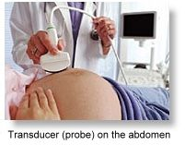
Many studies have been conducted to determine the physiological effects of ultrasound cavitation
No direct correlation has been found between ultrasound imaging and cancer, low birth weight, dyslexia or delayed speech development
Reliable data from ultrasound techniques is hard to come by
Additional studies are ongoing
Biggest risk is misdiagnosis

Slide 28
Future of Ultrasound
Improved clarity for use in cancer diagnosis
Increased therapeutic use to correct blood clots and kidney stones
Portability and veterinary use
Joint and muscle treatment through cavitation

Slide 29
What are the limitations of General Ultrasound Imaging?
Ultrasound waves are disrupted by air or gas; therefore ultrasound is not an ideal imaging technique for air-filled bowel or organs obscured by the bowel. In most cases, barium exams, CT scanning, and MRI are the methods of choice in this setting.
Large patients are more difficult to image by ultrasound because greater amounts of tissue attenuates (weakens) the sound waves as they pass deeper into the body.

Slide 30
Reference
www.google.com
www.wikipedia.org
www.studymafia.com

Slide 31
THANK YOU

