Slide 1
www.studymafia.org
Seminar
On
LAN WAN MAN
Submitted To: Submitted By:
www.studymafia.org www.studymafia.org

Slide 2
Content
Networking
LAN
Star Topology
Bus Topology
Ring Topology
WAN
MAN
Conclusion

Slide 3
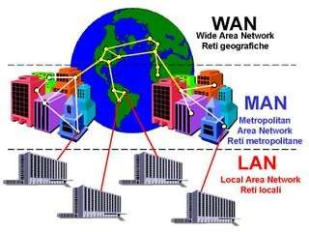
Networking:
A computer network is a communication that allows sharing information and resource.
Types of Networking
Three major types of networking:
a
1 ) LAN 2 ) MAN
3 ) WAN
Other types of networking:
i ) Personal Aria Network
(PAN)
ii ) Home Network
iii ) Enterprise Private Network

Slide 4
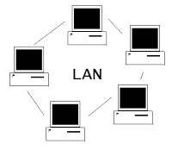
LAN (Local Area Network )
A local area network is a computer network that connects computer in a limited area such as home, school, office building. A LAN is useful for sharing resource like files, printers, games and other application.

Slide 5
Network Topology
Star Topology
Bus Topology
Ring Topology

Slide 6
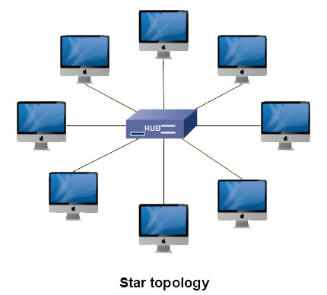
Star Topology
In a star network devices are connected to a central computer, called a hub.
Nodes communicate across the network by passing data through the hub.

Slide 7
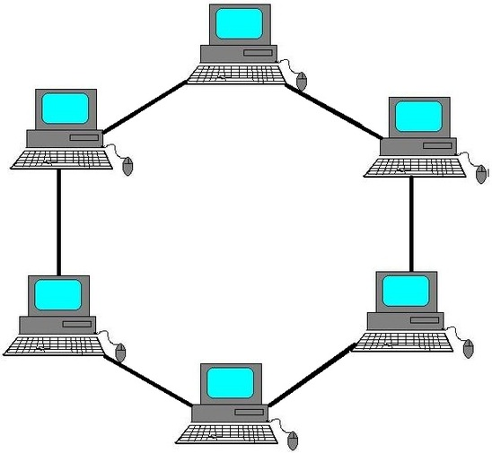
Ring Topology
A local-area network (LAN) whose topology is a ring. That is, all of the nodes are connected in a closed loop. Messages travel around the ring, with each node reading those messages addressed to it.

Slide 8
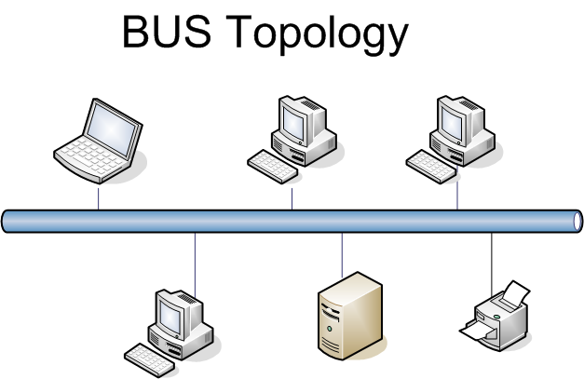
Bus Topology
In networking a bus is the central cable -- the main wire -- that connects all devices on a local-area network (LAN).
It is also called the backbone. This is often used to describe the main network connections composing the Internet.
Bus networks are relatively inexpensive and easy to install for small networks. Ethernet systems use a bus topology.

Slide 9
Advantages of LAN
Few advantages of LAN are mentioned below:
Resource sharing
E-mail
Security
Security
Cost
Speed

Slide 10
Disadvantages of LAN
Disadvantages of LAN are mentioned below:
Cables may break
File server may break
Needs administrative time
Expensive to install

Slide 11
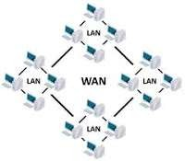
WAN (Wide Area Network)
A wan spans a large geographical area, such as a state, country. WAN connects multiple smaller networks such as local area network or metro area networks.

Slide 12
WAN Types
SD- WAN
X.25
SONET
Leased line
ISDN
Frame Relay
DSL
Dial-up
Cable modem
ATM

Slide 13
MAN (Metropolitan Area Network)
A metropolitan area network is a network that interconnects users with computer resource in a geographical area or a region than that covered by even a large local area network but smaller area network covered by WAN .
It is used for interconnection of several local area networks by bridging them backbone line.

Slide 14
Conclusion
LAN is a private network used in small offices or homes usually within 1km range with high speed transfer data rate and fulltime service connectivity in low cost. WAN covers a large geographical area for example, a country or a continent.
Its data transfer data is usually low as compared to LAN, but it is compatible with a variety of access lines and has an advanced security.
MAN covers an area bigger than LAN within a city or town and serves as an ISP for larger LAN.
It uses optical fibers or wireless infrastructure to link the LANs therefore, providing high speed regional resource sharing.

Slide 15
Reference
www.google.com
www.wikipedia.com
www.studymafia.org

Slide 16
THANKS

