Slide 1
www.studymafia.org
Seminar
On
Land Pollution
Submitted To: Submitted By:
www.studymafia.org www.studymafia.org
Notes:
1
1

Slide 2
Content
What is Land Pollution?
Causes
Effects
Solution
Conclusion

Slide 3
What is Land Pollution?
Land pollution is the destruction of the earth’s land surfaces, often directly or indirectly as a result of human activities and their misuse of land resources.
It occurs when waste is not disposed off properly, or can occur when humans throw chemicals unto the soil in the form of pesticides, insecticides and fertilizers during agricultural practices. Exploitation of minerals (mining activities) has also contributed to the destruction of the earth’s surface.

Slide 4
Causes of Land Pollution
1. Deforestation and soil erosion:
Deforestation carried out to create dry lands is one of the major concerns. Land that is once converted into a dry or barren land, can never be made fertile again, whatever the magnitude of measures to redeem it are.
Land conversion, meaning the alteration or modification of the original properties of the land to make it use-worthy for a specific purpose is another major cause. This hampers the land immensely. Also there is a constant waste of land.

Slide 5
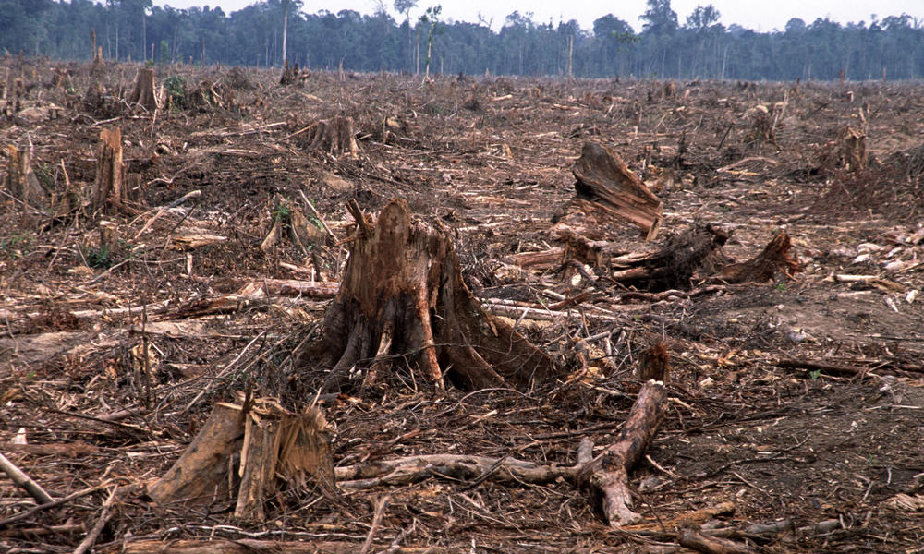

Slide 6
2. Mining activities:
During extraction and mining activities, several land spaces are created beneath the surface.
We constant hear about land caving in; this is nothing but nature’s way of filling the spaces left out after mining or extraction activity.

Slide 7
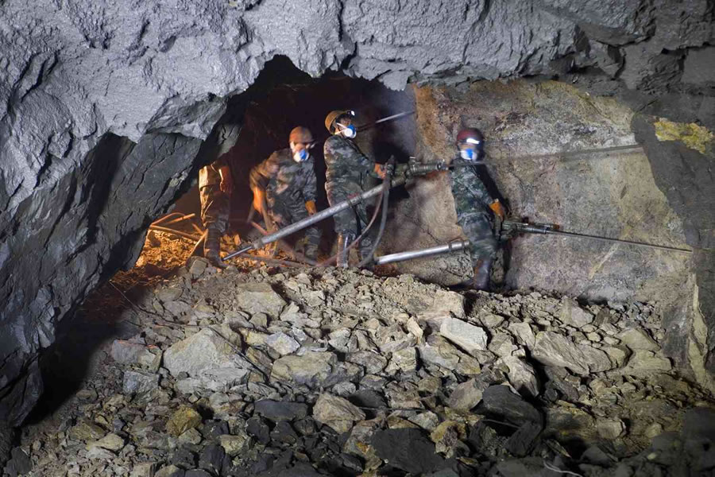
MINING ACTIVITIES.

Slide 8
3. Overcrowded landfills: Each household produces tonnes of garbage each year. Garbage like aluminum, plastic, paper, cloth, wood is collected and sent to the local recycling unit. Items that can not be recycled become a part of the landfills that hampers the beauty of the city and cause land pollution.

Slide 9
OVERCROWDED FILLS.

Slide 10
4. Industrialization: Due to increase in demand for food, shelter and house, more goods are produced. This resulted in creation of more waste that needs to be disposed of. To meet the demand of the growing population, more industries were developed which led to deforestation. Research and development paved the way for modern fertilizers and chemicals that were highly toxic and led to soil contamination.

Slide 11
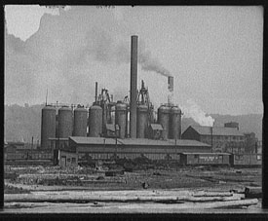
INSDUSTRIALIZATION.

Slide 12
5. Construction activities: Due to urbanization, large amount of construction activities are taking place which has resulted in large waste articles like wood, metal, bricks, plastic that can be seen by naked eyes outside any building or office which is under construction.

Slide 13
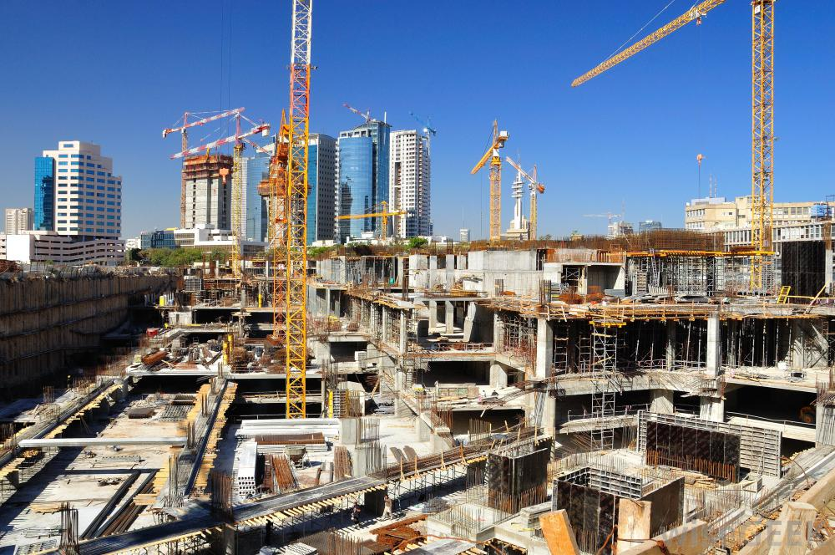
CONSTRUCTION ACTIVITIES

Slide 14
6. Nuclear waste: Nuclear plants can produce huge amount of energy through nuclear fission and fusion. The left over radioactive material contains harmful and toxic chemicals that can affect human health. They are dumped beneath the earth to avoid any casualty.

Slide 15
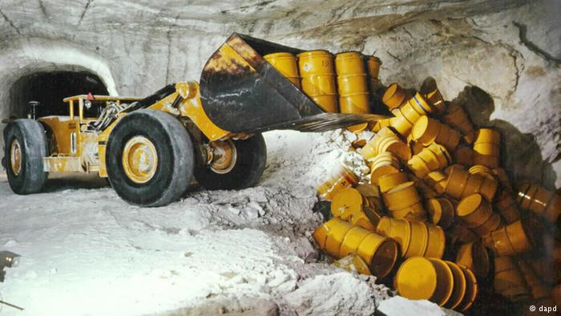
NUCLEAR WASTE.

Slide 16
Effects of Land Pollution
1. Soil pollution: Soil pollution is another form of land pollution, where the upper layer of the soil is damaged. This is caused by the overuse of chemical fertilizers, soil erosion caused by running water and other pest control measures; this leads to loss of fertile land for agriculture, forest cover, fodder patches

Slide 17
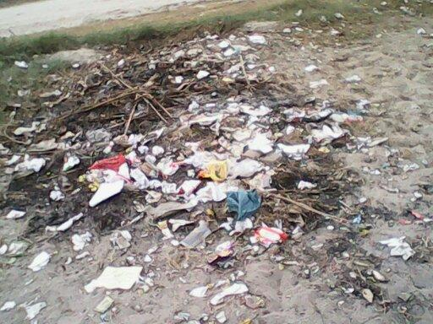
SOIL POLLUTION.

Slide 18
2. Change in climate patterns: The effects of land pollution are very hazardous and can lead to the loss of ecosystems. When land is polluted, it directly or indirectly affects the climate patterns.

Slide 19
CHANGE IN CLIMATE PATTERNS

Slide 20
3. Environmental Impact: When deforestation is committed, the tree cover is compromised on. This leads to a steep imbalance in the rain cycle. A disturbed rain cycle affects a lot of factors. To begin with, the green cover is reduced. Trees and plants help balance the atmosphere, without them we are subjected to various concerns like Global warming, the green house effect, irregular rainfall and flash floods among other imbalances.

Slide 21
ENVIRONMENTAL IMPACT.

Slide 22
4. Effect on human health: The land when contaminated with toxic chemicals and pesticides lead to problem of skin cancer and human respiratory system. The toxic chemicals can reach our body through foods and vegetables that we eat as they are grown in polluted soil.

Slide 25
5. Cause Air pollution: Landfills across the city keep on growing due to increase in waste and are later burned which leads to air pollution. They become home for rodents, mice etc which in turn transmit diseases.

Slide 26
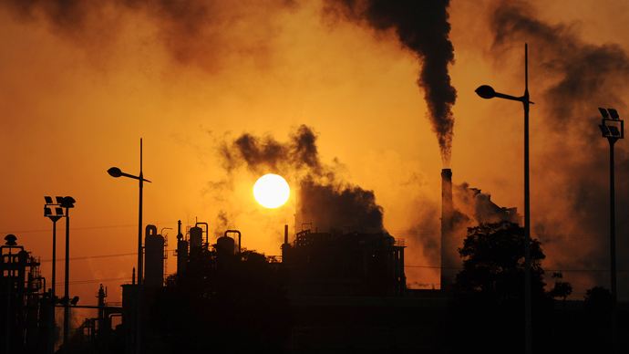
CAUSE OF AIR POLLUTION

Slide 27
6. Distraction for Tourist: The city looses its attraction as tourist destination as landfills do not look good when you move around the city. It leads to loss of revenue for the state government.

Slide 28
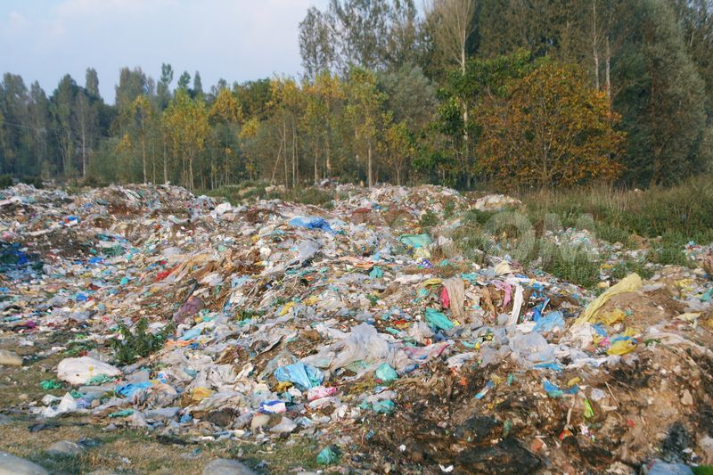
DISTRACTION FOR TOURIST

Slide 29
7. Effect on wildlife: The animal kingdom has suffered mostly in the past decades. They face a serious threat with regards to loss of habitat and natural environment. The constant human activity on land, is leaving it polluted; forcing these species to move further away and adapt to new regions or die trying to adjust. Several species are pushed to the verge of extinction, due to no homeland.

Slide 30
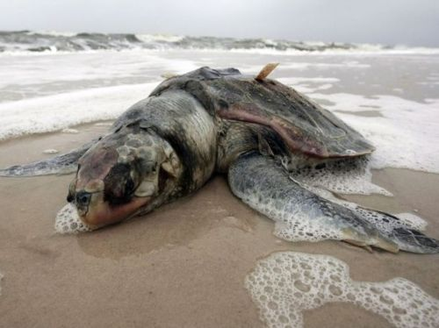
EFFECTS ON WILDLIFE

Slide 31
Solutions for Land Pollution
1. Make people aware about the concept of Reduce, Recycle and Reuse.
2. Reduce the use of pesticides and fertilizers in agricultural activities.
3. Avoid buying packages items as they will lead to garbage and end up in landfill site.
4. Ensure that you do not litter on the ground and do proper disposal of garbage.
5. Buy biodegradable products.
6. Do Organic gardening and eat organic food that will be grown without the use of pesticides.
7. Create dumping ground away from residential areas.

Slide 35
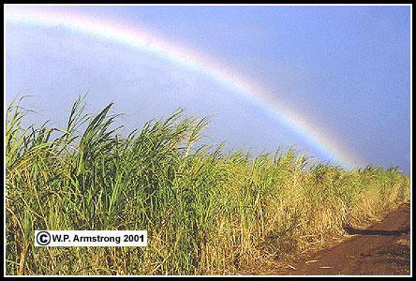
Conclusion
Certainly a country that is growing rapidly and developing in various fields. but in the rapid pace of development, many do not realize that it also carries side effects on the environment. So we have to go Sustainable Development.

Slide 36
References
www.google.com
www.wikipedia.com
www.studymafia.org
Seminarppt.com

Slide 37
THANKS

