Slide 1
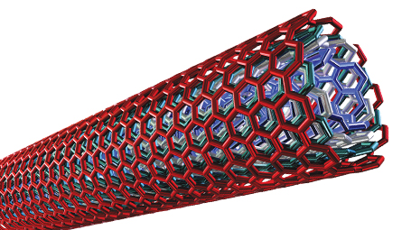
NANOMATERIALS
www.studymafia.org
Submitted by:
Studymafia.org
SUBMITTED TO:
STUDYMAFIA.ORG

Slide 2
Table Of Content
What are Nanomaterials?
Properties of Nanomaterials?
Nanomaterial shapes
Why nanomaterials ?
Approaches
Applications of nanomaterials
Advantages of Nanomaterials
Disadvantages of Nanomaterials
Conclusion

Slide 3
What is nanomaterial
Nanomaterials are commonly defined as materials with an average grain size less than 100 nanometers
Nanomaterials have extremely small size which having at least one dimension 100 nm
One billion nanometers equals one meter

Slide 4
Properties of Nanomaterials?
Physical properties
Size, shape, specific surface area, aspect ratio
Agglomeration/aggregation state
Size distribution
Surface morphology/topography
Structure, including crystallinity and defect structure
Solubility

Slide 5
Properties of Nanomaterials?....
Chemical properties
Structural formula/molecular structure
Composition of nanomaterial (including degree of purity, known impurities or additives)
Phase identity
Surface chemistry (composition, charge, tension, reactive sites, physical structure, photocatalytic properties, zeta potential)
Hydrophilicity/lipophilicity

Slide 6
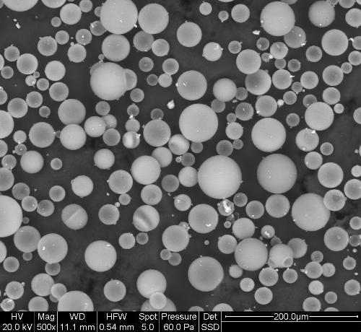
Nanomaterial shapes
nanomaterials can be nanoscale in one dimension ( surface films )
Two dimensions (strands or fiber)
Three dimensions ( particles )
They can exist in single or fused forms with spherical, tubular, and irregular shapes.

Slide 7
Why nanomaterials ?
Nanotechnology exploits benefits of ultra small size, enabling the use of particles to deliver a range of important benefits
Small particles are ‘invisible’ :
Transparent Coatings/Films are attainable
Small particles are very weight efficient:
Surfaces can be modified with minimal material

Slide 8
the behavior of nanomaterials may depend more on surface area than particle composition itself.
Relative-surface area is one of the principal factors that enhance its reactivity, strength and electrical properties.

Slide 9
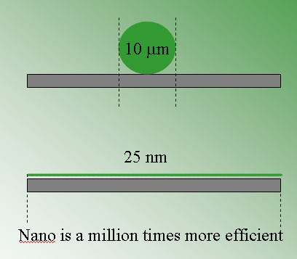
Weight efficient and Uniform coverage
Large spherical particles do not cover much surface area
Nanoparticles Equal mass of small platelet particles provides thorough coverage (1 x 106 times more)

Slide 10
by patterning matter on the nano scale, it is possible to vary fundamental properties of materials without changing the chemical composition

Slide 11
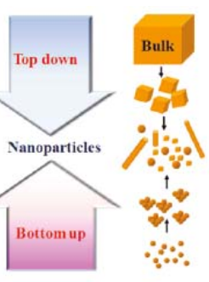
Approaches
Top-down – Breaking down matter into more basic building blocks. Frequently uses chemical or thermal methods.
Bottoms-up – Building complex systems by combining simple atomic-level components.

Slide 12
Methods for creating nanostructures
Mechanical grinding example of ( top-down ) method
Wet Chemical example of both ( top-down) & ( bottom up )

Slide 13
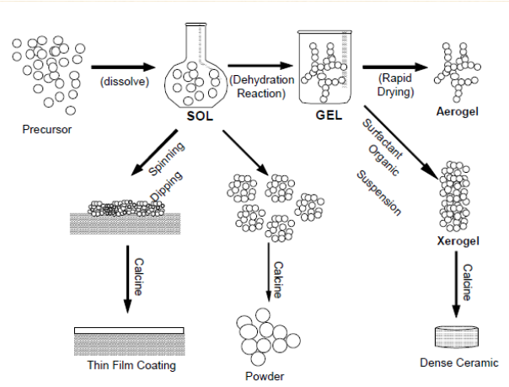
Methods for creating nanostructures
Sol-gel process

Slide 14
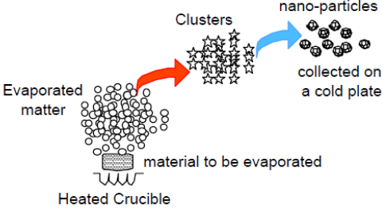
Methods for creating nanostructures
Gas Phase ( furnace )

Slide 15
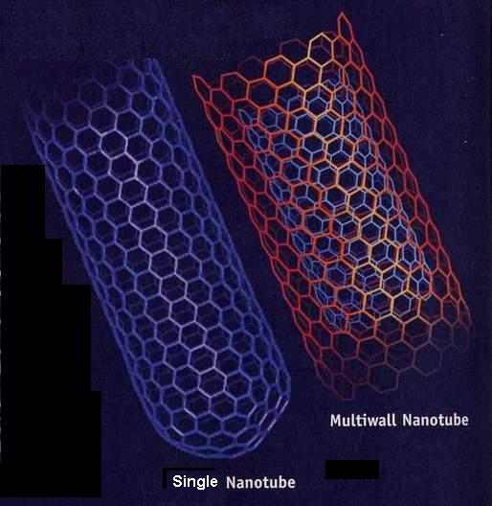
Different types of Nanomaterial
Nanopowder
Nanotube :
tiny strips of graphite sheet rolled into tubes

Slide 16
Why are nanomaterials important
These materials have created a high interest in recent years by their high mechanical, electrical, optical and magnetic properties.

Slide 17
Applications of nanomaterials
Light source - QD lasers, QC (Quantum Cascade) lasers
Light detector – QDIP (Quantum Dot Infrared Photo-detector)
Electromagnetic induced transparency (EIT) – to obtain transparent highly dispersive materials
Ballistic electron devices
Tunneling electron devices
Single electron devices

Slide 18
Advantages of Nanomaterials
The properties of nanomaterials, particularly their size, offer various different advantages compared to the bulk-form of the materials, and their versatility in terms of the ability to tailor them for specific requirements accentuates their usefulness. An additional advantage is their high porosity, which again increases demand for their use in a multitude of industries.
In the energy sector, the use of nanomaterials is advantageous in that they can make the existing methods of generating energy - such as solar panels - more efficient and cost-effective, as well as opening up new ways in which to both harness and store energy.
Nanomaterials are also set to introduce a number of advantages in the electronics and computing industry. Their use will permit an increase in the accuracy of the construction of electronic circuits on an atomic level, assisting in the development of numerous electronic products.

Slide 19
Disadvantages of Nanomaterials
Due to the relative novelty of the widespread use of nanomaterials, there is not a large amount of information on the health and safety aspects of exposure to the materials.
Currently, one of the main disadvantages associated with nanomaterials is considered to be inhalation exposure. This concern arises from animal studies, the results of which suggested that nanomaterials such as carbon nanotubes and nanofibers may cause detrimental pulmonary effects, such as pulmonary fibrosis. Further possible health risks are ingestion exposure and dust explosion hazards.
Additionally, there are still knowledge gaps regarding nanomaterials, meaning the manufacturing process can often be complex and difficult. The overall process is also expensive, requiring optimum results - especially regarding their use in consumer goods - in order to avoid financial losses.

Slide 20
Conclusion
Cylinders always align along diagonal of texture, even with small wave amplitude
For hydrophilic walls, small wall spacing with small wave amplitude only distorts structure
For hydrophilic walls, large wall spacing with small wave amplitude promotes (1 0 0) orientation
For hydrophilic walls, planar defects may be more likely if wall spacing > space needed for # of layers
systems with hydrophobic walls may avoid planar defects, because
the deposition of a monolayer of surfactant on the wall.
The chain softness mitigates the pattern

Slide 21
References
Wikipedia
Google
Studymafia
pptplanet

Slide 22
Thank you

