Slide 1
www.studymafia.org
Seminar
On
Research Methodology
Submitted To: Submitted By:
www.studymafia.org www.studymafia.org
Notes:
1
1

Slide 2
Content
Introduction
What is Research Methodology
Research Methods
Data Analysis Methods
Why do research?
Nature of Research
What is ‘not’ Research?
Stages of the research process
Advantages
Disadvantages
References

Slide 3
Introduction
Introduction to Research Methodology The design of any research project requires considerable attention to the research methods and the proposed data analysis. Within this section, we have attempted to provide some information about how to produce a research design for a study. We offer a basic overview of the research methods portion of a research proposal and then some data analysis templates for different types of designs. Our goal is not to answer every question, but provide a head start.

Slide 4
What is Research Methodology
The process used to collect information and data for the purpose of making business decisions.
The methodology may include publication research, interviews, surveys and other research techniques, and could include both present and historical information.

Slide 5
Research Methods
The methods section of any proposal must address several fundamental design components. The research method documents describes a number of components required for a fundable proposal.

Slide 6
Data Analysis Methods
Data analysis methods vary considerably from and even within the types of research designs. Some methods, such as single-subject designs, do not necessarily need a australian pokies online statistical analysis to convey experimental control over the dependent variables. Most “quantitative” designs, such as randomized trials and many quasi-experimental designs, require statistical analysis.

Slide 7
Why do research?
Validate intuition
Improve methods
Demands of the Job
For publication

Slide 8
Nature of Research
Bogus survey
Statistics are hard to obtain and interpret
Difficult to know if the situation is getting better or worse
Program producers will not allow to talk about the complexities of methods but will use numbers to horrify viewers (Like News about floods, earthquakes etc.)
Real research
Methodologically rigorous
Findings are interpretable

Slide 9
What is ‘not’ Research?
Just collecting facts or information with no clear purpose.
Reassembling and reordering facts or information without interpretation.
What is Research then?
Something that people (Researchers/scientists) undertake in order to find things out in a systematic way, there by increasing their knowledge’ (Saunders et al. (2009).

Slide 10
Characteristics
There is a clear purpose to find things out
Data are collected systematically
Data are interpreted systematically

Slide 11
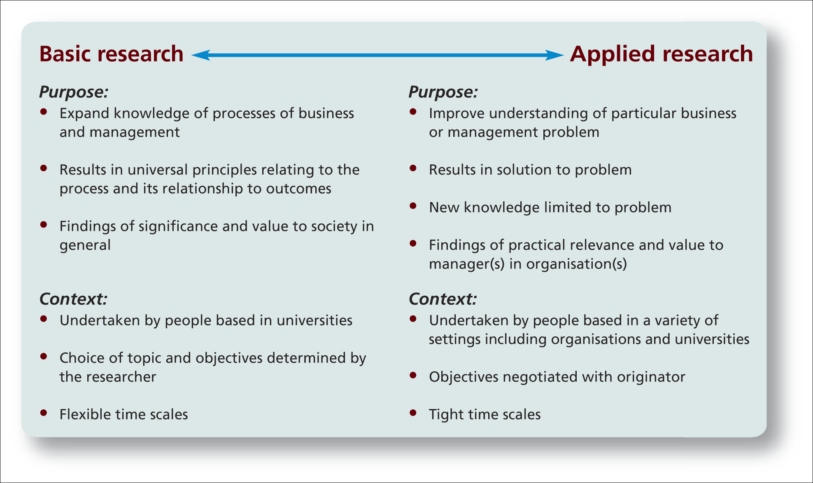
Features of Research: Basic and Applied

Slide 12
Stages of the research process
Formulating and clarifying a topic
Reviewing the literature
Designing the research
Collecting the data
Analysing the data
Writing up of the dissertation/paper/report etc.

Slide 13
Advantages
Practical
Large amounts of information can be collected from a large number of people in a short period of time and in a relatively cost effective way.
Can be carried out by the researcher or by any number of people with limited affect to its validity and reliability.
The results of the questionnaires can usually be quickly and easily quantified by either a researcher or through the use of a software package.
Can be analysed more 'scientifically' and objectively than other forms of research.
When data has been quantified, it can be used to compare and contrast other research and may be used to measure change.
Positivists believe that quantitative data can be used to create new theories and / or test existing hypotheses .

Slide 14
Disadvantages
Is argued to be inadequate to understand some forms of information - i.e. changes of emotions, behaviour, feelings etc.
Phenomenologists state that quantitative research is simply an artificial creation by the researcher, as it is asking only a limited amount of information without explanation.
Lacks validity.
There is no way to tell how truthful a respondent is being.
There is no way of telling how much thought a respondent has put in.
The respondent may be forgetful or not thinking within the full context of the situation.
People may read differently into each question and therefore reply based on their own interpretation of the question - i.e. what is 'good' to someone may be 'poor' to someone else, therefore there is a level of subjectivity that is not acknowledged.

Slide 15
References
www.google.com
www.wikipedia.com
www.studymafia.org
www.pptplanet.com

Slide 16
Thanks

