Slide 1

www.studymafia.org
Seminar
On
GLOBAL WARMING
Submitted To: Submitted By:
www.studymafia.org www.studymafia.org
Notes:
1
1

Slide 2
Content
Introduction
What is Global Warming?
How Global Warming Works.
Example of the Greenhouse Effect.
Difference between “global warming” and “climate change.
Effects of Global Warming.
Why is global warming happening?
What can you do to help solve the problem?
Conclusion
Reference

Slide 3
Introduction
Is the world getting warmer?
If so, are the actions of mankind to blame for earth’s temperature increases?
What can/should be done about these issues?

Slide 4
What is global warming?
Global Warming is the increase of Earth's average surface temperature due to effect of greenhouse gases,
such as carbon dioxide emissions from burning fossil fuels or from deforestation, which trap heat that would otherwise escape from Earth.
This is a type of greenhouse effect.

Slide 5

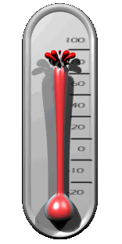



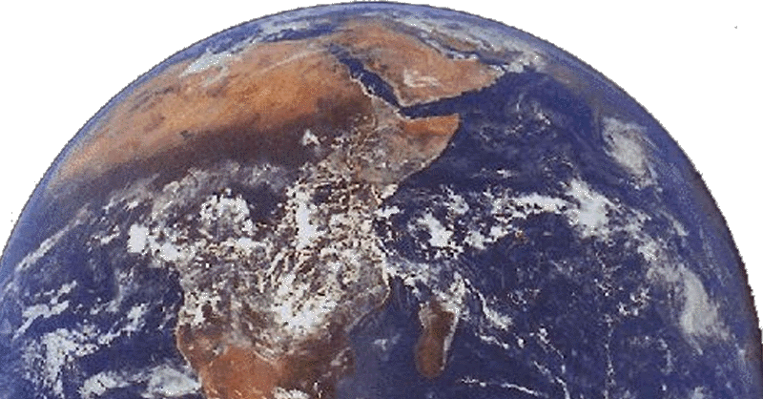


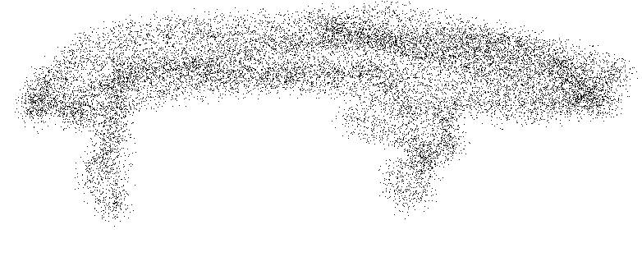
How Global Warming Works
Carbon Dioxide (CO₂)
Fossil fuels (coal, oil, natural gas)

Slide 6
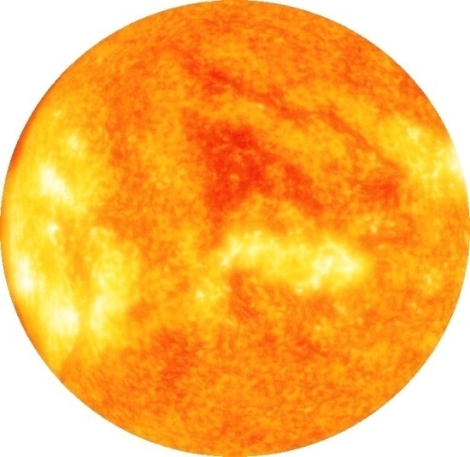

Example of the Greenhouse Effect
The Sun’s energy passes through the car’s windshield.
This energy (heat) is trapped inside the car and cannot pass back through the windshield, causing the inside of the car to warm up.

Slide 7

What’s the difference between “global warming” and “climate change”?

Slide 8
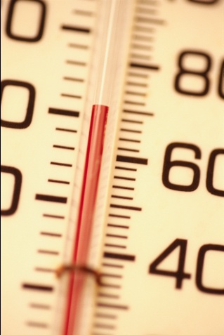
Difference
GLOBAL WARMING
is the increase of the Earth’s average surface temperature due to a build-up of greenhouse gases in the atmosphere.
CLIMATE CHANGE
is a broader term that refers to long-term changes in climate, including average temperature and precipitation.

Slide 9
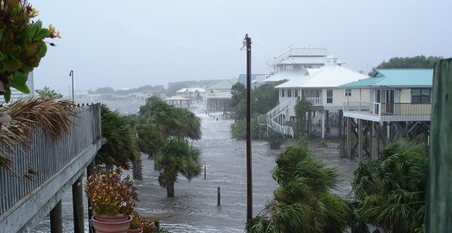

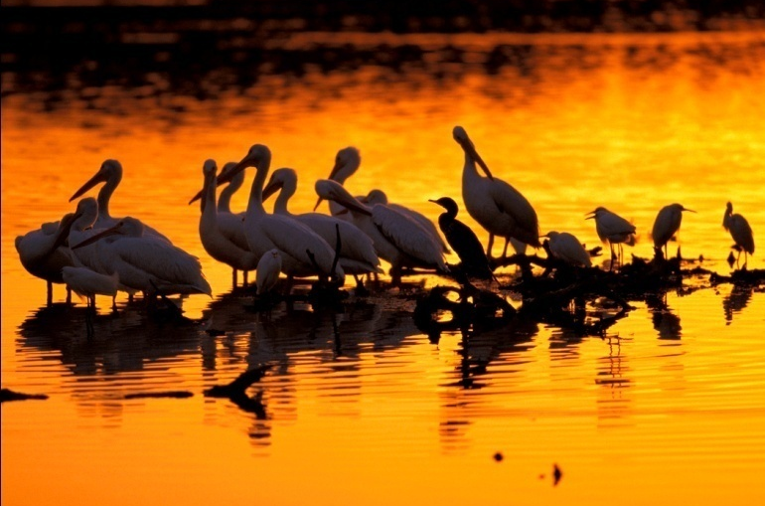

Effects of Global Warming
Rising Sea Level
Increased Temperature
Habitat Damage and
Species Affected
Changes in Water Supply

Slide 10
Why is global warming happening?

Slide 11
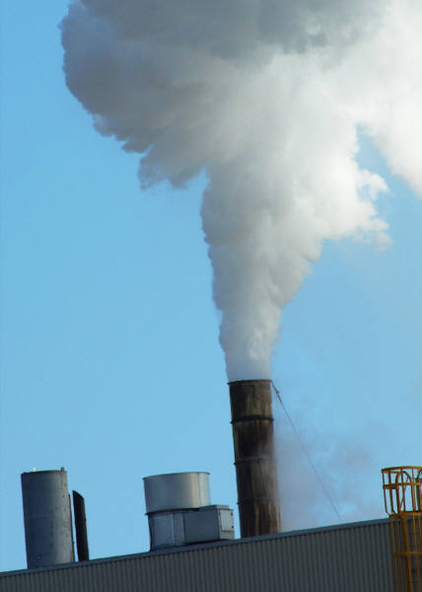
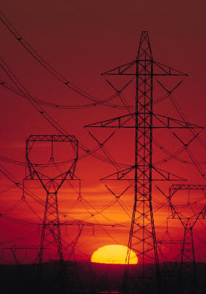
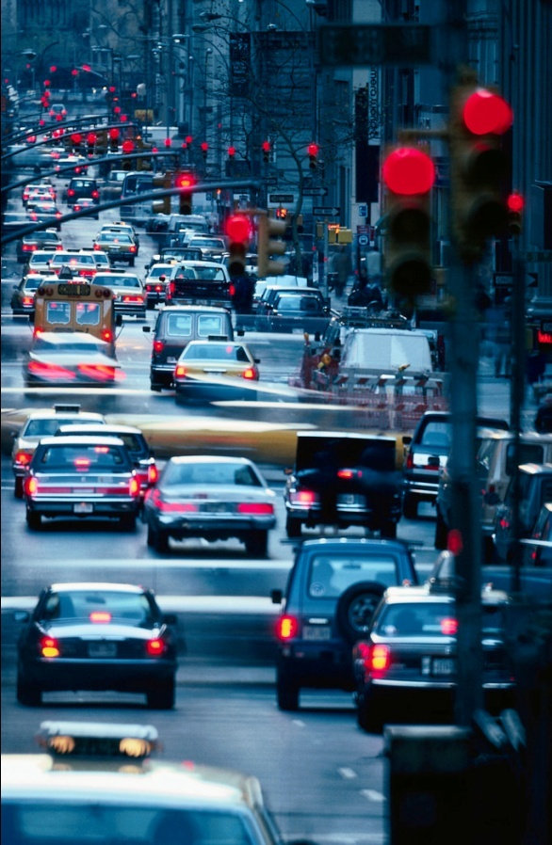
Burning of Fossil Fuels
Pollution from coal, natural gas, and oil
Pollution from coal, natural gas, and oil
Pollution from coal, natural gas, and oil

Slide 12

We can stop global warming!
Notes:
Scientists agree that the burning of fossil fuels is causing global warming. Since these fuels are burned for energy, and everyone uses energy, everyone can help stop global warming just by using less energy or energy from renewable sources!

Slide 13


Simple Things To Do
Turn off your computer or the TV
when you’re not using it.
Take shorter showers. Heating water uses energy.
Keep rooms cool by closing the blinds, shades, or
curtains.
Turn off the lights when you leave a room.
Use compact fluorescent bulbs.

Slide 14


Simple Things To Do
Dress lightly when it’s hot instead of turning up
the air conditioning. Or use a fan.
Dress warmly when it’s cold instead of turning
up the heat.
Offer to help your parents keep the air filters on
your AC and furnace clean.
Walk short distances instead of asking for a
ride in the car.
Plant a tree.
Recycle.

Slide 15
Conclusion
There is very little doubt that global warming will change our climate in the next century. So what are the solutions to global warming? First, there must be an international political solution.
Second, funding for developing cheap and clean energy production must be increased, as all economic development is based on increasing energy usage.
We must not pin all our hopes on global politics and clean energy technology, so we must prepare for the worst and adapt. If implemented now, a lot of the costs and damage that could be caused by changing climate can be mitigated.

Slide 16
Reference
www.google.com
www.wikipedia.com
www.studymafia.org
www.pptplanet.com

Slide 17
Thanks

