Slide 1
www.studymafia.org
Seminar
On
Communication Skills
Submitted To: Submitted By:
www.studymafia.org www.studymafia.org

Slide 2
CONTENT
Meaning of Communication
What makes a good communicator?
Process
Communication game
What did we learn?
Active listing
Six ways of using non-verbal communication skills effectively
Effective presentation skills
Reference

Slide 3
COMMUNICATION - MEANING
Communication is a dynamic process…
through this process we convey a thought or feeling to someone else.
how it is received depends on a set of events, stimuli, that person is exposed to.
how you say what you say plays an important role in communication.

Slide 4
WHAT MAKES A GOOD COMMUNICATOR?
An Active Listener,
An Effective Presenter,
A Quick Thinker.
A Win-Win Negotiator.

Slide 5
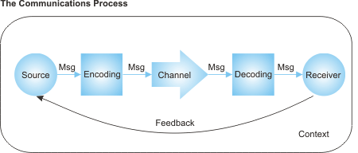
PROCESS OF COMMUNICATION

Slide 6
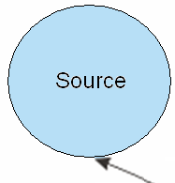
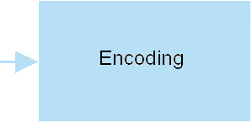
PROCESS OF COMM…(cntd…)
Source:
Why to communicate?
What to communicate?
Usefulness of the communication.
Accuracy of the Information to be communicated.
Encoding:
The process of transferring the information you want to communicate into a form that can be sent and correctly decoded at the other end.
Ability to convey the information.
Eliminate sources of confusion. For e.g. cultural issues, mistaken assumptions, and missing information.
Knowing your audience.

Slide 7
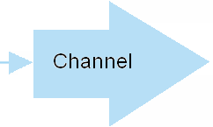
PROCESS OF COMM…(cntd…)
Verbal Communication Channels
Face-To-Face meetings,
Telephones,
Video Conferencing.
Written Communication Channels
Letters,
e-Mails,
Memos,
Reports.

Slide 8
PROCESS OF COMM…(cntd…)
Strengths and Weaknesses
Verbal Communication:
Strength - Role of Body Language.
Weakness - Not possible to give long list of directions
Written Communication:
Strength - A proof of a communication
Weakness - Written words does not show a person’s actual feelings.

Slide 9
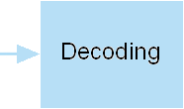
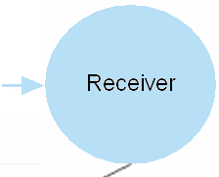
PROCESS OF COMM…(cntd…)
EFFECTIVE DECODING:
Listen actively,
Reading information carefully,
Avoid Confusion,
Ask question for better understanding.
The audience or individuals to whom we are sending the information.
THE INFLUENCE FOR RECEIVER:
The prior knowledge can influence the receiver’s understanding of the message.
Blockages in the receiver’s mind.
The surrounding disturbances.

Slide 10
PROCESS OF COMM…(cntd…)
FEEDBACK:
Feedback can be:
Verbal Reactions and Non-Verbal Reactions.
Positive feedback and Negative feedback.

Slide 11
PROCESS OF COMM…(…end)
CONTEXT:
Various Cultures (Corporate, International, Regional, etc),
Language,
Location or Place (Restaurant, Office, Auditorium, Room, etc).
Situation
The sender needs to communicate the context to the receiver for better clarity in the communication process.

Slide 12
COMMUNICATION GAME # 1
RULE:
Make a group of Four.
Sequentially assign a number to every individual.
1 representative Pick up on chit from the lot.
Memorize the sentence and return the chit.
Go back and utter the sentence to the 2nd person.
No one else should hear the sentence.
Then the 2nd person should utter it to the 3rd person and so on.
The last person should announce the sentence to all.
And 1st person reads the chit.

Slide 13
WHAT DID WE LEARN?
Only verbal communication can create chaos while it reaches the last person.
Every person’s thought process influences the individual understanding.
So be an active listener......

Slide 14
ACTIVE LISTENING
Few tips towards Active Listening:
Understand your own communication style.
Be an active listener.
Use normal communication.
Give Feedback

Slide 15
ACTIVE LISTENING…(cntd…)
1. Understand your own communication style:
High level of self-awareness to creating good & long lasting impression on others.
Understand how others perceive you.
Avoid being CHAMELEON by changing with every personality you meet.
Make others comfortable by selecting appropriate behavior that suits your personality while listening. (Ideally nodding your head).

Slide 16
ACTIVE LISTENING…(cntd…)
2. Be An Active Listener:
People speak @ 100 to 175 WPM but can listen intelligently @ 300 WPM.
One part of human mind pays attention, so it is easy to go into mind drift.
Listen with a purpose.
Purpose can be to gain information, obtain directions, understand others, solve problems, share interest, see how another person feels, show support, etc.
If it is difficult to concentrate then repeat the speakers words in your mind.

Slide 17
ACTIVE LISTENING…(cntd…)
3. Use Non-verbal Communication:
Smile,
Gestures,
Eye contact,
Your posture.

Slide 18
ACTIVE LISTENING…(cntd…)
4. Give Feedback
Remember that what someone says and what we hear can be amazingly different.
Repeat back or summarize to ensure that you understand.
Restate what you think you heard and ask, "Have I understood you correctly?"

Slide 19
SIX WAYS OF USING NON-VERBAL COMMUNICATION SKILLS EFFECTIVELY
Some major areas of nonverbal behaviors to explore are:
Eye contact
Facial expressions
Gestures
Posture and body orientation
Proximity
Paralinguistic
Humor

Slide 20
SIX WAYS OF …(cntd…)
EYE CONTACT:
Eye is an direct and most expressive part of our body.
Different ways of Eye Contact
Direct Eye Contact: (Shows confidence)
Looking downwards (Listening carefully or Guilty)
Single raised eyebrow (Doubting)
Both raised eyebrows (Admiring)
Bent eyebrows (Sudden focus)
Tears coming out (Emotional either happy or hurt)
………and many more

Slide 21
SIX WAYS OF …(cntd…)
FACIAL EXPRESSION:
Smile covers the most part of facial expression:
Smiling is a powerful cue that transmits:
Happiness
Friendliness
Warmth
Liking
Affiliation

Slide 22
SIX WAYS OF …(cntd…)
GESTURES:
If you fail to gesture while speaking, you may be perceived as boring, stiff and unanimated.
A lively and animated teaching style captures students' attention, makes the material more interesting, facilitates learning and provides a bit of entertainment.
Head nods, a form of gestures, communicate positive reinforcement to students and indicate that you are listening.

Slide 23
SIX WAYS OF …(cntd…)
POSTURE AND BODY ORIENTATION:
You communicate numerous messages by the way you walk, talk, stand and sit.
Standing erect, but not rigid, and leaning slightly forward communicates to students that you are approachable, receptive and friendly.
Furthermore, interpersonal closeness results when you and your students face each other.
Speaking with your back turned or looking at the floor or ceiling should be avoided; it communicates disinterest to your class.

Slide 24
SIX WAYS OF …(cntd…)
PROXIMITY:
Cultural norms dictate a comfortable distance for interaction with audience.
You should look for signals of discomfort caused by invading young audience‘s space.
Some of these are:
Rocking,
Leg swinging,
Tapping,
Gaze aversion,
To counteract this, move around the classroom to increase interaction with your students. Increasing proximity enables you to make better eye contact and increases the opportunities for students to speak.

Slide 25
SIX WAYS OF …(cntd…)
Paralinguistic : This facet of nonverbal communication includes such vocal elements as: - Tone - Pitch - Rhythm - Timbre - Loudness - Inflection

Slide 26
FEW FACTS
- You have over 630 muscles in your body. - Eye muscles are the busiest muscles in the body. Scientists estimate they may move more than 100,000 times a day. - You have over 30 muscles in your face to help you smile or frown. It takes 17 muscles to smile and 43 to frown. SO SMILE EVERYTIME YOU SEE SOMEONE. - The strongest muscle in your body is your tongue. USE IT EFFECTIVELY. - It takes the interaction of 72 different muscles to produce human speech.

Slide 27
EFFECTIVE PRESENTATION SKILLS
Presentation Skills while appearing for an interview.
Your Dressing sense (Males & Females),
Documents needed to be carried,
Your body language (while standing, while sitting, while walking),
Your attitude (Soberness, Soft words, avoid western accent),
Your Confidence (while talking, body movements, aggression, etc).

Slide 28
Reference
www.google.com
www.wikipedia.com
www.studymafia.org

Slide 29
Thanks

