Slide 1
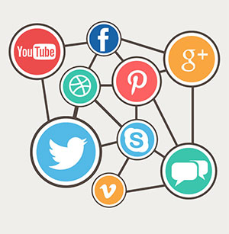
www.studymafia.org
Seminar
On
Social Media
Submitted To: Submitted By:
www.studymafia.org www.studymafia.org
Notes:
1
1

Slide 2
Content
Introduction
What is Social Media?
Why social media is important in our life?
How Social Media Works
Some Examples of Social Media
Types of Social Media

Slide 3
Content Cont.
7 functions of social media?
Is social media good or bad for students?
Business applications of social media
Advantages
Disadvantages
Conclusion

Slide 4
Introduction
Social media is a medium that is growing quite prevalent nowadays because of its user-friendly characteristics.
Social media platforms like Facebook, Twitter, Instagram, etc are allowing people to unite with each other across distances.
In other words, the entire world is at just one touch finger touch away and wholly thanks to social media. Today’s generation is particularly one of the most aggressive users of social media.

Slide 5
What is Social Media?
Social Media can be defined as an array of internet-based platforms, which promotes and enhance the sharing of information.
Some of the most common types of social media are websites and applications focused to microblogging, forums, social bookmarking, social creation, social networking and Wikipedia. Conclusion

Slide 6
Why social media is important in our life?
Social Media can be defined as an array of internet-based platforms, which promotes and enhance the sharing of information.
Some of the most common types of social media are websites and applications focused to microblogging, forums, social bookmarking, social creation, social networking and Wikipedia. Conclusion

Slide 7
How Social Media Works
Social media sites start with a user creating a profile, usually by providing a name and an email address.
Once a profile has been created, users can create and share content. For instance, an Instagram user with a new account can take a picture and share it on their profile with a caption.
Social media often uses "feeds" that allow users to scroll through content.

Slide 8
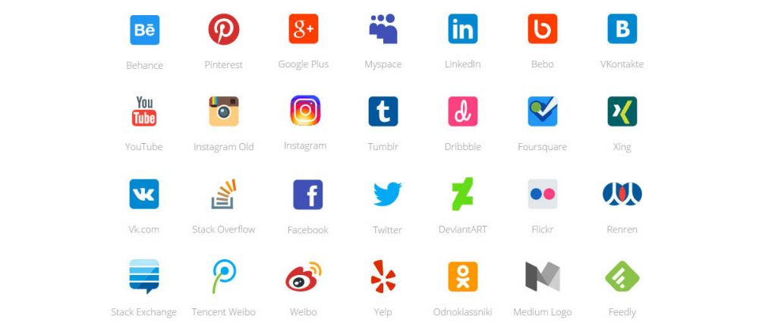
Some Examples of Social Media

Slide 9
Types of Social Media
1. Social News The users are allowed to post news links to the outside articles on the social news websites. A most prominent example of this type of social media channel is Reddit.
2. Social Networks The users are allowed to connect and share with the people having similar interests and backgrounds on a social networking website. The most example of a social networking site is Facebook.

Slide 10
Types of Social Media Cont.…..
3. Media Sharing The users can share different types of media such as video and photos on the media share websites. The most popular media sharing website in the world is YouTube.
4. Bookmarking Sites The users are allowed to save and organize links to several online websites and resources on these websites. The most popular bookmarking site in the world is StumbleUpon.

Slide 11
7 functions of social media?
Identity
Conversations
Sharing,
Presence
Relationships
Reputation
Groups

Slide 12
Is social media good or bad for students?
School students are very young and their minds are not much developed hence they cannot differentiate between good and bad.
They can easily get influenced and distracted. It might also lead to biased, prejudiced views about people or issues they hardly have any knowledge of.

Slide 13
Business applications of social media
Social media analytics - the practice of gathering data from blogs and social media websites and analyzing that data to make business decisions. The most common use of social media analytics is to mine customer sentiment to support marketing and customer service activities.
Social CRM (customer relationship marketing) - can be a powerful business tool. For example, establishing a Facebook page allows people who like a brand to like their page, which creates avenues for communication, marketing and networking..

Slide 14
Business applications of social media Cont.……
Social media marketing (SMM) - takes advantage of social networking to help a company increase brand exposure and broaden customer reach. The goal is usually to create content compelling enough that users will share it with their social networks.
Enterprise social networking allows a company to connect individuals who share similar business interests or activities. Internally, social tools can help employees access information and resources they need to work together effectively and solve business problems.

Slide 15
Advantages
Compelling and relevant content will grab the attention of potential customers and increase brand visibility
You can respond almost instantly to industry developments and become heard in your field
It can be much cheaper than traditional advertising and promotional activities
Social content can indirectly boost links to website content by appearing in universal search results, improving search traffic and online sales

Slide 16
Disadvantages
You will need to commit resources to managing your social media presence, responding to feedback and producing new content
It can be difficult to quantify the return on investment and the value of one channel over another
Ineffective use - for example, using the network to push for sales without engaging with customers, or failing to respond to negative feedback - may damage your reputation

Slide 17
Conclusion
The use of social media aims to improve public perception, but the Trust’s campaigns have also shown savings in time and money.
For example, each recruitment campaign by the Trust used to take about 53 days and cost around £2,400 per person hired. By using social media, costs have now been reduced to about £800 per person hired and the time taken to recruit is down to 42 days.

Slide 18
References
www.google.com
www.wikipedia.com
www.studymafia.org
www.pptplanet.com

Slide 19
Thanks

