Slide 1
www.studymafia.org
Seminar
On
Computational Fluid Dynamics(CFD)
Submitted To: Submitted By:
www.studymafia.org www.studymafia.org
Notes:
1
1

Slide 2
Contents
What is Computational Fluid Dynamics(CFD)?
Why and where use CFD?
Physics of Fluid
Grids
Boundary Conditions
Numerical Staff
Applications
Advantage
Limitation

Slide 3
What is CFD?
Computational fluid dynamics (CFD) is the science of predicting fluid flow, heat transfer, mass transfer, chemical reactions, and related phenomena by solving the mathematical equations which govern these processes using a numerical process
➔ We are interested in the forces (pressure , viscous stress etc.) acting on surfaces (Example: In an airplane, we are interested in the lift, drag, power, pressure distribution etc)
➔ We would like to determine the velocity field (Example: In a race car, we are interested in the local flow streamlines, so that we can design for less drag)
➔ We are interested in knowing the temperature distribution (Example: Heat transfer in the vicinity of a computer chip)

Slide 4
What is CFD?
Fluid
Problem
Comparison&Analysis
Fluid Mechanics
C
F
D
Simulation Results
Physics of Fluid
Mathematics
Computer
Navier-Stokes Equations
Computer Program
Programming
Language
Numerical
Methods
Geometry
Discretized Form
Grids
Notes:
Now, let’s see what is CFD.
Firstly, we have a fluid problem.
To solve this problem, we should know the physical properties of fluid by using Fluid Mechanics.
Then we can use mathematical equations to describe these physical properties. This is Navier-Stokes Equation.
The Navier-Stokes Equation is analytical. Human can understand it and solve them on a piece of paper. But if we want to solve this equation by computer, we have to translate it to the discretized form.The translators are numerical discretization methods, such as Finite Difference, Finite Element methods.
Consequently, we also need to divide our whole problem domain into many small parts because our discretization is based on them.
Then, we can write programs to solve them. The typical languages are Fortran and C.
Running the programs on workstation or supercomputer. At the end, we cam get our simulation results.
We can compare and analyze the simulation results with experiments or the real problem. If the results are not sufficient to solve the problem, we have to repeat the process until find satisfied solution.
This is CFD.

Slide 5
Why use CFD?
 | Simulation(CFD) | Experiment
Cost | Cheap | Expensive
Time | Short | Long
Scale | Any | Small/Middle
Information | All | Measured Points
Repeatable | All | Some
Security | Safe | Some Dangerous
Notes:
We have known what is CFD. Now, let’s see why we use CFD?
Here is a comparison table of Simulation and Experiment. From this table, we can see that
Simulation is much cheaper that experiment because we do not need to buy the expensive experiment equipments.
We can get the results in short time with CFD.
We can do simulation for any scale of problem. For example, from the small bubbles to weather of earth. But experiment can only work for the small or middle size object.
From Simulation, we can get any information we need.But in experiment, we can only obtain data from the measured point.
Simulation is very easy to repeat, we only need to run the program again. But experiment is not so easy, especially the combustion,explosions. They are unrepeatable.
Some experiment are very dangerous, for example, pollution and radiation. But if we use Simulation, it is very safe.
###################
As you see, CFD has many advantages,. Some body may say, we do not need experiments any more, CFD is enough. This is wrong. We still need experiment to validate the simulation results. The improvement is that In the previous time, we needed hundreds experiments. Now we can firstly do simulations, at the end, do one or two experiments to validate.

Slide 6
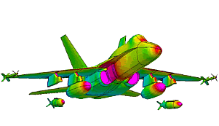
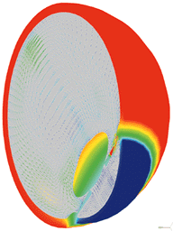
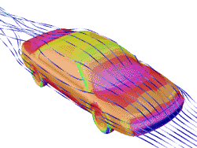
Where use CFD?
Aerospace
Aerospace
Automotive
Biomedical
Chemical Processing
HVAC
Hydraulics
Power Generation
Sports
Marine
Biomedicine
Automotive
Temperature and natural convection currents in the eye following laser heating.
Notes:
Now, let me show you some applications of CFD.
Aerospace is a very important CFD application field. For example, the design of airplane.
Automotive is another important field. This picture show the streamlines of a car.
Biomedicine is a new field for CFD. This graph shows the the temperature and natural convection currents in the eye following laser heating.

Slide 7
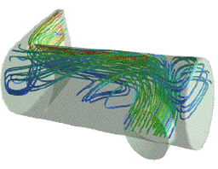
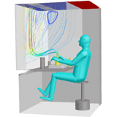
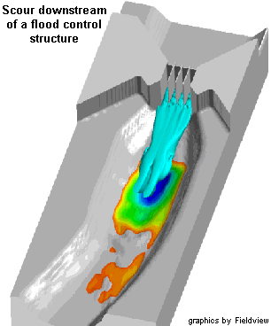
Where use CFD?
Chemical Processing
Aerospacee
Automotive
Biomedical
Chemical Processing
HVAC(Heat Ventilation Air Condition)
Hydraulics
Power Generation
Sports
Marine
reactor vessel - prediction of flow separation and residence time effects.
Hydraulics
HVAC
Streamlines for workstation ventilation
Notes:
Chemical industry is another important CFD application field. This graph show - prediction of flow separation and residence time effects in Polymerization reactor vessel.
This graph shows the streamlines of a workstation. This is very useful for Heat Ventilation Air Condition.
This graph shows the application in Hydraulics.

Slide 8
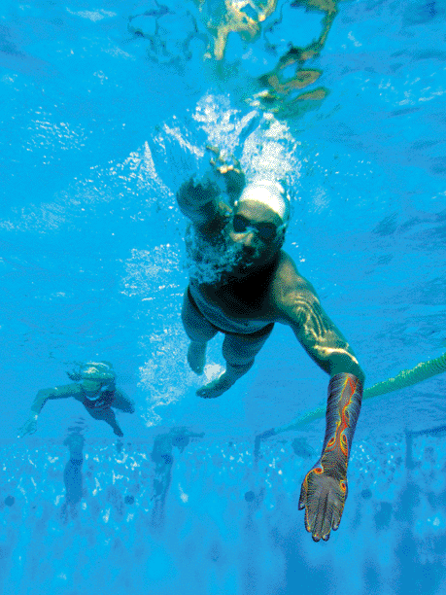
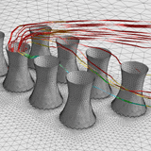
Where use CFD?
Sports
Power Generation
Aerospace
Automotive
Biomedical
Chemical Processing
HVAC
Hydraulics
Power Generation
Sports
Marine
Flow around cooling towers
Marine
Notes:
We can also use CFD to improve the techniques of swimming.
Improve the design of Power Factory and ship.

Slide 9
Physics of Fluid
Fluid = Liquid + Gas
Density ρ
Viscosity μ:
resistance to flow of a fluid
Substance | Air(18ºC) | Water(20ºC) | Honey(20ºC)
Density(kg/m³) | 1.275 | 1000 | 1446
Viscosity(P) | 1.82e-4 | 1.002e-2 | 190
Notes:
The applications of CFD are very interesting. How can we get this results? Firstly, we should know the physics of fluid.
The first thing we should make clear is what is fluid. Fluid is liquid and gas, for example, water and air.
Fluid has some important properties, for example, Pressure, velocity, temperature and mass. Here I want to emphasis two properties.
The first one is density. In fluid mechanics, if density is constant, we call is fluid is incompressible fluid. Sometimes, if the change of the density is very small, we can also treat the fluid as incompressible fluid. For example, water.
If density is variable, we call the fluid is compressible. For example, air is compressible fluid.
Later on we will see the mathematical equation for incompressible fluid is much simples than compressible fluid.
Another important property is viscosity. Viscosity is an internal property of a fluid that offers resistance to flow. For example, to stir water is much easier than stir honey because the viscosity of water is much small than honey.
This table shows the density and viscosity of air, water and honey.

Slide 10
Conservation Law
in
M
out
Mass
Momentum
Energy
Notes:
To describe the physical properties by mathematics, we need a conservation law.
This picture shows the principle of conservation law. The change of the mass is equal to the mass flow in minus mass flow out.
If the mass flow in is equal to mass flow out, then the change of mass is zero.
Actually, the conservation law is not only for mass, but also for momentum and energy.

Slide 11
Discretization
Discretization
Analytical Equations
Discretized Equations
Discretization Methods
Finite Difference
Straightforward to apply, simple, sturctured grids
Finite Element
Any geometries
Finite Volume
Conservation, any geometries
Notes:
We have get Navier-Stokes equations. But these equations are analytical equations. Human can understand and solve, but computer can not.
So we need to translate them to the forms which computer can understand. This process is discretization.
The typical discretization methods are Finite Difference, Finite Element and Finite volume methods.
Here I will introduce finite volume method for you.

Slide 12
Finite Volume I
General Form of Navier-Stokes Equation
Local change with time
Flux
Source
Integrate over the
Control Volume(CV)
Integral Form of Navier-Stokes Equation
Local change
with time in CV
Flux Over
the CV Surface
Source in CV
Notes:
The Navier-Stokes euqations can be written as this general form. If we set busai equal 1, we can get continuity equation, busai equal to Uj, we get momentum equation, pusai equal to T, then we can get energy equation.
If we integrate over the Control Volume, we call it CV. Using Gauss theory, we can get the Volume Integral Form of Navier –Stokes Equation like this.
The first volume integral is local in control volume, the second is flux over the surface of control volume. The right hand side is the source term.
Next step, we should find the method how to approximate the volume integral and surface integral.

Slide 13
Finite Volume II
Conservation of Finite Volume Method
A
B
A
B

Slide 14
Finite Volume III
Approximation of Volume Integrals
Approximation of Surface Integrals ( Midpoint Rule)
Interpolation
Upwind
Central
Notes:
Firstly, let’s see the volume integral.
Here, I introduce the simplest approach. It is first order approach. If we want higher accuracy, we can use more complex methods.
For example, we want to get the mass of CV. It is the integral of density by volume. We can use the density of the center point time the volume of CV to approximate it. If the density is constant, which means the flow is incompressible, then this approach is exact approach. The other example is the momentum of CV. We still use the value of center point.
To approach the surface integral, I also introduce a simple method. It is midpoint rule, it is second order method.
For 2D case, the pressure integral at surfaces id the sum of 4 surfaces. Then we can use the pressure at the midpoint of side times length of side instead of do integral along the side.
Then another problem comes out. Our variable are stored at the center of control volume, how can we get the value at the border?
We can use interpolation to realize it.

Slide 15
Discretization of Continuity Equation
One Control Volume
Whole Domain
Notes:
Firstly, let’s see the volume integral.
Here, I introduce the simplest approach. It is first order approach. If we want higher accuracy, we can use more complex methods.
For example, we want to get the mass of CV. It is the integral of density by volume. We can use the density of the center point time the volume of CV to approximate it. If the density is constant, which means the flow is incompressible, then this approach is exact approach. The other example is the momentum of CV. We still use the value of center point.
To approach the surface integral, I also introduce a simple method. It is midpoint rule, it is second order method.
For 2D case, the pressure integral at surfaces id the sum of 4 surfaces. Then we can use the pressure at the midpoint of side times length of side instead of do integral along the side.
Then another problem comes out. Our variable are stored at the center of control volume, how can we get the value at the border?
We can use interpolation to realize it.

Slide 16
Discretization of Navier-Stokes Equation
FV Discretization of Incompressible N-S Equation
Unsteady
Convection
Diffusion
Source
Time Discretization
Explicit
Implicit
Notes:
If we use finite volume method for the all domain, we get a matrix system for Navier-Stokes Equation. Here is the Finite Volume discretization of Incompressible N0S Equation.
Omiga .. Is unstaedy term, …..
Especially the unsteady term is changing with time, we need time discretization for this term. There are two ways: explicit and implicit.
If we want to get the value of du/dt at time n+1, we can only use the value of u at time n. This is explicit method.
If we use the value at both previous and current time step, it is implicit method.
Explicit method is very stable, but slow. Implicit method is much faster, but not always stable.

Slide 17
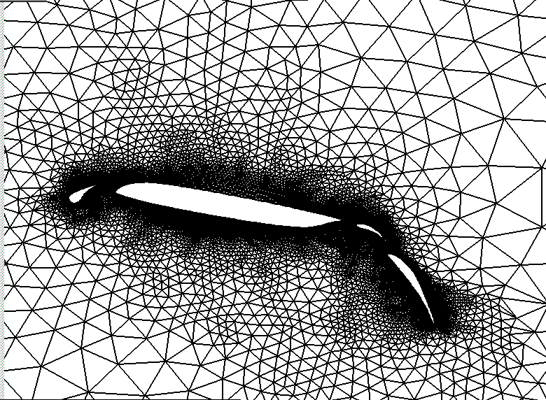
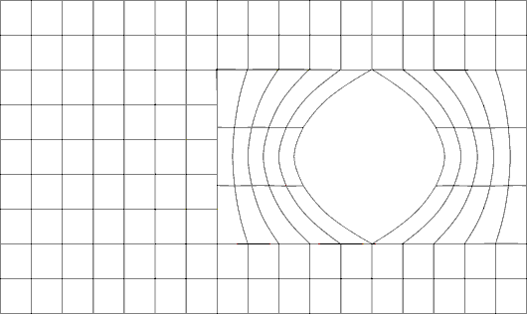
Grids
Structured Grid
+ all nodes have the same number of elements around it
only for simple domains
Unstructured Grid
+ for all geometries
irregular data structure
Block Structured Grid
Notes:
From finite volume method, we know that we need to divide the whole problem domain into many small domains, then integrate at these small domains. This is Gird Generation
We have 3 methods to generate the grids.
The simplest one is structured grid. This type of grids, all nodes have the same number of elements around it. We can describe and store them easily. But this type of grid is only for the simple domain.
If we have a complex domain, we can use unstructured grid. For example, this is a complex object. The flow near the object is
very important and complex, we need very fine grid at this region. Far away from the airfoil, the flow is comparably simple, so we can use coarse grid.
Generally, unstructured grid is suitable for all geometries, it is very popular in CFD. The disadvantage is that because the data structure is irregular, it is more difficult to describe and store them.
Block structure grid is a compromising of structured and unstructured grid. The idea is, firstly, divide the domain into several blocks, then use different structured grids in different blocks.

Slide 18
Boundary Conditions
Typical Boundary Conditions
No-slip(Wall), Axisymmetric, Inlet, Outlet, Periodic
No-slip walls: u=0,v=0
Inlet ,u=c,v=0
Outlet, du/dx=0
dv/dy=0,dp/dx=0
r
o
x
v=0, dp/dr=0,du/dr=0
Axisymmetric
Periodic boundary condition in spanwise direction of an airfoil
Notes:
To solve the equation system, we also need boundary conditions.
The typical boundary conditions in CFD are No-slip boundary condition, Axisymmetric boundary condition, Inlet, outlet boundary condition and Periodic boundary condition.
For example, there is a pipe, the flow comes in from the west, comes out from the east side. So we can use inlet at the west side, which means we can set the velocity manually.
At the west side, we use outlet boundary condition to keep all the properties constant at x direction, which means the gradient is zero.
At the wall of pipe, we can set the velocity is zero, this is no-slip boundary condition.
At the center of pipe, we can use axisymmetric boundary condition.
Periodic boundary condition is

Slide 19
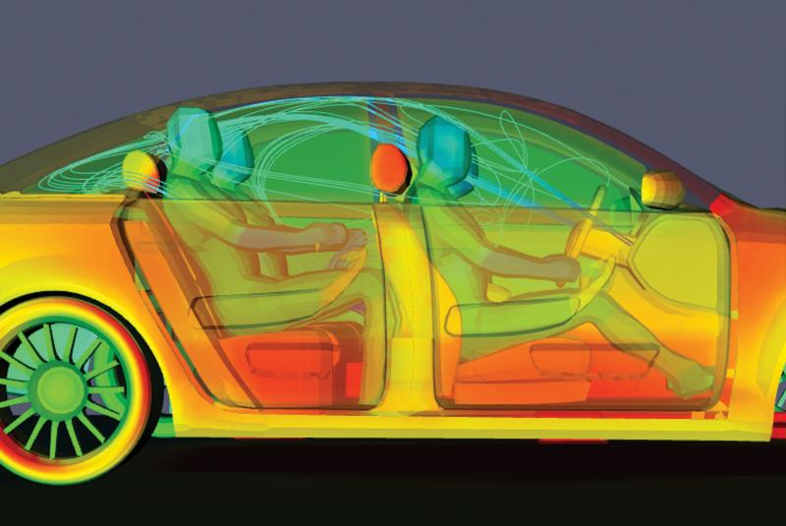
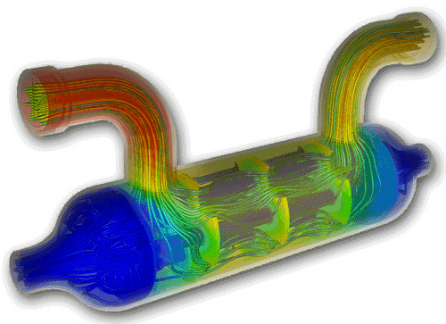
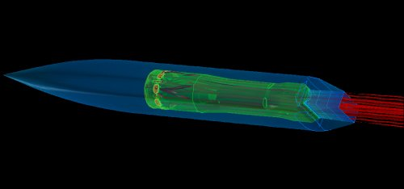
Applications
Car safety thermal imaging using CFD
Heat exchanger imaging
Imaging of missile prototypes

Slide 20
Advantages
Relatively low cost.
CFD simulations are relatively inexpensive, and costs are likely to decrease as computers become more powerful.
Speed.
CFD simulations can be executed in a short period of time.
Ability to simulate real conditions.
CFD provides the ability to theoretically simulate any physical condition.
Comprehensive information.
CFD allows the analyst to examine a large number of locations in the region of interest, and yields a comprehensive set of flow parameters for examination.

Slide 21
Limitations
The CFD solutions can only be as accurate as the physical models on which they are based.
Solving equations on a computer invariably introduces numerical errors.
Round-off error: due to finite word size available on the computer. Round-off errors will always exist (though they can be small in most cases).
Truncation error: due to approximations in the numerical models. Truncation errors will go to zero as the grid is refined. Mesh refinement is one way to deal with truncation error.
Boundary conditions.
As with physical models, the accuracy of the CFD solution is only as good as the initial/boundary conditions provided to the numerical model.

Slide 22
References
www.google.com
www.wikipedia.com
www.studymafia.org
www.pptplanet.com

Slide 23
Thanks

