Slide 1
www.studymafia.org
Seminar
On
Jet Engine
Submitted To: Submitted By:
www.studymafia.org www.studymafia.org
Notes:
1
1

Slide 2
Index
Introduction
History of jet engine
Parts of jet engine
How a get engine works
Types of jet engine
Comparison of Turbo Jet
Jet engines Vs Rockets
Difficulties
Suggestion for improvement
Merit and Demerits
Jet engine uses
Conclusion
References

Slide 3
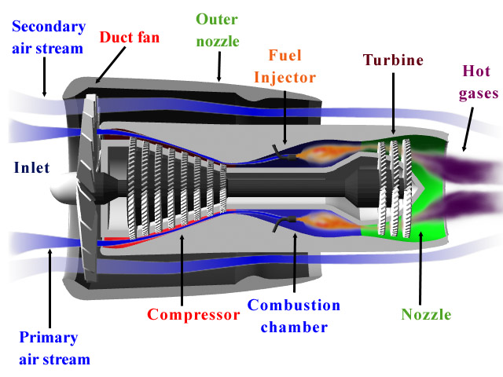
introduction
Jet engine is nothing but a gas turbine.
It works under the principle of Newton's 3rd law.
it stats that “for every acting force there is an equal and opposite force”.
Gas turbine operates like toy balloon.

Slide 4
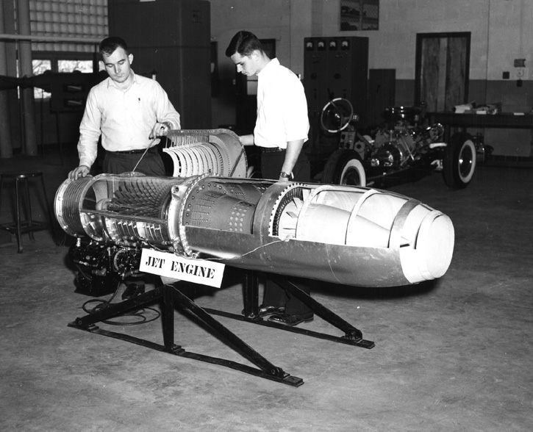
History of jet engine
The first jet engine was built by Egyptian scientists during 100 BC.
These device was know as Aeolipile.
Dr.hans von ohain and sir frank whittle were the main developers.

Slide 5
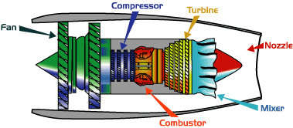
Parts of jet engine
Fan
Compressor
Combustor
Turbine
Mixer
Nozzle

Slide 6
How a jet engine works
Jet engine move the airplane forward with a great force that is produced thrust and cause the plane to fly very fast.
Fuel Burner
Fuel is mixed with the air , and electric spark light the air, cause it to combust.
Air intake
Sucked in by the compressor.
Compressor
series of vanes and stators.
The vanes rotate, while the stator remains stationary.
Compressor speed and temperature increases gradually .
Combustion chamber
The air is burst.
Increase in the temperature of the air, thus increase in pressure inside the engine.

Slide 7
Continued….
Turbine
Works like a windmill
The blades gain energy from the hot gassed moving past them.
This movement is used to power the compressor.
Jet pipe and propelling nozzle
the hot air rushes out the nozzle.
High pressure
Hot air russes out at very high speed.

Slide 8
TYPES OF JET ENGINE
Ramjet
Turbojet
Turbofan
Turboprop
Turboshaft

Slide 9
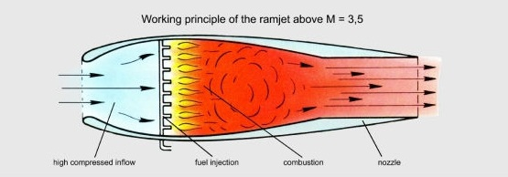
RAMJET
It has no moving parts.
Its compression ratio depend upon forward speed.
It has no static thrust. Guided-missile system , space vehicle use this type of jet.

Slide 10
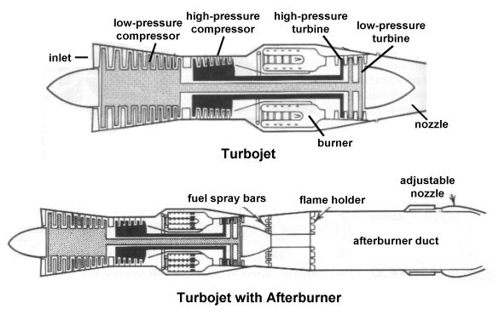
Turbo Jet
The turbo engine is a reaction engine .
Substantial increase in thrust can be obtained by employing an afterburner.

Slide 11
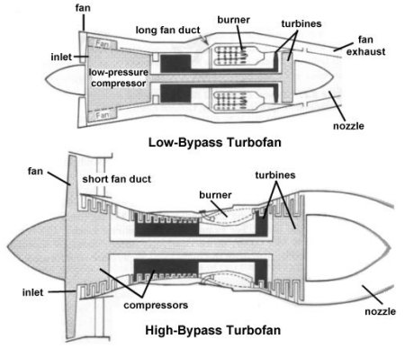
Turbofan
The objective of the sort of bypass system is to increase thrust without increasing fuel consumption.
It achieves this by increasing the total air-mass flow and reducing the velocity within the same total energy supply

Slide 12
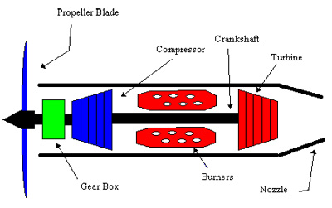
Turboprop
A turboprop is a jet engine attached to a propeller.
Modern turboprop engine are equipped with propeller that have a smaller diameter but a large number of a blades for efficient operation at much higher flight speed.

Slide 13
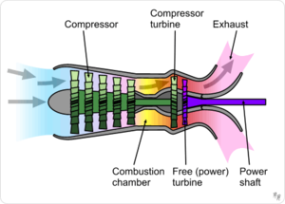
Turboshaft
It doesn't have a propeller.
It provide power for a helicopter rotor.
It permits the rotor speed to be kept constant even when the speed of the generator is varied.

Slide 14
Jet Engine Vs Rockets
Jet Engine | Rockets
Oxygen from atmosphere for combustion. | Carry their own for combustion.
Work only in atmosphere. | Work in vacuum and atmosphere.
Liquid fuel. | Liquid and solid fuel.
Complex structure. | Simple structure.
High efficiency. | Low efficiency.

Slide 15
Suggestion for improvement
Employ active cooling.
Designing better materials and alloys which retain strength at high temperature .
Smart structures – Structure and material which changes their shapes and properties in flight.
Design engines which switch from scramjet to ramjet.

Slide 16
Merits and Demerits
Merits of jet engine over IC engine
Mechanical efficiency of jet engine is high as compared to IC engine.
Weight and speed of jet engine per HP developed is higher then IC engine.
Ignition and lubricating system are much simpler in jet engine then IC engine.
Demerits of jet engine over IC engine
Thermal efficiency of jet engine is low compared to IC engine.
Difficult to start.
Turbine blades need a special cooling system due high temperature.

Slide 17
Jet engine uses
The industry they’re most prominent in is the transport industry ,where they are used to propel aircraft, boats, and in some one of creations such as a turbojet power truck.
The first use of the jet engine was to power military aircraft.
The Bell P-59A Airacomet was also developed by the Americans. They had a massive advantage over propeller driver planes , in that they were much faster.
The General electric company used a “turboprop” jet engine to run an electric generator.
The jet engine is not only used on aircraft but on boats , where water jet are used to propel the boat forward

Slide 18
Conclusion
Normal type of jet engine is used to domestic purpose i.e. Traveling , carrying goods etc.
Ram and scram type of jet engine used in only in defence sector. Because it travels at supersonic speed and generally high level of training is required.
Since it travels at such a speed it is can not used for travelling.
So that common type of jet engines are very common in use.

Slide 19
References
www.google.com
www.wikipedia.com
www.studymafia.org

Slide 20
THANKS

