Slide 1
Cloud Storage

Slide 2
Content
Introduction
What is cloud storage?
How does cloud storage work?
Cloud Storage - Business Benefits
What does it cost to users?
Types of Cloud Storage
Advantages of Cloud Storage
Disadvantages of Cloud Storage
Conclusion
References

Slide 3
Introduction
Cloud storage is a model of data storage in which the digital data is stored in logical pools, the physical storage spans multiple servers (and often locations), and the physical environment is typically owned and managed by a hosting company.

Slide 4
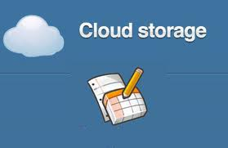
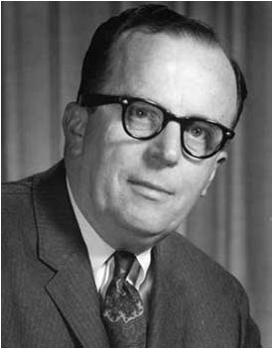
What is cloud storage?
History
J.C.R. Licklider – One of the fathers of the cloud based computing idea.
Global network that allows access from anywhere at anytime.
Technological limits of the 60’s.
Concept
Cloud storage is a service model in which data is maintained, managed and backed up remotely and made available to users over a network (typically the Internet).

Slide 5
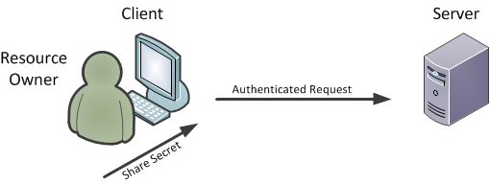
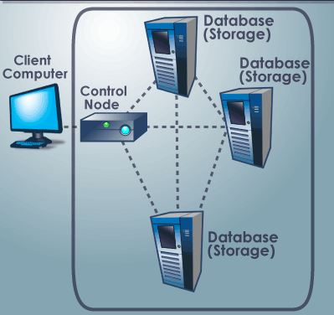
How does cloud storage work?
Redundancy
Core of cloud computing
Equipment
Data servers
Power supplies
Data files
Replication

Slide 6
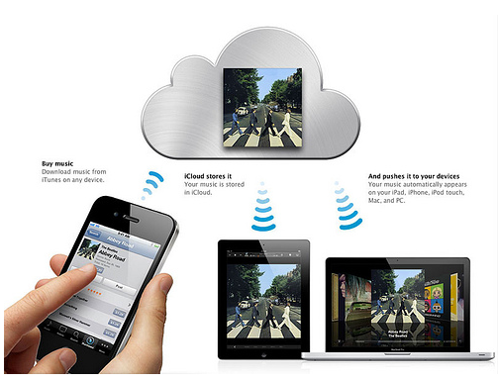
Cloud Storage - Personal Use Benefits
iCloud
iCloud is a service provided by Apple
5GB storage space is free of cost
Once the iCloud is used you can share your stored data on any of your different Apple devices
Aceess to all files, music, calendar, email
Only iOS 5 has iCloud installed

Slide 7
Cloud Storage - Business Benefits
With cloud storage, there's no need for CDs, external hard drives, or localized servers
Data is quickly and automatically updated in the cloud and available for your retrieval whenever you need it
Should your office become the victim of a burglary, fire, or natural disaster, your data is safe and secure in the cloud, even if your physical assets are destroyed.
One of the greatest benefits of cloud storage is its ability to grow with its users
With no need for physical, on-site storage space, you can have a smaller workspace, less equipment to buy, and fewer IT employees to maintain your equipment and manage your data
IT staff's can spend more time to focusing on other important tasks to help your business growth.

Slide 8
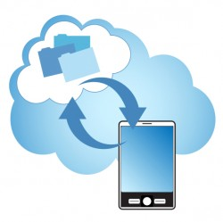
What does it cost to users?
Things to consider:
What does the company or you need out of the service
Storage Space
Budget
Performance
Typical transfer rate 2-3Mb/sec
Technical Support
Data Protection
Disaster Recovery
Comprehensive Backup
Security

Slide 9
Types of Cloud Storage
Personal Cloud Storage
Public Cloud Storage
Private Cloud Storage
Hybrid Cloud Storage

Slide 10
Advantages of Cloud Storage
Cost
Purchasing physical storage can be expensive. Without the need for hardware cloud storage is exceptionally cheaper per GB than using external drives.
Accessibility Using the cloud for storage gives you access to your files from anywhere that has an internet connection.
Recovery In the event of a hard drive failure or other hardware malfunction, you can access your files on the cloud. It acts as a backup solution for your local storage on physical drives.
Security Cloud storage providers add additional layers of security to their services.

Slide 11
Disadvantages of Cloud Storage
Internet Connection Cloud based storage is dependent on having an internet connection. If you are on a slow network you may have issues accessing your storage.
Hard Drives Cloud storage is supposed to eliminate our dependency on hard drives right? Well some business cloud storage providers require physical hard drives as well.
Support Support for cloud storage isn't the best, especially if you are using a free version of a cloud provider. Many providers refer you to a knowledge base or FAQs.
Privacy When you use a cloud provider, your data is no longer on your physical storage. So who is responsible for making sure that data is secure? That's a gray area that is still being figured out.

Slide 12
Conclusion
Grid Computing was the last research-led centralised approach.
However there are concerns that the mainstream adoption of cloud computing could cause many problems for users.
Many new open source systems appearing that you can install and run on your local cluster.

Slide 13
References
www.google.com
www.wikipedia.com
www.studymafia.org

Slide 14
Thanks

