Slide 1
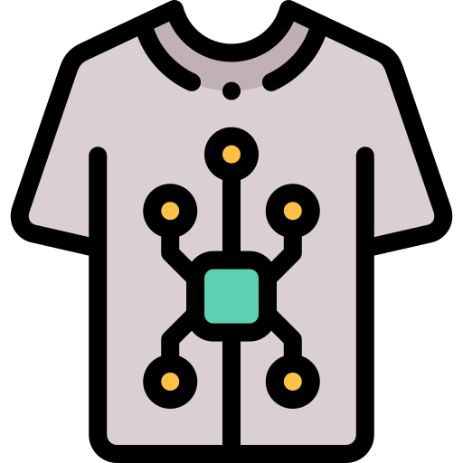
www.studymafia.org
Seminar
On
Smart Fabrics (Textile)
Submitted To: Submitted By:
www.studymafia.org www.studymafia.org

Slide 2
Content
Definition
Components
Working Principle
Classification
Functions
Applications
Importance
Conclusion
References

Slide 3
Definition of Smart Fabrics
SMART FABRICS or TEXTILES are defined as textiles that can sense and react to environmental conditions or stimuli, from mechanical, thermal, magnetic, chemical, electrical, or other sources.
They are able to sense and respond to external conditions (stimuli) in a predetermined way. Textile products which can act in a different manner than an average fabric and are mostly able to perform a special function certainly count as smart textiles.

Slide 4
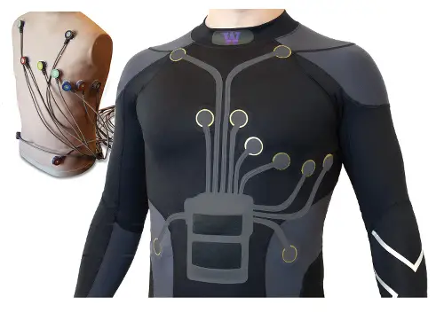

Slide 5
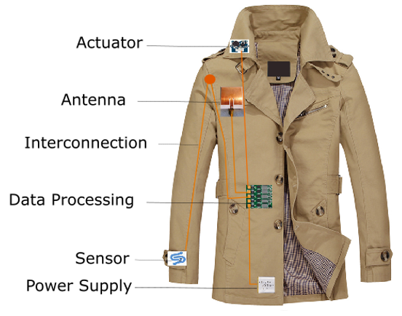
Component Of Smart Fabrics
Sensors
Actuators
Controlling units

Slide 6
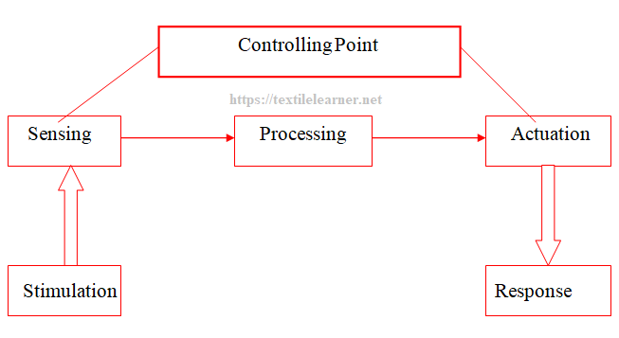
Working Principle of Smart Textile

Slide 7
Classification of smart textiles:
Smart textiles are classified into three categories depending on functional activity, as follows:
Passive smart textiles
Active smart textiles
Very or ultra-smart textiles

Slide 8
Functions
Sensors– It capture parameters from the environment
Data Processing– It is required when active processing is necessary
Actuators– It respond by the resulting function of the sensor
Stimulation – It is found in the environment
Giving Response– From the actuators, it gives a response

Slide 9
Applications of smart textiles:
Comfort wear
Heat protection
Medical applications
Military applications
Computing textiles
Fashion
Aviation
Space research

Slide 10
Importance of Smart Textile for Future
Smart Textiles are becoming internationally a dynamic innovation for textile sector.
For textile sector smart textiles, is promoting a good strengthen position internationally and create new job opportunities for the poor people.
Smart textile is a new field to spread knowledge to develop through textile material and textile processes.
Textile is a material close to the human being and it is a natural carrier of technology. So smart textile can easily contribute for the upcoming textile sector.

Slide 11
Conclusion
We have shown how to combine conventional sewing and electronics techniques with a novel class of materials to create interactive digital devices. All of the input devices can be made by seamstresses or clothing factories, entirely from fabric.
These textile-based sensors, buttons, and switches are easy to scale in size. They also can conform to any desired shape, which is a great advantage over most existing, delicate touch sensors that must remain flat to work at all. Subsystems can be connected together using ordinary textile snaps and fasteners. Finally, most of what has been described can be thrown in the wash if soiled by coffee, food, or sand at the beach.

Slide 12
Reference
Google.com
Studymafia.org
Wikipedia.org

Slide 13
Thanks

