Slide 1
Seminar On Ultrasonic Machining
www.studymafia.org
Submitted To: Submitted By:
www.studymafia.org www.studymafia.org

Slide 2
Content
Introduction
Schematic diagram
Principle & Working
Mechanism
USM system & subsystem
Process parameter & effect
Application
Advantages & disadvantages
References

Slide 3
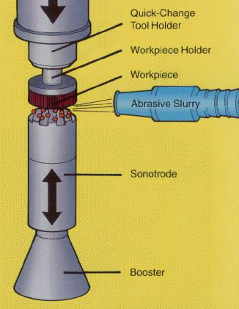
Ultrasonic Machining- Introduction
Ultrasonic machining is a non-traditional mechanical means of uniform stock material removal process
It is applicable to both conductive and nonconductive materials.
Particularly suited for very hard and/or brittle materials such as graphite, glass, carbide, and ceramics.

Slide 4
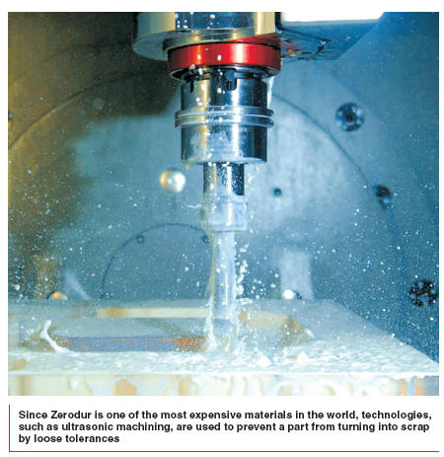
Ultrasonic Machining
It is a mechanical material removal process, used to erode material in the form of fine holes and cavities in hard or brittle workpiece.
It uses formed tools, vibrations of high frequency and a suitable abrasive slurry mix.
Ultrasonic range is possible with the help of piezoelectric materials.
Frequency > 20,000 Hz.

Slide 5
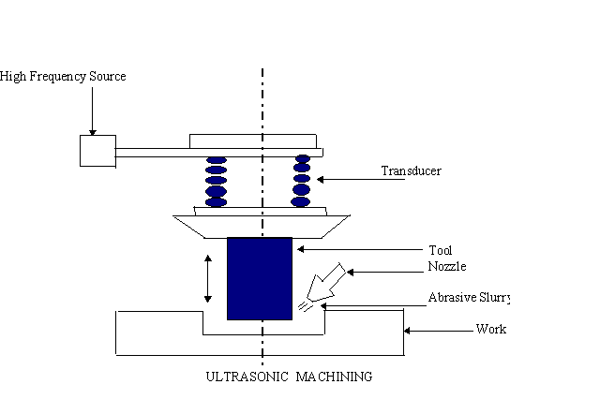
Schematic Diagram

Slide 6
Process
Impact erosion process - abrasive particles.
Cutting →abrasive particles in the slurry (fluid).
Material removal →abrading action →“shaped tool” and the workpiece.

Slide 7
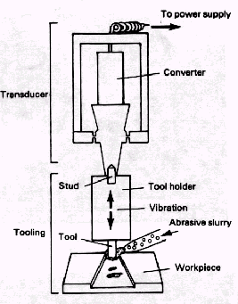
Working Principle
The process is performed by a cutting tool, which oscillates at high frequency, typically 20-40 kHz, in abrasive slurry.
The tool is gradually fed with a uniform force.
The high-speed reciprocations of the tool drive the abrasive grains across a small gap against the workpiece .
The impact of the abrasive is the energy principally responsible for material removal in the form of small wear particles that are carried away by the abrasive slurry.
The shape of the tool corresponds to the shape to be produced in the workpiece.

Slide 8
Mechanism for material removal
Occurs when the abrasive particles, suspended in the slurry between the tool and workpiece, are struck by the downstroke of the vibration tool.
The impact propels the particles across the cutting gap, hammering them into the surface of both tool and workpiece. Collapse of the cavitation bubbles in the abrasive suspension results in very high local pressures.
Under the action of the associated shock waves on the abrasive particles, microcracks are generated at the interface of the workpiece – brittle fracture.
The brittle fracture lead to chipping of particles from the workpiece.

Slide 9
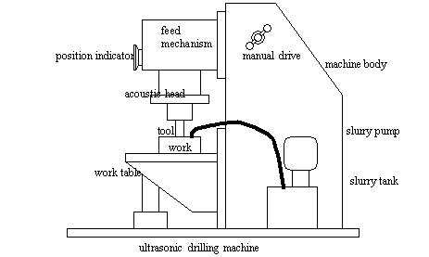
USM system components
Power supply
Transducer
Tool holder
Tool
Abrasive slurry

Slide 10
USM system components
Transducer
Piezoelectric transducers utilize crystals like quartz whose dimensions alter when being subjected to electrostatic fields.
The charge is directionally proportional to the applied voltage.
To obtain high amplitude vibrations the length of the crystal must be matched to the frequency of the generator which produces resonant conditions.

Slide 11
USM system component
2. Abrasive
Abrasive Slurry
- Common types of abrasive
- Boron carbide (B₄C) good in general, but expensive
- Silicon carbide (SiC) glass, germanium, ceramics
- Corundum (Al₂O₃)
- Diamond (used for rubies , etc)
- Boron silicon-carbide (10% more abrasive than B₄C)
Liquid
- Water most common
- Benzene
- Glycerol
- Oils
- High viscosity decreases MRR

Slide 12
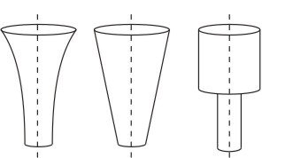
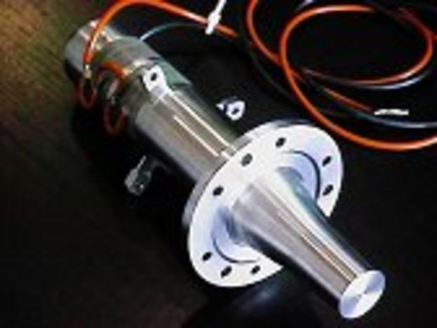
USM system component
3. Tool Holder/Acoustic head
The shape of the tool holder is cylindrical or conical, or a modified cone which helps in magnifying the tool tip vibrations.
Its function is to increase the tool vibration amplitude and to match the vibrator to the acoustic load. Therefore it must be constructed of a material with good acoustic properties and be highly resistant to fatigue cracking.
Monel and titanium have good acoustic properties and are often used together with stainless steel, which is cheaper.
Exponential tapered stepped

Slide 13
USM system component
4. Tool
Tool material should be tough and ductile. Low carbon steels and stainless steels give good performance.
Tools are usually 25 mm long ; its size is equal to the hole size minus twice the size of abrasives.
Mass of tool should be minimum possible so that it does not absorb the ultrasonic energy.
It is important to realize that finishing or polishing operations on the tools are sometimes necessary because their surface finish will be reproduced in the workpiece.
Tool and toolholder are often attached by silver brazing.

Slide 14
Process Parameters
Amplitude of vibration (a) - 15- 50 um.
Frequency of vibration (f)-19-25kHz
Feed force (F)
Feed pressure (p)
Abrasive size-15-150um
Contact area of the tool – A
Volume concentration of abrasive in slurry - C

Slide 15
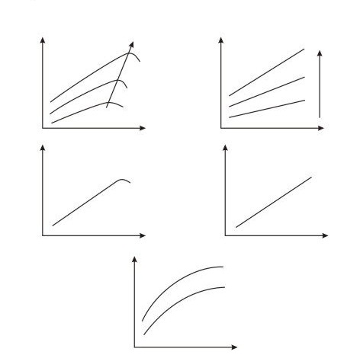
Process Parameters

Slide 16
Application
It is mainly used for
(1) drilling
(2) grinding,
(3) Profiling
(4) coining
(5) piercing of dies
(6) welding operations on all materials which can be treated suitably by abrasives.
(7) Used for machining hard and brittle metallic alloys, semiconductors, glass, ceramics, carbides etc.
(8) Used for machining round, square, irregular shaped holes and surface impressions.

Slide 17
Advantages
Machining any materials regardless of their conductivity
USM apply to machining semi-conductor such as silicon, germanium etc.
USM is suitable to precise machining brittle material.
USM does not produce electric, thermal, chemical abnormal surface.
Can drill circular or non-circular holes in very hard materials
Less stress because of its non-thermal characteristics

Slide 18
Disadvantages
USM has low material removal rate. (3-15mm3/min)
Tool wears fast in USM.
Machining area and depth is restraint in USM.

Slide 19
References
Google.com
Wikipedia.org
Studymafia.org

Slide 20
Thanks

