Slide 1
www.studymafia.org
Seminar
On
RaspberryPi
Submitted To: Submitted By:
www.studymafia.org www.studymafia.org
Notes:
1
1

Slide 2
Content
What is a Raspberry Pi?
Key Components
Programming Languages
Raspberry Pis in Primary Ed.
Office
Reference

Slide 3
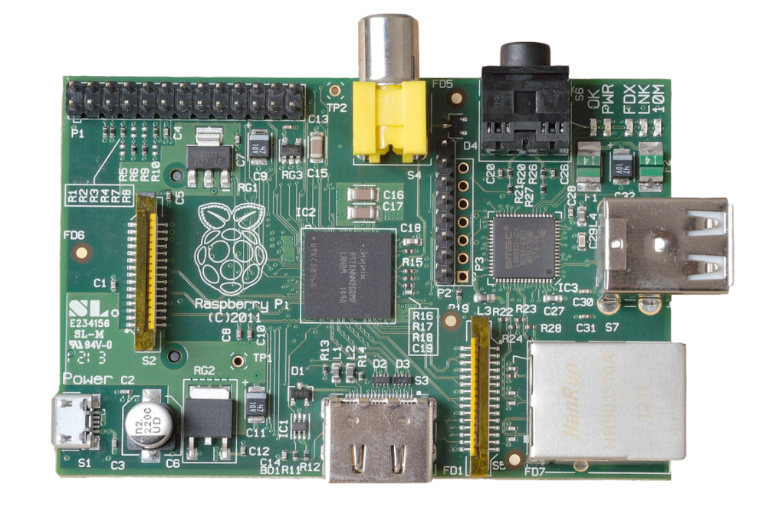
What is a Raspberry Pi?
University of Cambridge’s Computer Laboratory
Decline in skill level
Designed for education
A credit card sized PC
Plugs into a TV or monitor
Inexpensive(ish) ~$35 each
Capability:
Programming
Electronic Projects
Office
Play HD Videos

Slide 4
Key Components
Essential:
Raspberry Pi board
Prepared Operating System SD Card
USB keyboard
Display (with HDMI, DVI, or Composite input)
Power Supply
Highly suggested extras include:
USB mouse
Internet connectivity - LAN cable
Powered USB Hub
Case

Slide 5
Programming Languages
The Raspberry Pi Foundation recommends Python
Any language which will compile for ARMv6 can be used
Installed by default on the Raspberry Pi:
C
C++
Java
Scratch
Ruby

Slide 6
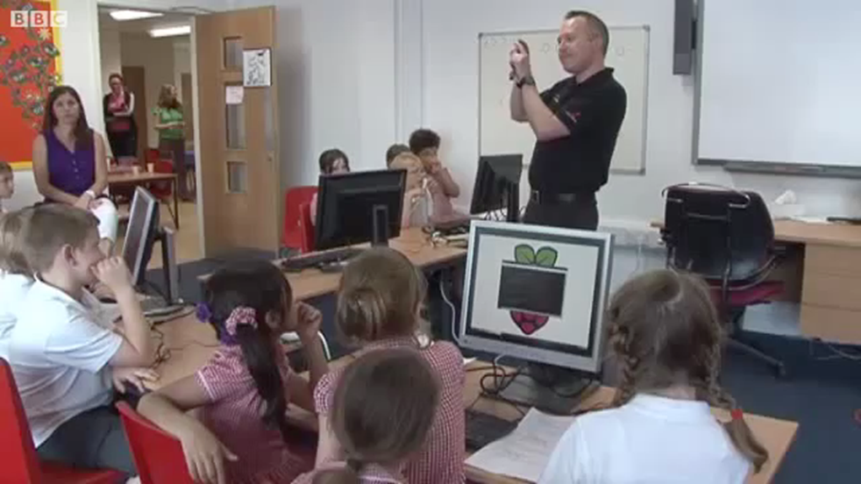
Raspberry Pis in Primary Ed.
http://www.youtube.com/watch?v=KdTwQXre1DU

Slide 7
Setup

Slide 8
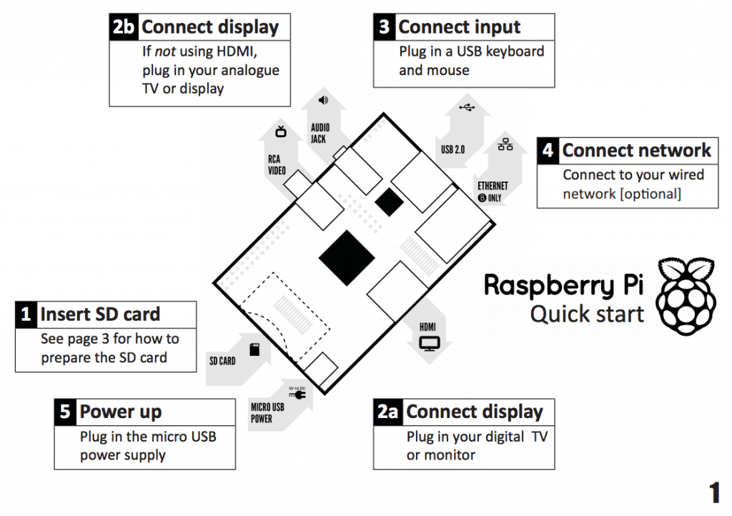

Slide 9
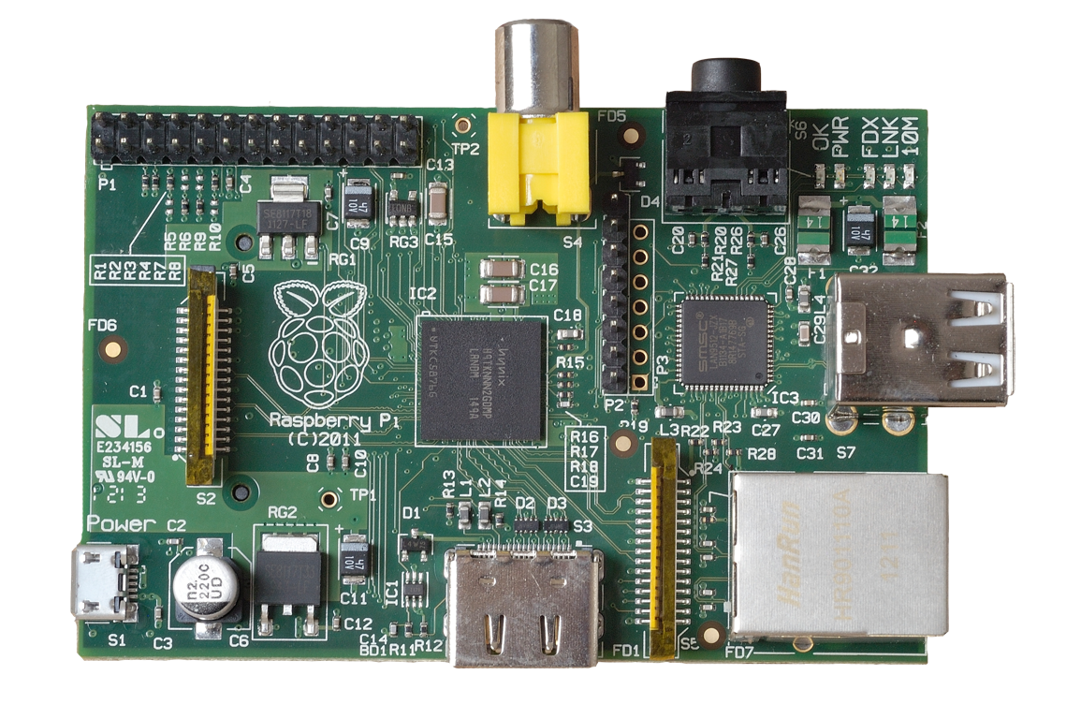
Power
5v micro
USB connector
(Similar to the one on a lot of mobile phones!)

Slide 10
3.5mm Audio
Standard headphone socket
A/V (Audio/Video)
RCA Video
(works with most older TVs)
HDMI Audio & Video
(works with modern TVs and DVI monitors)

Slide 11
Connectivity
2 x USB 2.0
ports
GPIO
(General
Purpose
Input &
Output)
10/100Mb
Ethernet

Slide 12
Internals
LAN Controller
DSI
(display interface)
CSI
(camera interface)
SOC (System On a Chip)
Broadcom BCM2835 700Mhz

Slide 13
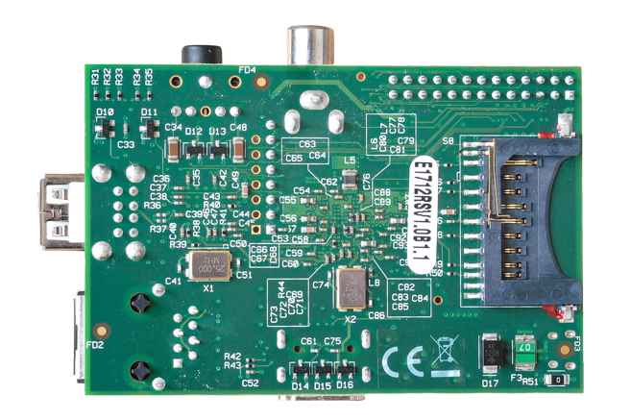
Storage
SD Card Slot
(supports SD cards up to 32GB)

Slide 14
10 Uses for a Raspberry Pi

Slide 15
10
Office
9
8
7
6
5
4
3
2
1

Slide 16
Office
10
9
8
7
6
5
4
3
2
1

Slide 17
9
Programming
10
8
7
6
5
4
3
2
1

Slide 18
Programming
10
9
8
7
6
5
4
3
2
1

Slide 19
Game Console
8
10
9
7
6
5
4
3
2
1

Slide 20
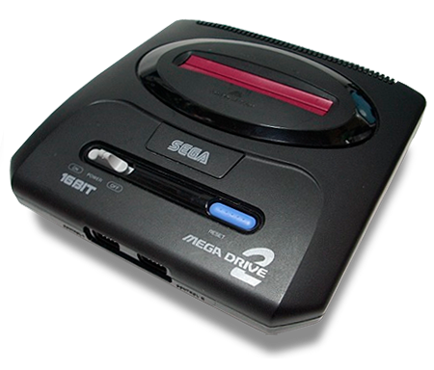
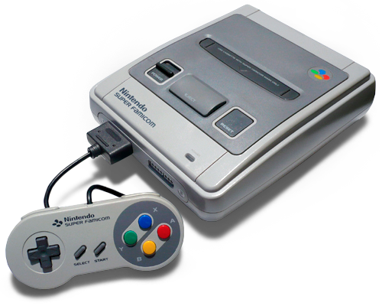
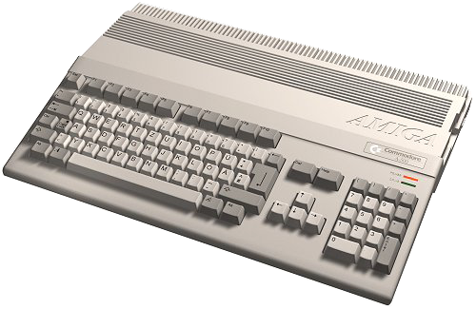
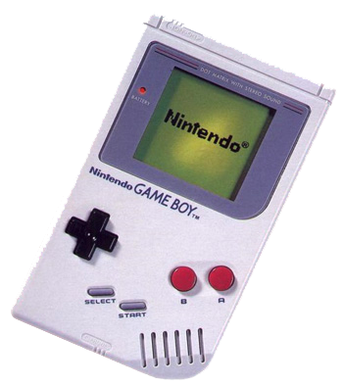
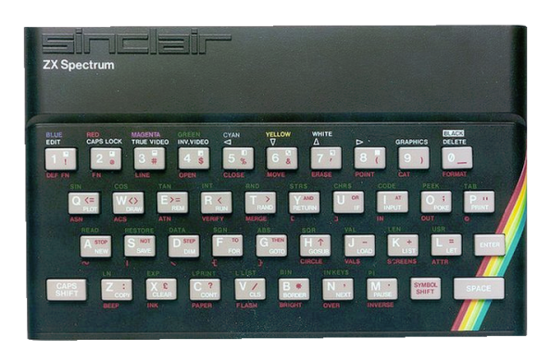
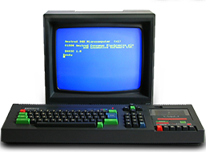
Game Console
10
9
8
7
6
5
4
3
2
1

Slide 21
7
Web Server
10
9
8
6
5
4
3
2
1

Slide 22
Web Server
10
9
8
7
6
5
4
3
2
1

Slide 23
6
Tor Router
10
9
8
7
5
4
3
2
1

Slide 24
Tor Router
10
9
8
7
6
5
4
3
2
1

Slide 25
5
HTPC
10
9
8
7
6
4
3
2
1

Slide 26
HTPC
10
9
8
7
6
5
4
3
2
1

Slide 27
4
Bird House
10
9
8
7
6
5
3
2
1

Slide 28
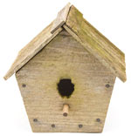
Bird House
10
9
8
7
6
5
4
3
2
1

Slide 29
Super
Computer
3
10
9
8
7
6
5
4
2
1

Slide 30
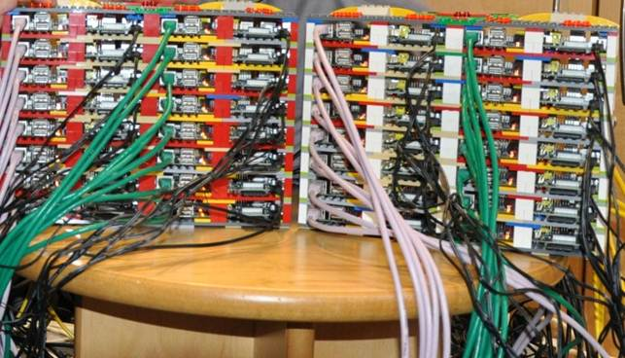
Supercomputer
10
9
8
7
6
5
4
3
2
1

Slide 31
2
Clock
10
9
8
7
6
5
4
3
1

Slide 32
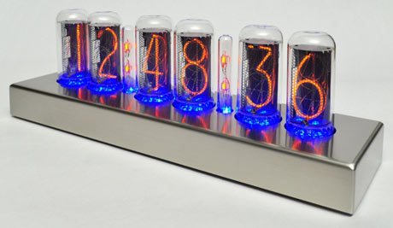
Clock
10
9
8
7
6
5
4
3
2
1

Slide 33
1
PiBot!
10
9
8
7
6
5
4
3
2

Slide 34
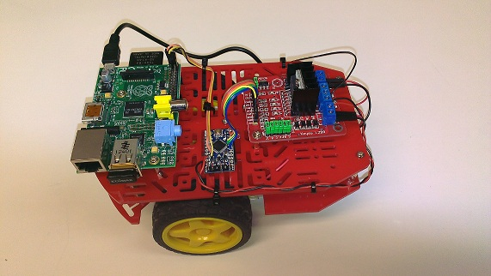
PiBot!
10
9
8
7
6
5
4
3
2
1

Slide 35
REFERENCES
www.google.com
www.wikipedia.com
www.studymafia.org
www.pptplanet.com

Slide 36
Thanks

