Slide 1
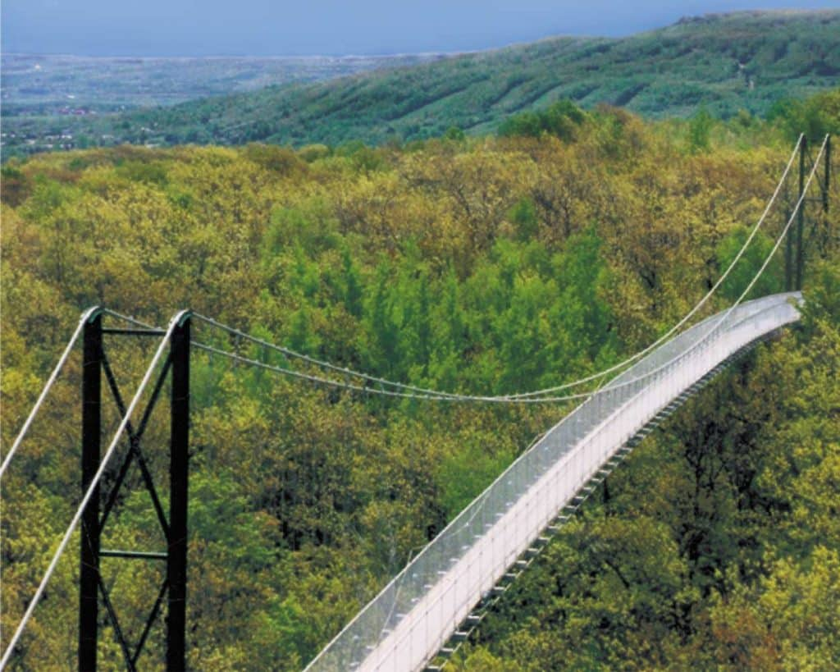
www.studymafia.org
Seminar
On
Suspension Bridge
Submitted To: Submitted By:
www.studymafia.org www.studymafia.org
Notes:
1
1

Slide 2
Contents
What???
Types of Bridges
Arch Bridge
Beam Bridge
Cable-stayed Bridge
Cantilever Bridge
Truss Bridge
Suspension Bridge – An Introduction
Terms related to Suspension Bridge
Structural Analysis
Structural Failure
Quality Control in Suspension Cable
Advantages & Limitations
Load Distribution in Different Types of Bridges
Conclusion
References

Slide 3
Bridge
A bridge is a structure built to span a valley, road, body of water, or other physical obstacle, for the purpose of providing passage over the obstacle.
Designs of bridges vary depending on the function of the bridge and the nature of the terrain where the bridge is constructed.

Slide 4
Types of Bridge
There are six main types of bridges:-
Arch Bridge
Beam Bridge
Cable-stayed Bridge
Cantilever Bridge
Truss Bridge
Suspension Bridge

Slide 5
Arch Bridge
Arch bridges are arch-shaped and have abutments at each end.
An arch bridge doesn't need additional supports or cables. In fact it’s the shape of the structure that gives it its strength.
Arch bridges are designed to be constantly under compression.
The weight of the bridge is thrust into the abutments at either side.
Usually they are made for short span range but often set end-to-end to form a large total length.

Slide 6
Beam Bridge
Beam bridges are the simplest kind of bridge today.
Bridges consist of one horizontal beam with 2 supports usually on either ends.
It is frequently used in pedestrian bridges and for highway overpasses & flyovers.
They are constructed for short span requirements.
The weight of the bridge and any traffic on it is directly supported by the piers.
The top side of the deck is under compression while the bottom side of the deck is under tension.
To increase the bridge’s strength designers introduce truss to the bridge’s beam.

Slide 7
Cable-stayed Bridge
A bridge that consists of one or more pylons with cables.
There are two major classes of cable-stayed bridges such as a harp design & a fan design.
The cable-stay design is best suited for a medium span range.
The towers form the primary load-bearing structure.
It has greater stiffness.
The cables act as both temporary & permanent supports to the bridge-deck.
The tower in a cable-stayed bridge is responsible for absorbing and dealing with the compression forces while the cables are under tension.
fan design
harp design

Slide 8
Cantilever Bridge
A bridge built using cantilevers, structures that project horizontally into space, supported on only one end.
For small footbridges, the cantilevers may be simple beams; however, large cantilever bridges are designed using trusses.
These are constructed for short to medium span ranges.
Cantilevers support loads by tension of the upper members & compression of the lower ones.

Slide 9
Truss Bridge
A bridge composed of straight connected elements which may be stressed from tension, compression, or sometimes both in response to dynamic loads.
A truss bridge is economical to construct owing to its efficient use of materials.
These are usually constructed for short to medium span range.
In India truss bridges are generally constructed for rail traffic.
Vertical members are in tension, lower horizontal members in tension, shear, and bending, outer diagonal and top members are in compression, while the inner diagonals are in tension.

Slide 10
Suspension Bridge
Nowadays these are the pioneers in bridge technology.
Of all the bridge types in use today, the suspension bridge allows for the longest span ranging from 2,000 to 7,000 feet.
This type of bridge has cables suspended between towers & the cables support vertical suspender cables that carry the weight of the deck below. This arrangement allows the deck to be level or to arc upward for additional clearance.
The suspension cables are anchored at each end of the bridge.
They are ideal for covering busy waterways.

Slide 11
Terms related to Suspension Bridge
Side span: segment between two pylons at the ends of a bridge.
Centre span: segment between two pylons at the centre of a bridge.
Side pylon: tower-like vertical construction situated at the side. usually supporting the cables of a suspension bridge.
Foundation of a pylon: very durable lower part of a tower.
Suspender: support cable.
Suspension cable: set of braided wire that supports a bridge.
Pylon: tower-like vertical support that usually supports the cables of a suspension bridge or a cable-stayed bridge.
Stiffening girder: tightener beam.

Slide 12
Structural Analysis
The main forces in a suspension bridge are tension in the main cables and compression in the pillars. Since almost all the force on the pillars is vertically downwards and they are also stabilized by the main cables, they can be made quite slender.
In a suspended deck bridge, cables suspended via towers hold up the road deck. The weight is transferred by the cables to the towers, which in turn transfer the weight to the ground.
Most of the weight or load of the bridge is transferred by the cables to the anchorage systems. These are imbedded in either solid rock or huge concrete blocks. Inside the anchorages, the cables are spread over a large area to evenly distribute the load and to prevent the cables from breaking free.

Slide 13
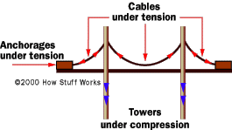
Structural Analysis

Slide 14
Structural Failure
Some bridges have in the past suffered from structural failure due to combination of poor design and severe weather conditions.
Collapse of the bridge also depends upon a phenomenon called resonance. It is the phenomenon when a body vibrates at its natural frequency & it shatters.
To avoid these types of failures today all new bridges prototypes have to be tested in a wind tunnel before being constructed.

Slide 15
Quality Control in Suspension Cable
The main suspension cable in older bridges was often made from chain or linked bars, but modern bridge cables are made from multiple strands of wire. This contributes greater redundancy; a few flawed strands in the hundreds used pose very little threat, whereas a single bad link or eyebar can cause failure of the entire bridge.
Another reason is that as spans increased, engineers were unable to lift larger chains into position, whereas wire strand cables can be largely prepared in mid-air from a temporary walkway.
The cables are made of thousands of individual steel wires bound tightly together. Steel, which is very strong under tension, is an ideal material for cables; a single steel wire, only 0.1 inch thick, can support over half a ton without breaking.

Slide 16
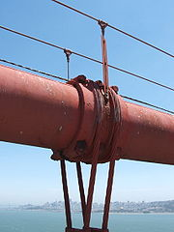
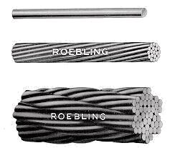
Quality Control in Suspension Cable

Slide 17
Advantages over other bridge types
Longer main spans are achievable than with any other type of bridge.
May be better able to withstand earthquake movements than can heavier and more rigid bridges.
The center span may be made very long in proportion to the amount of materials required, allowing the bridge to economically span a very wide canyon or waterway.
It can be built high over water to allow the passage of very tall ships.

Slide 18
Limitations compared to other bridge types
Considerable stiffness or aerodynamic profiling may be required to prevent the bridge deck vibrating under high winds.
The relatively low deck stiffness compared to other types of bridges makes it more difficult to carry heavy rail traffic where high concentrated live loads occur.
Under severe wind loading, the towers exert a large torque force in the ground, and thus require very expensive foundation work when building on soft ground.

Slide 19
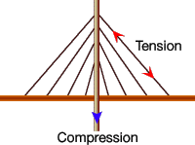
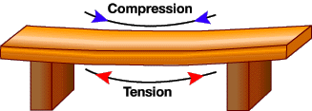
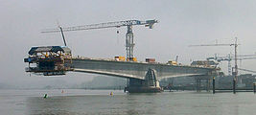
Load distribution in different types of bridges
Cable-stayed bridge
Beam bridge
tension
compression
Cantilever bridge

Slide 20
Conclusion
These are the pinnacles in modern days bridge technology.
Longer spans of up to 2000 ft-7000 ft is possible.
They are ideal for covering busy waterways such as Gulf, Strait, Lake, etc.
These bridges are mainly meant for light & heavy roadways rather than railways.
The main forces in a suspension bridge are tension in the main cables and compression in the pillars.

Slide 21
REFERENCES
www.google.com
www.wikipedia.com
www.studymafia.org

Slide 22
Thanks

