Slide 1
www.studymafia.org
Seminar
On
LINUX
Submitted To: Submitted By:
www.studymafia.org www.studymafia.org

Slide 2
OVERVIEW
What is Linux?
History of Linux
Features Supported Under Linux
The features of Linux

Slide 3
WHAT IS LINUX ?
Linux is a generic term referring to Unix-like graphical user interface (GUI) based computer operating systems.
It is Multi-user, Multitasking, Multiprocessor
Coexists with other Operating Systems
Runs on multiple platforms

Slide 4
BEFORE LINUX
In 80’s, Microsoft’s DOS was the dominated OS for PC
Apple MAC was better, but expensive
UNIX was much better, but much, much more expensive. Only for minicomputer for commercial applications
People was looking for a UNIX based system, which is cheaper and can run on PC

Slide 5
GNU PROJECT
Established in 1984 by Richard Stallman
GNU is a recursive acronym for “GNU's Not Unix”
Aim at developing a complete Unix-like operating system which is free for copying and modification
Stallman built the first free GNU C Compiler in 1991. But still, an OS was yet to be developed

Slide 6
BEGINNING OF LINUX
A famous professor Andrew Tanenbaum developed Minix, a simplified version of UNIX that runs on PC
Minix is for class teaching only. No intention for commercial use
In Sept 1991, Linus Torvalds, a second year student of Computer Science at the University of Helsinki, developed the preliminary kernel of Linux, known as Linux version 0.0.1

Slide 7
LINUX TODAY
Linux has been used for many computing platforms
PC, Supercomputer
Commercial vendors moved in Linux itself to provide freely distributed code. They make their money by compiling up various software and gathering them in a distributable format
Red Hat, Slackware, etc
About 29 million people use Linux worldwide

Slide 8
LINUX-FREE SOFTWARE
Free software, as defined by the FSF (Free Software Foundation), is a "matter of liberty, not price." To qualify as free software by FSF standards, you must be able to:
Run the program for any purpose you want to, rather than be restricted in what you can use it for.
Share the program with others.
Improve the program and release those improvements so that others can use them.

Slide 9
LINUX SOFTWARES
Red Hat Linux : One of the original Linux distribution.
The commercial, nonfree version is Red Hat Enterprise Linux, which is aimed at big companies using Linux servers and desktops in a big way
Debian GNU/Linux : A free software distribution. Popular for use on servers
Gentoo Linux : Gentoo is a specialty distribution meant for programmers

Slide 10
UBUNTU
Ubuntu is a free Linux distros
Ubuntu is reliable and stable.
Ubuntu is the distribution with the biggest software repositories.
Ubuntu has a good hardware support for most available companies.
Ubuntu have a lot of variants (Kubuntu, Xubuntu, Edubuntu, Goubuntu, MIDI Ubuntu).

Slide 12
LINUX DESKTOP

Slide 13
Default Fedora Desktop
The default desktop has three distinct areas. From top to bottom, the areas are:
The menu panel
The desktop area
The window list panel

Slide 14
MENU PANEL
Applications - The Applications menu contains a variety of icons that start software applications. It is similar to the Microsoft Windows Start menu.
Places - The Places menu contains a customizable list of directories, mounted volumes, recent documents, and a Search function. Volumes that are mounted may be external USB drives (flash, hard disk, CD, etc.), directories shared across a network, or other media devices such as a portable music player.

Slide 15
SYSTEM MENU
Log Out
About
Help
Lock Screen
Preferences

Slide 16
Mozilla Firefox web browser
OpenOffice.org Writer is a word processing program
OpenOffice.org Impress is for creating and giving presentations
OpenOffice.org Calc is a spreadsheet tool
Evolution mail client and personal information manager

Slide 17
THE DESKTOP AREA
Computer - This contains all volumes (or disks) mounted on the computer. These are also listed in the Places menu. Computer is equivalent to My Computer on Microsoft Windows.
Home - This is where the logged-in user stores all files by default, such as music, movies, and documents. There is a different home directory for each user, and by default users cannot access each others' home directories. Home is equivalent to My Documents on Microsoft Windows.
Trash - Deleted files are moved to Trash. Empty Trash by right-clicking the icon and clicking Empty Trash

Slide 18
START HERE

Slide 19
PROGRAM WINDOW

Slide 20
APPLICATION WINDOW

Slide 21
OFFICE SOFTWARE
Word processor
Spreadsheet
Presentation
Database application

Slide 23
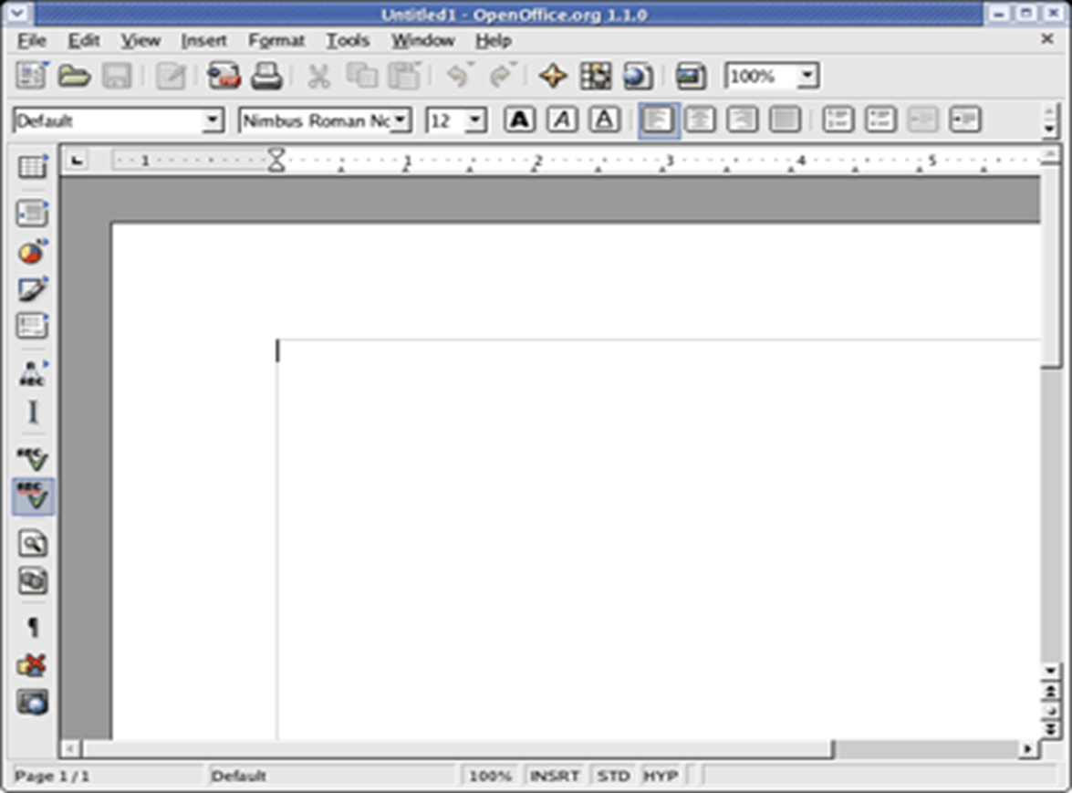

Slide 24
WEB BROWSER
Firefox

Slide 26
OTHER SOFTWARES
Audio Player: The XMMS (X Multimedia System), which is used to play digital sound files
CD Player: The default CD player
Sound Juicer CD Ripper: Burn your own CDs
Messaging Client: GAIM supports AIM, MSN, ICQ, and many other popular IM networks
gFTP: Useful for grabbing files through FTP (File Transfer Protocol)

Slide 27
WHY LINUX?
Powerful
Runs on multiple hardware platforms
Users like its speed and stability
No requirement for latest hardware
It’s “free”
Licensed under GPL
Vendors are distributors who package Linux

Slide 28
Multi-user
A multi-user operating system allows for multiple users to use the same computer at the same time and/or different times.
Multiprocessing
An operating system capable of supporting and utilizing more than one computer processor

Slide 29
Multitasking
An operating system that is capable of allowing multiple software processes to run at the same time
Multithreading
Operating systems that allow different parts of a software program to run concurrently.

Slide 30
Open Source Software
People improve it, people adapt it, people fix bugs. And this can happen at a speed that, compared to conventional software development, seems astonishing

Slide 31
Linux Provide Security
As there is a limited access
Of user to basic files and folders, in Linux network it provide security to user’s privacy. Without disclosing the secured data Linux acts as a efficient server

Slide 32
Linux is Virus Free!!
Linux is "virus-free" in that there are essentially no viruses for Linux in the wild, although research viruses certainly do exist.

Slide 33
Keeping up to date
By Upgrading
Linux upgrades faster than Windows
Compatibility
Linux is Backward Compatible unlike Windows

Slide 34
ADVANTAGES OF LINUX
Linux systems are extremely stable
Linux is Free
No threat of viruses
Linux comes with most of the required software pre-installed
Update all your software with minimum fuss
Linux never gets slow
Linux does not need defragmentation
Linux can even run on oldest hardware
Adding more software is a matter of a few clicks
Most Windows-only apps have their either their native version or alternatives for Linux
With Linux, you get the highest degree of possible customizability

Slide 35
Reference
www.google.com
www.wikipedia.com
www.studymafia.org

Slide 36
Thanks

