Slide 1
www.studymafia.org
Seminar
On
Gi-Fi Technology
Gi-Fi
Submitted To: Submitted By:
www.studymafia.org www.studymafia.org

Slide 2
Content
CURRENTLY USING TECHNOLOGIES
TECHNOLOGIED THAT USED
WHY Gi – Fi ?
COMPARISON BETWEEN BLUETOOTH AND Wi-Fi
INTRODUCTION OF Gi – Fi
ARCHITECTURE OF Gi –Fi
FEATURES OF Gi –Fi
APPLICATIONS
CONCLUSIONS

Slide 3
Currently Using Technologies
Bluetooth
Wi-Fi

Slide 4
Technologies Using
Bluetooth
Wi-Fi
Optical Fibre
Wireless Access
Cables

Slide 5
Why GI-FI
The reason for pushing into Gi-Fi technology
is because of
slow rate,
high power consumption,
low range of frequency operation
of earlier technologies i.e. , Bluetooth
and Wi-Fi.

Slide 7
Introduction to Gi-Fi
GI-FI means gigabit wireless.
Worlds first transceiver integrated on single chip.
Operates on 60ghz on the CMOS process.
Allows wireless transfer of audio and video data at upto 5GB per second.
Transfer data within an indoor environment usually within a range of 10ms.

Slide 8
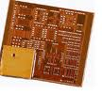
Transreceiver Gi-Fi Chip

Slide 9
Architecture of Gi-Fi
The core components of a GI-FI system is the subscriber station which available to several access points .
It supports standard of IEEE 802.15.3C
The wirelessspan is computer network used for communication among computer devices (including telephones and personal digital assistants) close to one person
An 802.15.3c based system often uses small antenna at the subscriber station. The antenna is mounted on the roof. It supports line of sight operation.

Slide 10
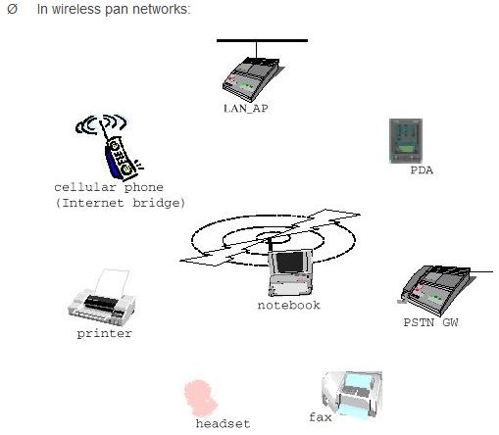
GI-FI Access devices

Slide 11
Features of Gi - Fi technology
High speed of data transfer
Low power consumption
High security
Cost effective
Small size

Slide 12
APPLICATIONS
In wireless PAN networks.
Inter-vehicle communication system.
Huge data file transfer.
Office appliances.
Video information transfer.

Slide 13
Conclusion
Within five years, we expect Gi-Fi to be the dominant technology for wireless networking. By that time it will be fully mobile, as well as providing low- cost, high broadband access, with very high speed large files swapped with in seconds which will develop wire less home and office of future.
If the success of Wi-Fi and the imminent wide usage of WiMAX is any indication, Gi-Fi potentially can bring wireless broadband to the enterprise in an entirely new way.

Slide 14
Reference
www.google.com
www.wikipedia.com
www.studymafia.org

Slide 15
Thanks

