Slide 1
www.studymafia.org
Seminar
On
Daknet
Submitted To: Submitted By:
www.studymafia.org www.studymafia.org
Notes:
1
1

Slide 2
Content
Introduction
Why Daknet
Daknet network Architecture
How Daknet works
Daknet in action
Features of Daknet
Applications of DAK Net
Advantages of DAK Net
Disadvantages of DAK Net
Conclusion

Slide 3
Challenges to Rural Connectivity
Lack of sensitization.
Most rural areas don’t have the infrastructure to support cheap and good connectivity.
Poor internet access.
Availability of power is also a challenge

Slide 4
But… can they afford internet expenses..??

Slide 5
Introduction
Daknet, is an ad hoc network , using wireless technology to provide digital connectivity.
It combines a physical means of transportation with wireless data transfer.
Works on IEEE 802.11b equipment at 2.4 Ghz.
No Base station is required.

Slide 6
Why Daknet?
Provide non real-time infrastructures and applications such as voice mail, e-mail, and electronic bulletin boards.
Provide store- and forward or asynchronous modes of communication .
Simpler to add in a device to the system.
Low maintenance cost.

Slide 7
Daknet Network Architecture
The main parts of a daknet architecture are:
Mobile access point
Hub
Kiosk

Slide 8
Mobile Access Point
Daknet travels data over short
point to point links between kiosks
Hub
It is a common connection point .
Used to connect segments of a LAN.
Contains multiple ports.
Kiosk:
Booth providing a computer related service .
Enable user to enter and display information.

Slide 9
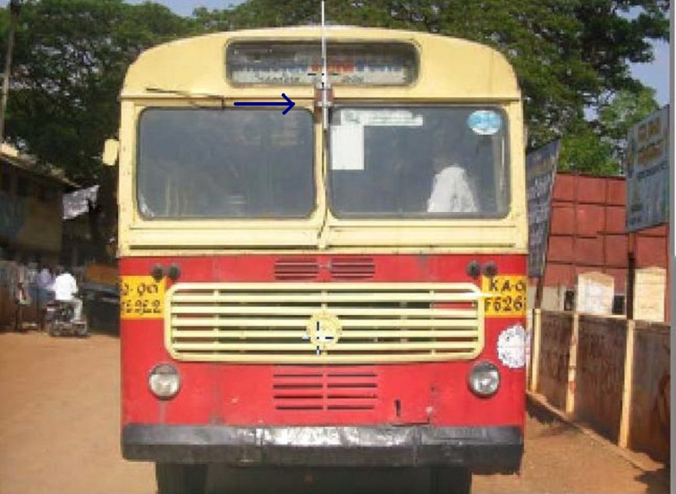
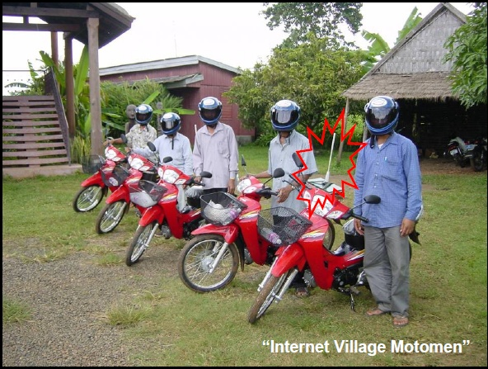
WiFi Cards
In Daknet a wireless card i.e wifi card is mounted on a vehicle that travels around to remote villages.

Slide 10
Advantages of using WiFi cards
Increase mobility
Cost for setting up a network is much less than running wires.
WiFi has a global set of standards.
support encryption in order to protect the data that is being transmitted.

Slide 11
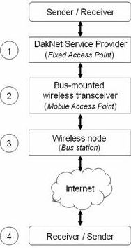
How Daknet works

Slide 12
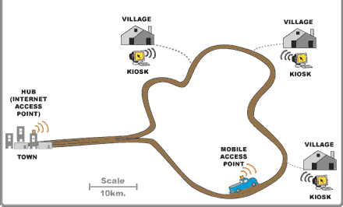

Slide 13
Features of DakNet
Provides one of the lowest-cost accessibility solutions in the world.
The same hardware, software and user interface can be used to enjoy real-time information access.
Provide a seamless method of upgrading to always on broadband connectivity.

Slide 14
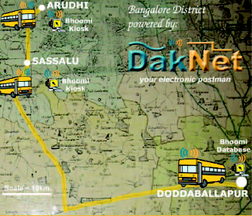
Daknet In Action
Daknet is currently in action in many places. They are,
Bhoomi initiative in Karnataka
SARI (Sustainable Access for Rural India) project of Tamilnadu
Ratnakiri project in Cambodia

Slide 15
Scaling It Up
Going to be deployed and tested in larger implementations with applications that exploit in broadband capabilities
Cost Lowering
Developing a highly interoperable and cross platform software module.

Slide 16
Applications of DAK Net
The Applications of DAK Net include:
Internet and Intranet messaging which may include uploading and downloading data (audio-video) and e-mail.
Users can have access to mobile e-commerce applications.
They can also have access to e-Gov applications (Apps) which are very secure and helpful.

Slide 17
Advantages of DAK Net
As it is a wireless service, it is easy to expand on the network coverage across the village with no cables for installation. This helps in more connectivity to the people.
It is cost effective as it uses the unlicensed part of the Radio Spectrum which bring to reduced licensing fees and regulatory challenges.
The implementation process does not require any wires or cables, there is no installation cost involved or maintenance needed
Utilizing low cost materials makes the whole process cost effective

Slide 18
Disadvantages of DAK Net
Some applications such as VOIP are not supported by the network.
Asynchronous web provides no effective surfing technique.
Due to its complicity, expert guidance is required for the villagers to understand the use of the Kiosk.
There is limited storage space in the Kiosk

Slide 19
Conclusion:
Daknet’s low deployment cost and enthusiastic reception by rural users has motivated dozens of inquiries for further deployments.
Larger goal : Shift the policy focus of the Government’s universal service obligation funds from wireless village telephones to wireless ad-hoc networking.

Slide 20
References
Electronics for you journal
Web Sites:
www.studymafia.org
www.wikipedia.org
www.seminarppt.com

Slide 21
Thank you…….

Slide 22
Queries...??

