Slide 1
www.studymafia.org
Seminar
On
Iphone
Submitted To: Submitted By:
www.studymafia.org www.studymafia.org

Slide 2
Content
What is Iphone?
iPhone Features
Types Of iPhone
iPhone 3G
iPhone 3GS
iPhone 4
iPhone 4S
iPhone 5,
The iPhone
The iPhone 5S 5C
Limitations of an iPhone
Conclusion
Reference

Slide 3
What is Iphone?
iPhone is a line of smartphones designed and marketed by Apple Inc. Executes IOS mobile operating system formerly known as "iPhone OS" until mid-2010.
The iPhone has a camera of 8 megapixel and a music player (equivalent to the iPod) plus software to send and receive text messages and voice messages.

Slide 4
iPhone Features
Phone – The iPhone’s phone features are solid. It includes innovative features like Visual Voicemail and standard features like text messaging and voice dialing.
Web browsing – The iPhone offers the best, most complete mobile browsing experience. Though it doesn’t support the standard Flash browser plug in, it doesn’t require dumbed-down “mobile” versions of websites, instead offering the real thing on a phone.
Email – Like all good smartphones, the iPhone has robust email features and can sync to corporate email servers running Exchange.
Calendar/PDA – The iPhone is a personal information manager, too, with calendar, address book, stock-tracking, weather update, and related features.

Slide 5
Cont…
iPod – A shortcut description of an iPhone is a combined cell phone and iPod, so of course its music player features offer all the advantages and coolness of iPods.
Video playback – With its big, beautiful, 3.5-inch screen, the iPhone is a great choice for mobile video playback, whether using the built-in YouTube application, adding your own video, or buying or renting content from the iTunes Store.
Apps – With the addition of the App Store, iPhones can now run all kinds of third-party programs, from games (both free and paid) to Facebook and Twitter to restaurant finders and productivity apps. The App Store makes the iPhone the most useful smartphone around.
Cameras - One major change in the iPhone is the inclusion of two camera, whereas previous models only had one. The camera on the back of the phone shoots 5-megapixel still images and takes 720p HD video. The user-facing camera allows FaceTime video chats.

Slide 6
Versions of the iPhone
There are, to date, 8 versions of the iPhone. The Original iPhone, iPhone 3G, iPhone 3GS, iPhone 4, iPhone 4S, iPhone 5, the iPhone and the iPhone 5S 5C.
Version is equivalent to generation, pattern, ie eight different devices (hardware), so it should not be confused with the version of the iPhone version of your operating system or iOS.

Slide 7
iPhone 3G
Physically similar to the original iPhone.
This model incorporates 3G connectivity as its name suggests, A-GPS is assisted GPS and a new housing entirely of plastic in black or white glossy curve (white housing was only available in the higher capacity model), along features of the first iPhone.

Slide 8
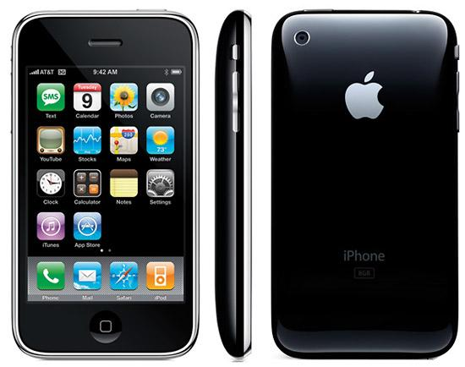

Slide 9
iPhone 3GS
Physically equal to the IPhone 3G. The iPhone 3GS gets its name from the English word speed (velocity), since it is up to two times faster than the iPhone 3G.
It incorporates video recording, compass and 3-megapixel camera with autofocus and white balance, voice commands, and a longer duration of battery

Slide 10
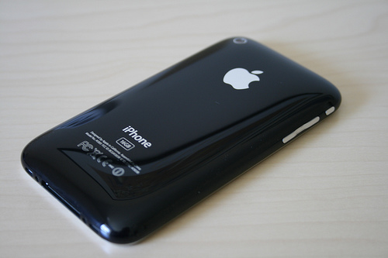

Slide 11
iPhone 4
Today, the iPhone 4 is considered the latest iPhone model that will be current, ie, still receives software updates, and the latest, iOS 7.1 is a phone that continues to market due to its popular design and performance . The iPhone 4 is the 4th generation mobile device from Apple that was launched in 2010.
Stresses the facelift versus iPhone 3G and 3GS, highlighted by the debut of iOS 4, including multitasking, wallpaper on the home screen, 5 megapixel camera with HD recording and an A4 Chip processor, now with iOS 7.1 iPhone 4 gets its fluidity and performance.

Slide 12
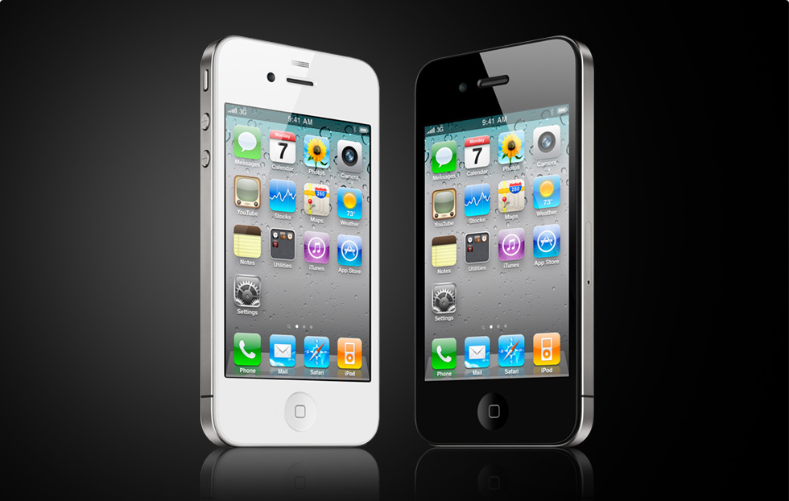

Slide 13
iPhone 4S
The iPhone 4S was filed on October 4, 2011 Among the new features are:. 8 megapixel camera with five lenses, recording and editing in full HD, dual-core A5 chip with 1 Ghz new GPU, double the maximum speeds data HSDPA up to 14.4 Mb / s, voice control "SIRI" will support CDMA and GSM networks, among others.
iPhone 4S has been the best selling iPhone of all history, managed to sell 4 million units in just one weekend.

Slide 14
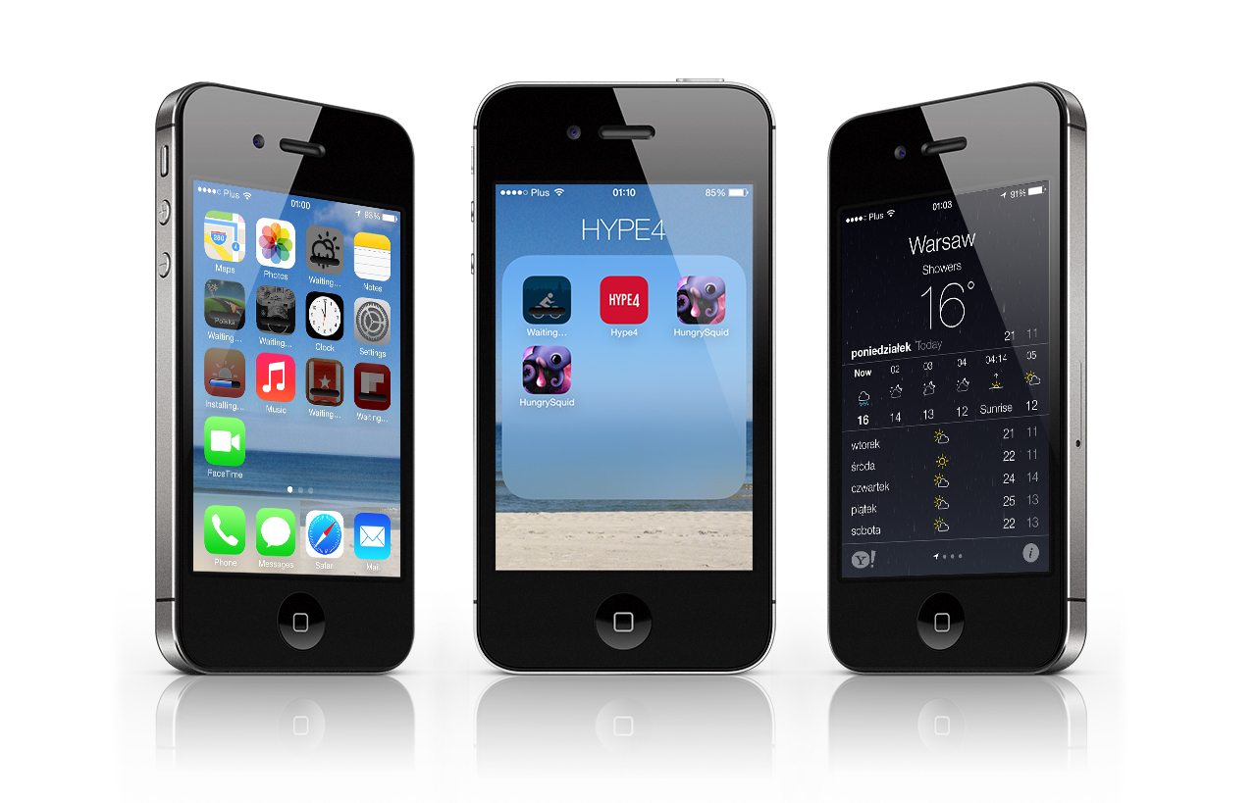

Slide 15
iPhone 5
Apple introduced the new iPhone 5 on September 12, 2012, the iPhone 5 has a bigger screen of 4 inches.
It is built of glass and aluminum. Is thinner than ever made (only 7.6 mm thick), being 20% lighter.
The screen resolution is 1136 x 640 pixels and has 44% more saturation than the last.
The new iPhone includes LTE and Wi-Fi, new technology that lets you use the 5 GHz band and reach speeds of 150 Mbit / s.

Slide 16
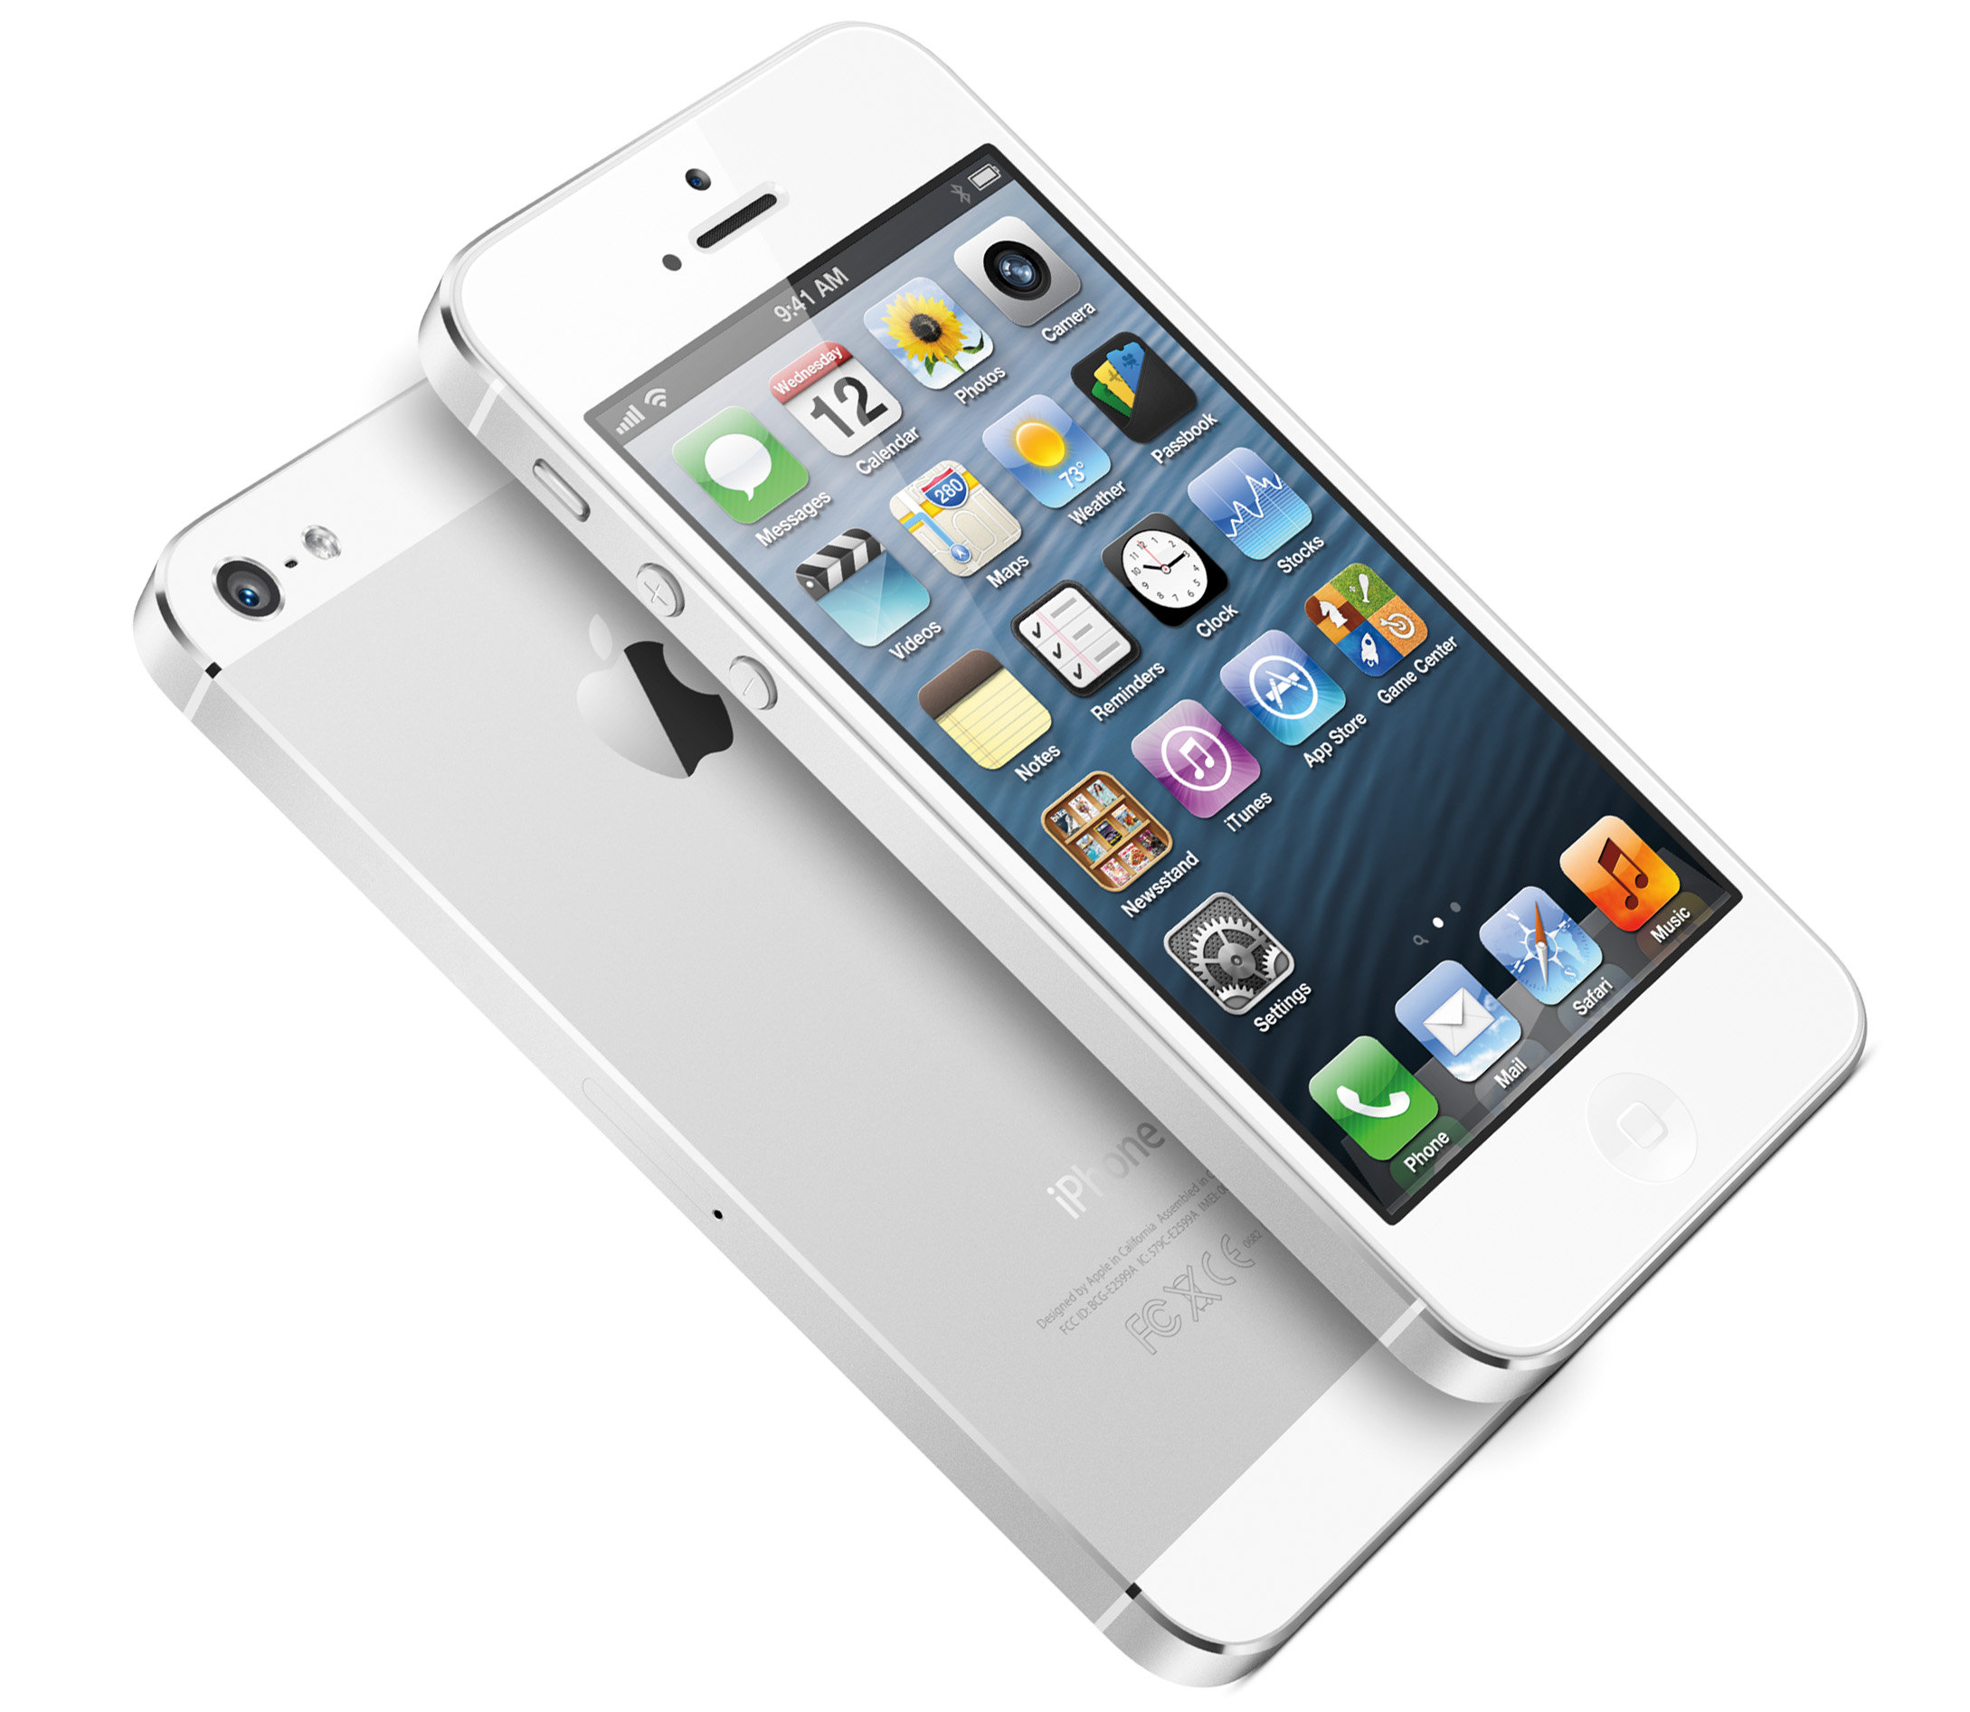

Slide 17
iPhone 5c
Take the same technology as the iPhone 5, even though their asses finishes are water-resistant polycarbonate, 7 and iOS has some improvements in cameras. This available in various colors and in typical Apple offers capabilities that are 16GB Includes 32GB and 8MP camera with Full HD recording (1080p) Includes digital zoom in video recording (3X) Take the A6 chip, which is what we see in the iPhone 5 and similar to the iPad with Retina display

Slide 18
iPhone 5s
The new iPhone 5s, and incorporates many best features like the new sensor Touch ID, the completely redesigned iSight camera, the new A7 and M7 chip. It is also available in three colors: spatial, gray silver and gold.
Some features of iPhone 5s are: 4-inch Retina Display iSight Camera 8 megapixel with flash TrueTrone recording in slow motion (120fps), burst of 10 photos per second and panoramic photo mode

Slide 19
Limitations
Adobe Flash
Syncing Software
Battery Life
Multitasking and Older iPhone Models

Slide 20
Conclusion
The iPhone is pretty
It's touchy-feely
It will make other phones better
It's not a phone, it's a platform
It is but the ghost of iPhones yet to come

Slide 21
Reference
www.google.com
www.wikipedia.com
www.studymafia.org

Slide 22
Thanks

Slide 23
Queries?

