Slide 1

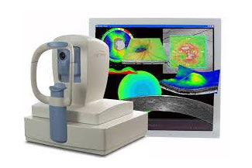
www.studymafia.org
Seminar
On
Optical Coherence Tomography
Submitted To: Submitted By:
www.studymafia.org www.studymafia.org
Notes:
1
1

Slide 2
CONTENT
Introduction
What is OCT
Advantage of OCT
Nowadays and future equipment
Needle for OCT
OCT in Nontransparent Tissue
OCT application
Limitation
Future works
Underway work
Extention and application of OCT
Market
Conclusion
References

Slide 3
Introduction
Optical coherence tomography (OCT) is a fundamentally new type of optical imaging modality.
OCT performs high-resolution, cross-sectional tomographic imaging of the internal microstructure in materials and biologic systems by measuring backscattered or backreflected light.

Slide 4
What is OCT(Optical Coherence Tomography)?
OCT use low-coherence interferometry to produce a two or three dimensional image of optical scattering from internal tissue microstructures.
Michelson interferometer is used to perform low-coherence interferometry
OCT measures intensity of reflected infrared light.

Slide 5
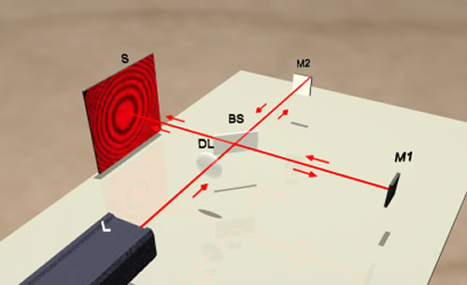
Michelson interferometer

Slide 6
fundamental OCT Schematic
SLD
PZT
Sample
Detector
Demodulator
AD
Reference
Computer

Slide 7
Advantage of OCT
Broad dynamic range,
High resolution
Rapid data acquisition rate,
Small inexpensive catheter/endoscope design
Compact portable structure
(fiber optically based, making possible the development of small catheters and endoscopes)
The frame rate for OCT systems are four to eight frames per second.(assume an image size of 256 by 512 pixels.)

Slide 8
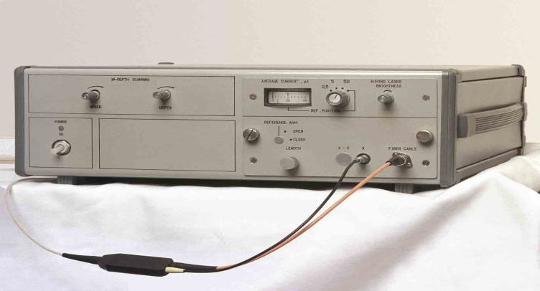
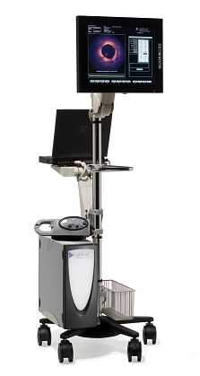
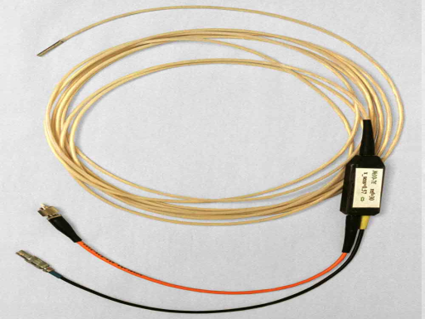
Nowadays and future equipment
Low-coherence Superluminescent diode:800 –1300 nm center waveength and severl milliwatts power.
DISPLAY
AND
KEYBOARD
INTEROMETER ELECTRONICS
AND
OPTICS
+COMPUTER
FIBEROPTIC PROBE
Not available for sale
Pending 510(k)

Slide 9
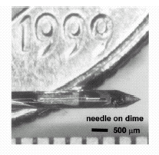
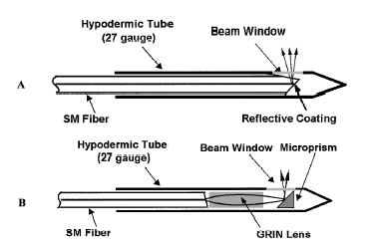
Needle for OCT

Slide 10
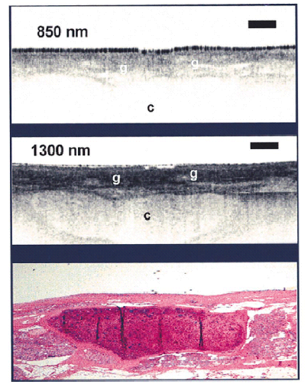
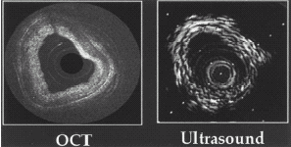
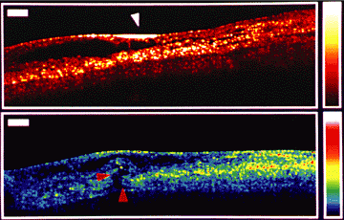
OCT in Nontransparent Tissue
B arterial layers
A epiglottis
C atherosclerotic plaques

Slide 11
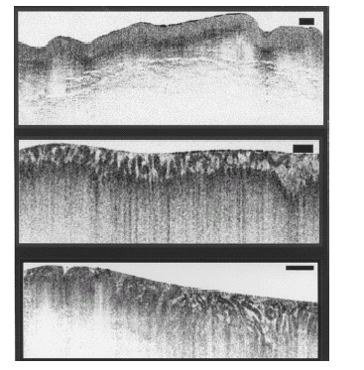
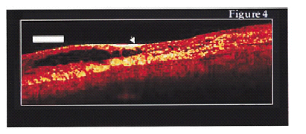
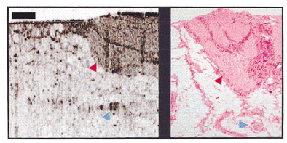
OCT application
Esophagus & epithelium & early cancer
Vulnerable plaque
B Reduce Biopsy Hazardous
Prostate
A Reduce High False-Negative Rates
Applied in guiding microsurgical procedure

Slide 12
Limitation
Penetration: 2-3mm Ideal: 4mm
Resolution :
catheter/endoscope based image: 10μm, noncatheter: 4 μm,
1. femtosecond laser is expensive (1 μm)
2. transverse resolution needs to be similar to axial resolution, below 10 μm need short confocal parameter which results in the focus falling off rapidly.
Acquisition rate: <10franes/second
Lack of large-scale clinical trials

Slide 13
Future works
Penetration and Resolution:
1. Need to develop with similar median wavelength, power, and bandwidth to those of the mode locked laser.
2. Need more complex catheter/ endoscope designs to alleviate the focus falling off rapidly.
Acquisition rates: video rate is anticipated with future embodiments.

Slide 14
Underway work
Combine OCT with Doppler velocimetry and measurement of birefringence properties.
The potential of giving OCT the ability to make both structural and dynamic assessments.

Slide 15
Extention and application of OCT
Name | Work | Research | Application
Dr. Zhongping Chen | University of California, Irvine | Doppler OCT | studying blood vessel function and fluid flow, generally in small structures.
Dr. Johannes de Boer | Massachusetts General Hospital (MGH) | polarization-sensitive OCT | diagnosing burns and guiding appropriate treatment
Dr. Brett Bouma and Dr. Guillermo Tierney | MGH | very portable, high-performance OCT systems for clinical diagnostic studies | major clinical investigations are ongoing in the fields of gastroenterology, dermatology, cardiology, urology, orthopedics, gynecology, and otolaryngology.

Slide 16
Market
Imalux Corporation: leader
potential of OCT marketing is $2.5 billion in annual revenue
OCT will result in a multi-application industry similar to the path taken by ultrasound.
markets of gastroenterology, urology, and gynecology represent revenue potential of $781 million.

Slide 17
Conclusion
OCT can perform a type of optical biopsy, the micron-scale imaging of tissue morphology in situ and in real time.
Image information is available immediately without the need for excision and histologic processing of a specimen.
The development of high-resolution and high-speed OCT technology as well as OCT compatible catheter/endoscopes and other delivery systems represent enabling steps for many future OCT imaging clinical applications.

Slide 18
References
www.google.com
www.wikipedia.com
www.studymafia.org

