Slide 1
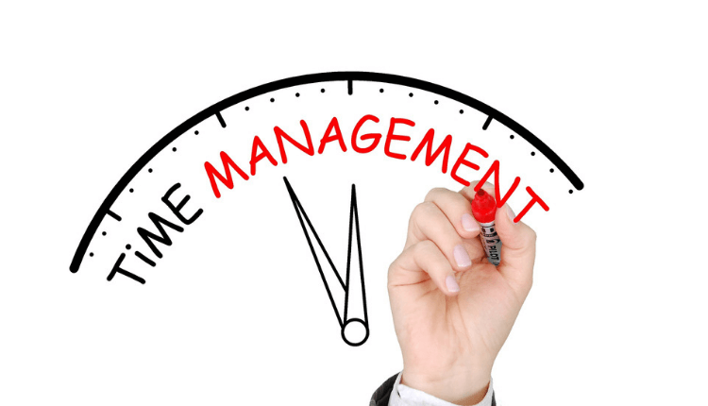
www.studymafia.org
Seminar
On
Time Management
Submitted To: Submitted By:
www.studymafia.org www.studymafia.org
Notes:
1
1

Slide 2
Definition
Time Management refers to managing time effectively so that the right time is allocated to the right activity.
2
Notes:
SAY: Before we wrap up the course, let’s review what we have learned today.
During this course, we have
<READ the bullets from the slide.>
GO to next slide.

Slide 3
Introduction
Effective time management allows individuals to assign specific time slots to activities as per their importance.
Time Management refers to making the best use of time as time is always limited.
3
Notes:
SAY: Before we wrap up the course, let’s review what we have learned today.
During this course, we have
<READ the bullets from the slide.>
GO to next slide.

Slide 4
4
Notes:
SAY:
The purpose of epidemiology in public health practice is to
discover the agent, host, and environmental factors that affect health;
determine the relative importance of causes of illness, disability, and death;
identify those segments of the population that have the greatest risk from specific causes of ill health; and
evaluate the effectiveness of health programs and services in improving population health.
GO to next slide.

Slide 5
Time Management Techniques
Effective Planning
Plan your day well in advance. Prepare a To Do List or a “TASK PLAN”. Jot down the important activities that need to be done in a single day against the time that should be allocated to each activity.
●●●
5
Notes:
SAY:
The purpose of epidemiology in public health practice is to
discover the agent, host, and environmental factors that affect health;
determine the relative importance of causes of illness, disability, and death;
identify those segments of the population that have the greatest risk from specific causes of ill health; and
evaluate the effectiveness of health programs and services in improving population health.
GO to next slide.

Slide 6
Time Management Techniques
Setting Goals and Objectives
Working without goals and targets in an organization would be similar to a situation where the captain of the ship loses his way in the sea. Yes, you would be lost. Set targets for yourself and make sure they are realistic ones and achievable.
●●●
6
Notes:
SAY:
The purpose of epidemiology in public health practice is to
discover the agent, host, and environmental factors that affect health;
determine the relative importance of causes of illness, disability, and death;
identify those segments of the population that have the greatest risk from specific causes of ill health; and
evaluate the effectiveness of health programs and services in improving population health.
GO to next slide.

Slide 7
Time Management Techniques
Setting Deadlines
Set deadlines for yourself and strive hard to complete tasks ahead of the deadlines. Do not wait for your superiors to ask you everytime. Learn to take ownership of work.
One person who can best set the deadlines is you yourself.
●●●
7
Notes:
SAY:
The purpose of epidemiology in public health practice is to
discover the agent, host, and environmental factors that affect health;
determine the relative importance of causes of illness, disability, and death;
identify those segments of the population that have the greatest risk from specific causes of ill health; and
evaluate the effectiveness of health programs and services in improving population health.
GO to next slide.

Slide 8
Time Management Techniques
Delegation of Responsibilities
Learn to say “NO” at workplace. Don’t do everything on your own. There are other people as well. One should not accept something which he knows is difficult for him.
The roles and responsibilities must be delegated as per interest and specialization of employees for them to finish tasks within deadlines.
●●●
8
Notes:
SAY:
The purpose of epidemiology in public health practice is to
discover the agent, host, and environmental factors that affect health;
determine the relative importance of causes of illness, disability, and death;
identify those segments of the population that have the greatest risk from specific causes of ill health; and
evaluate the effectiveness of health programs and services in improving population health.
GO to next slide.

Slide 9
Time Management Techniques
Prioritizing Tasks
Prioritize the tasks as per their importance and urgency. Know the difference between important and urgent work. Identify which tasks should be done within a day, which all should be done within a month and so on.
Tasks which are most important should be done earlier.
●●●
9
Notes:
SAY:
The purpose of epidemiology in public health practice is to
discover the agent, host, and environmental factors that affect health;
determine the relative importance of causes of illness, disability, and death;
identify those segments of the population that have the greatest risk from specific causes of ill health; and
evaluate the effectiveness of health programs and services in improving population health.
GO to next slide.

Slide 10
Time Management Techniques
Spending the right time on right activity
Develop the habit of doing the right thing at the right time. Work done at the wrong time is not of much use.
Don’t waste a complete day on something which can be done in an hour or so. Also keep some time separate for your personal calls or checking updates on Facebook or Twitter.
10
Notes:
SAY:
The purpose of epidemiology in public health practice is to
discover the agent, host, and environmental factors that affect health;
determine the relative importance of causes of illness, disability, and death;
identify those segments of the population that have the greatest risk from specific causes of ill health; and
evaluate the effectiveness of health programs and services in improving population health.
GO to next slide.

Slide 11
Time Management Skills
Stay Organized
The workstation must be kept clean and organized.
Keeping important files organized helps you retrieve them immediately and thus saves time which goes on unnecessary searching. Staple important documents together.
Do not keep stacks of files and heaps of paper on your desk.
●●●
11
Notes:
SAY:
The purpose of epidemiology in public health practice is to
discover the agent, host, and environmental factors that affect health;
determine the relative importance of causes of illness, disability, and death;
identify those segments of the population that have the greatest risk from specific causes of ill health; and
evaluate the effectiveness of health programs and services in improving population health.
GO to next slide.

Slide 12
Time Management Skills
Learn to Prioritize
Set your priorities. Do not work just for the sake of working.
Prepare a “Task Plan” or a “To Do” List the moment you settle down for work. Jot down all the activities you wish to do in a single day as per importance and urgency.
High priority tasks must be attended to immediately.
●●●
12
Notes:
SAY:
The purpose of epidemiology in public health practice is to
discover the agent, host, and environmental factors that affect health;
determine the relative importance of causes of illness, disability, and death;
identify those segments of the population that have the greatest risk from specific causes of ill health; and
evaluate the effectiveness of health programs and services in improving population health.
GO to next slide.

Slide 13
Time Management Skills
Be Punctual and Disciplined
Being punctual helps you complete tasks way ahead of deadline.
Avoid taking too many leaves from work. Such an attitude is completely unprofessional.
Make sure you are there at your desk five minutes before your actual time.
●●●
13
Notes:
SAY:
The purpose of epidemiology in public health practice is to
discover the agent, host, and environmental factors that affect health;
determine the relative importance of causes of illness, disability, and death;
identify those segments of the population that have the greatest risk from specific causes of ill health; and
evaluate the effectiveness of health programs and services in improving population health.
GO to next slide.

Slide 14
Time Management Skills
Take Ownership of work
Do not work only when your boss is around. Work for yourself. The dedication has to come from within.
Be responsible for your work and learn to accept your mistakes.
If you have accepted something, then it becomes your responsibility to complete it within the allotted time slot.
●●●
14
Notes:
SAY:
The purpose of epidemiology in public health practice is to
discover the agent, host, and environmental factors that affect health;
determine the relative importance of causes of illness, disability, and death;
identify those segments of the population that have the greatest risk from specific causes of ill health; and
evaluate the effectiveness of health programs and services in improving population health.
GO to next slide.

Slide 15
Time Management Skills
Be a little Diplomatic
Do not accept everything which comes your way. A polite “NO” in the beginning will save your reputation later.
The employees must be delegated responsibilities as per their specialization and background. This way they take more interest and eventually finish work on time.
●●●
15
Notes:
SAY:
The purpose of epidemiology in public health practice is to
discover the agent, host, and environmental factors that affect health;
determine the relative importance of causes of illness, disability, and death;
identify those segments of the population that have the greatest risk from specific causes of ill health; and
evaluate the effectiveness of health programs and services in improving population health.
GO to next slide.

Slide 16
Time Management Skills
More Focused
Be a little focused and concentrate on work. Do not waste time by loitering and gossiping around.
Do not take long personal calls at work. Finish off work and leave for the day on time. You will have ample time to catch up with your friends or log on to social networking sites.
16
Notes:
SAY:
The purpose of epidemiology in public health practice is to
discover the agent, host, and environmental factors that affect health;
determine the relative importance of causes of illness, disability, and death;
identify those segments of the population that have the greatest risk from specific causes of ill health; and
evaluate the effectiveness of health programs and services in improving population health.
GO to next slide.

Slide 17
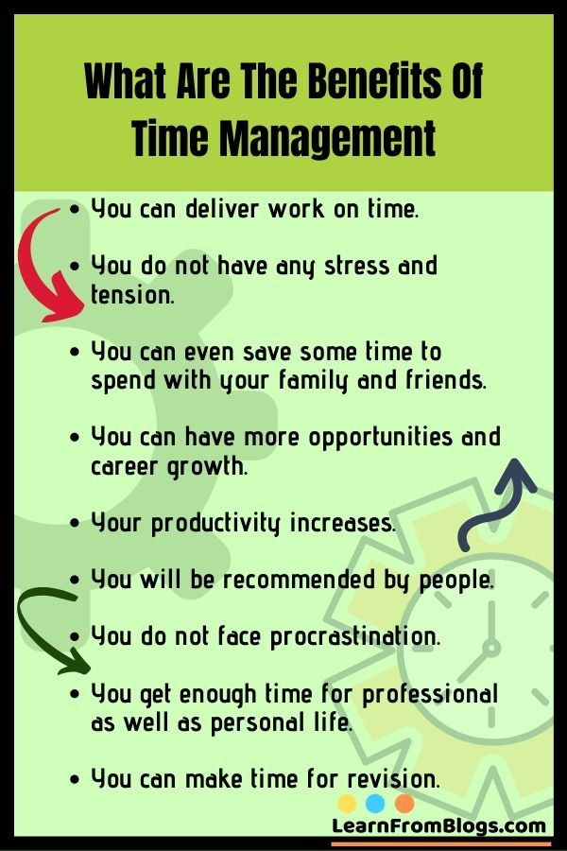

Slide 18
Conclusion
Time management is the process of organizing and planning how to divide your time between different activities. Get it right, and you'll end up working smarter, not harder, to get more done in less time – even when time is tight and pressures are high. The highest achievers manage their time exceptionally well.
18
Notes:
SAY:
The purpose of epidemiology in public health practice is to
discover the agent, host, and environmental factors that affect health;
determine the relative importance of causes of illness, disability, and death;
identify those segments of the population that have the greatest risk from specific causes of ill health; and
evaluate the effectiveness of health programs and services in improving population health.
GO to next slide.

Slide 19
References
www.google.com
www.wikipedia.com
www.studymafia.org

Slide 20
Thanks

