Slide 1
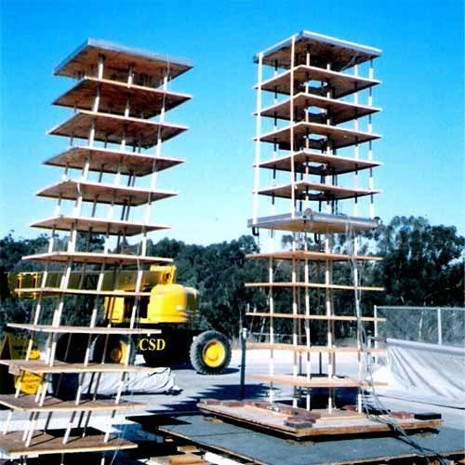
www.studymafia.org
Seminar
On
Earthquake Resistant
Building Construction
Submitted To: Submitted By:
www.studymafia.org www.studymafia.org
Notes:
1
1

Slide 2
CONTENTS
INTRODUCTION
HOW EARTHQUAKE RESISTENT BUILDING IS DIFERENT?
EFFECT OF EARTHQUAKE ON REINFORCED CONCRETE BUILDINGS
SEISMIC DESIGN PHILOSOPHY
REMEDIAL MEASURES TO MINIMISE THE LOSSES DUE TO
EARTHQUAKES
EARTHQUAKE RESISTANT BUILDING CONSTRUCTION WITH
REINFORCED HOLLOW CONCRETE BLOCK (RHCBM)
MID-LEVEL ISOLATION
EARTHQUAKE RESISTANCE USING SLURRY INFILTRATED
MAT CONCRETE (SIMCON)
TRADITIONAL EARTHQUAKE RESISTANT HOUSING
CONCLUSIONS
REFERENCES

Slide 3
INTRODUCTION
An earthquake is the vibration, sometimes violent to the earth’s surface that follows a release of energy in the earth’s crust.
This energy can be generated by a sudden dislocation of segments of the crust, by a volcanic eruption or even by a manmade explosion.
The dislocation of the crust causes most destructive earthquakes.

Slide 4
HOW EARTHQUAKE RESISTANT CONSTRUCTION IS DIFFERENT?
Since the magnitude of a future earthquake and shaking intensity expected at a particular site cannot be estimated with a reasonable accuracy, the seismic forces are difficult to quantify for the purposes of design.
Further, the actual forces that can be generated in the structure during an earthquake are very large and designing the structure to respond elastically against these forces make it too expensive.

Slide 5
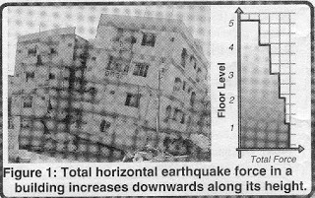
EFFECT OF EARTHQUAKE ON REINFORCED CONCRETE BUILDINGS
In recent times, reinforced concrete buildings have become common in India.
A typical RC building is made of horizontal members (beams and slabs) and vertical members (columns and walls) and supported by foundations that rest on the ground.
The system consisting of RC columns and connecting beams is called a RC frame.

Slide 6
SEISMIC DESIGN PHILOSOPHY
Severity of ground shaking at a given location during earthquake can be minor, moderate and strong.
Relatively speaking, minor shaking occurs frequently; moderate shaking occasionally and strong shaking rarely.
Earthquake resistant building:
Earthquake design philosophy:

Slide 7
REMEDIAL MEASURES TO MINIMISE THE LOSSES DUE TO EARTHQUAKES
Building planning
Foundation
Provision of band
Arches and domes
Staircases

Slide 8
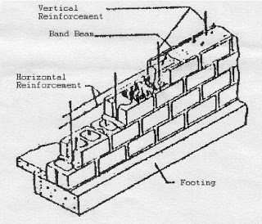
EARTHQUAKE RESISTANT BUILDING CONSTRUCTION WITH REINFORCED HOLLOW CONCRETE BLOCK (RHCBM)
Reinforced hollow concrete blocks are designed both as load-bearing walls for gravity loads and also as shear walls for lateral seismic loads, to safely withstand the earthquakes.
This structural system of construction is known as shear wall-diaphragm concept, which gives three-dimensional structural integrity for the buildings.

Slide 9
MID-LEVEL ISOLATION
This includes mid-level isolation system installed while the buildings are still being used.
This new method entails improving and classifying the columns on intermediate floors of an existing building into flexible columns that incorporate rubber bearings (base isolation systems) and rigid columns which have been wrapped in steel plates to add to their toughness.

Slide 10
EARTHQUAKE RESISTANCE USING SLURRY INFILTRATED MAT CONCRETE (SIMCON)
Following the devastating earthquakes in Turkey this summer that killed as many as 20,000 people and injured another 27,000, images of survivors trapped beneath the rubble of collapsed buildings appeared daily in news reports worldwide.
Now a North Carolina State University engineer is developing a new type of concrete to help prevent such scenes from happening again.

Slide 11
TRADITIONAL EARTHQUAKE REISTANT HOUSING
The Pherols of Uttarkashi
The Dhajji-Diwari buildings of Kashmir
The Kat-Ki- Kunni Buildings of Kulu Valley
Quincha earthquake resistant buildings

Slide 12
CONCLUSIONS
There is a lack of awareness in the earthquake disaster mitigations. Avoiding non-engineered structures with unskilled labour even in unimportant temporary constructions can help a great way.
Statewide awareness programmes have to be conducted by fully exploiting the advancement in the information technology.
Urgent steps are required to be taken to make the codal provisions regarding earthquake resistant construction undebatable.

Slide 13
REFERENCES
www.google.com
www.wikipedia.com
www.studymafia.org

Slide 14
Thanks

