Slide 1
www.studymafia.org
Seminar
On
Jini Technology
Submitted To: Submitted By:
www.studymafia.org www.studymafia.org

Slide 2
Content
Introduction about JINI.
History
Goal of JINI.
Architecture.
Component of JINI.
Benefits of JINI.
Limitations of JINI.
Application of JINI.
Conclusion.
References.

Slide 3
Introduction
Jini technology provides a simple infrastructure for delivering services(application, database, printing, storage etc) in a network and for creating an interaction between programs that use these services regardless of their hardware/software implementation.
Services can be added or removed from the network and new clients can find existing services.

Slide 4
History
The idea of the Jini system was invented by Sun cofounder Bill Joy at Sun Aspen Small works R&D lab in 1994.
Sun introduced Jini in July 1998. In November of 1998, Sun announced that there were some firms supporting Jini.
The word 'jini' means "the devil" which is the origin of the English word 'genie'. On January 25, 1999, Jini was officially launched and the technology is available for download.

Slide 5
Goal of Jini Technology
To enable users to share services and resources over a network.
To provide users the ability to access resources anywhere easily on the network, even though the network location of the user may constantly change.
To simplify the task of creating and managing network devices, software services, and users.

Slide 6
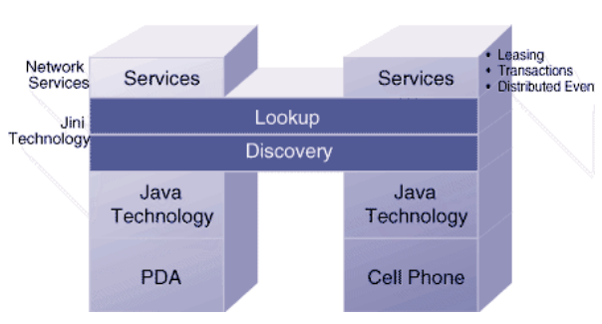
Jini Architecture
Connects to a TCP/IP network.
Use a discovery protocol to find at least one lookup service.
Register with the lookup service.
Continue to renew the resource's releases, as long as the service is available to the network.

Slide 7
Benefits of JINI
It is easy to add and remove services.
Services can be relocated on the network without affecting users.
JINI is open-source, meaning that the program code is freely available on the Internet and there are no fees for using it.
The JINI architecture is scalable.
Services are available immediately and are found automatically.
Everyone can access to same information & resources.

Slide 8
Limitations
Depends on java/RMI or external mechanism for security.
Does not scale well to very large systems because jini use lookup service as a broker between client & services.

Slide 9
Components
Services
Lookup Services
Discovery and Join
Extended RMI
Leasing
Transactions
Java Spaces
Distributed Security
Distributed Events

Slide 10
Services
A service can be anything that sits on the network and is ready to perform a useful function. Hardware devices, software, communications channels – even human users themselves -- can be services
Services may be added or withdrawn from a Jini federation at any time
Jini provides mechanisms for service registration, lookup and use
Services communicate by using a service protocol = set of Java interfaces
Set of services is open-ended

Slide 11
Lookup Services
Lookup Services are the central organizing mechanism for Jini-based systems and provide mapping of interfaces to objects. Lookup enables a client to query a lookup service for services that can help the client accomplish its goals
Hierarchical Lookup: Lookup service may include entry for other lookup services. When new services become available on the network, they register themselves with a lookup service
When clients wish to locate a service to assist with some task, they consult a lookup service
The runtime infrastructure uses one network-level protocol, called discovery, and two object-level protocols, called join and lookup

Slide 12
Discovery and Join
Discovery is the protocol by which Jini services register themselves with a lookup service
Discovery or Lookup is performed by doing a multicast (to find all lookup services) or unicast (when you know the machine on which the lookup service is running) lookup. Jini™ enabled Object (representing a hardware and/or software service) multicasts a packet with a reference to itself
The service receives RMI reference to Lookup service (one or more)
The service joins a federation by placing an object representing capabilities into the Lookup service for other clients and services to use for a period of time
Discovery enables clients and services to locate lookup services
Join enables a service to register itself in a lookup service

Slide 13
Extended RMI
Communication among services uses Java RMI
Extended with leases
RMI provides
Activation
Distributed Garbage Collection
Multicast
Replication

Slide 14
Leasing
A lease is a grant of guaranteed access over a time period.
Each lease is negotiated between the user of the service and the provider of the service as part of the service protocol
A service is requested for some period; access is granted for some period, presumably taking the request period into account. Leases in term of duration (relative time)
– lookup service needs to use resource to maintain registration
– device failure can cause error in the available service log
If lease expires without renewal, user and provider can free associated resource
Leases handle client and network failures, removal of services…
Leases in Jini is self-healing. Exclusive lease says service cannot be shared

Slide 15
Transactions
Partial failure in distributed systems is a nightmare
A series of operations, either within a single service or spanning multiple services, can be wrapped in a transaction
The Jini Transaction interfaces supply a service protocol needed to coordinate a two-phase commit
– all results save in temporary storage
– move from temporary to permanent storage
Insures changes made atomically- all or none
The very semantics of the notion of a transaction is left up to the service using the interfaces

Slide 16
Java Spaces
The JavaSpaces technology is written in the Java language and is a simple, fast and unified mechanism for dynamic communication, co-ordination and sharing of objects
In a distributed application, JavaSpaces technology acts as a virtual space between providers and requestors of network resources or objects
participants in a distributed solution can exchange tasks, requests information in the form of Java technology-based objects
JavaSpaces technology provides developers with the ability to create and store objects with persistence

Slide 17
Distributed Security
The design of the security model for Jini technology is built on the twin notions of a principal and an access control list.
Jini services are accessed on behalf of some entity—the principal, which generally traces back to a particular user of the system.
Services themselves may request access to other services based on the identity of the object that implements the service. Whether access to a service is allowed depends on the contents of an access control list that is associated with the object.
Security plays an important role in distributed systems. The Jini security model is based on the JDK 1.2 security system.

Slide 18
Distributed Events
Jini supports distributed events
An object may allow other objects to register interest in events in the object and receive a notification of the occurrence of such an event
Uses the Observer pattern and sensitive to network issues – delays, disruptions etc
Serializable and can be moved across a network
Most useful in observing service changes – lookup services going up or down etc
Enables distributed event-based programs to be written with a variety of reliability and scalability guarantees

Slide 19
Requirements of Jini
An infrastructure which operates as a dynamically distributed
system
A common language and implementation that enables low-overhead communication between distributed objects
A lookup service which identifies objects that supply those services
An add-in protocol which is implemented on each device—this is called the discovery/join protocol
A subtract-out mechanism—providing resilience when a device is unplugged which is called leasing

Slide 20
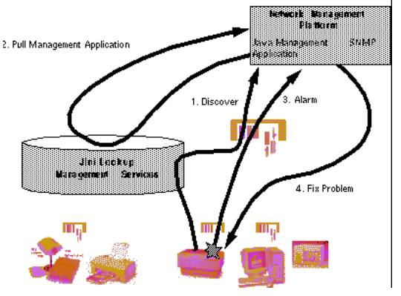
Application
Managing a Printer:

Slide 21
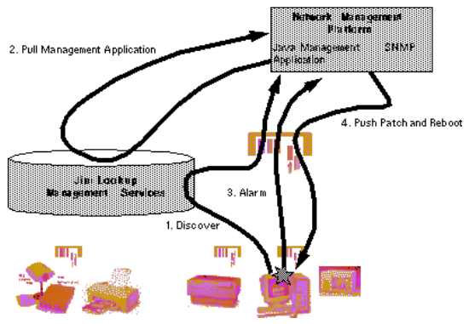
Application (Cont…)
Managing NT server:

Slide 22
Conclusion
Jini's promise is not limited to the domain of network devices.
It can be expanded to scanners, printers, phones, radios etc.
Before Jini can become the basis for such mission-critical applications, its ability to scale up to thousands of network devices and maintain high levels of security needs to be tested under stress and refined.

Slide 23
Reference
www.google.com
www.wikipedia.com
www.studymafia.org

Slide 24
Thanks

