Slide 1
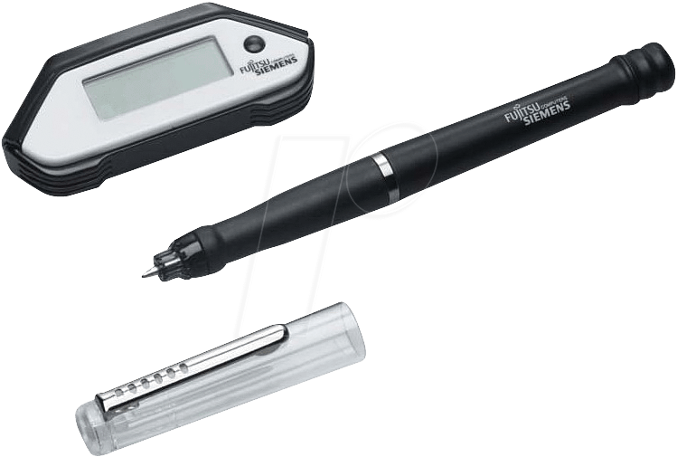
www.studymafia.org
Seminar
On
Smart Note Taker
Submitted To: Submitted By:
www.studymafia.org www.studymafia.org
Notes:
1

Slide 2
Introduction
The Smart Note Taker is such a helpful product that satisfies the needs of the people in today's technologic and fast life.
This product can be used in many ways.
The Smart Note Taker provides taking fast and easy notes to people who are busy one's self with something.
This will save time and facilitate life.

Slide 3
Features Of Smart Note Taker
With the help of smart note taker handwritten notes will be instantly converted into editable text.
It is good and helpful for blinds that think and write freely.
It’s also useful especially for instructors in presentation . The Instructors may not want to present the lecture in front of the board.

Slide 4
SYSTEM OVERVIEW
CONSTRUCTION
Since, JAVA applet is suitable for both the drawings and strings, all these applications can be put together by developing a single JAVA applet program.
Applet
Applet is a function of java which for example, is a kind of container (file) which contains a set of programs made in java.

Slide 5
Database
The system installed in the pen will consist of a database which will help the processor to recognize various words made visually in the air.

Slide 6
Working
Smart note taker will be simple but powerful. The product will be able to sense 3D shapes and motions that user tries to draw. The sensed information will be processed and transferred to the memory chip and then will be monitored on the display device.

Slide 7
TECHNICAL DEFINITION OF THE PRODUCT
Operating System
Software program to convert data into text or string format
Displacement Sensor
Parallel cable
Analog to digital converter
Switch
Rechargeable battery

Slide 8
OPPORTUNITIES IN THE MARKET
In the current market there are many similar products that are trying to convert handwritten documents into digital typed documents.
In these products, optical sensors are being widely used to perceive the motion.

Slide 9
Treats in the Market
Companies had succeeded to make similar products and put them in the market .
Putting a newly invented, innovative product in the market is not easy.
The prices in the market must be well observed for similar products.

Slide 10
SMART NOTETAKER’S
Smart note taker is incompatible among the other products.
It has some significant differences from its potential competitors.
This plays crucial role in the marketing strategy and attractiveness of product in the segmented mark.

Slide 11
CURRENT PRODUCTS
MOBILE NOTE TAKER
The Ultimate Handwriting Capture Device Mobile Note Taker TM is the world’s first portable handwriting capture device based on natural handwriting as an input.
PC NOTE TAKER
PC Notes Taker is the world's first device that captures natural handwriting on any surface onto a PC in real time.

Slide 12
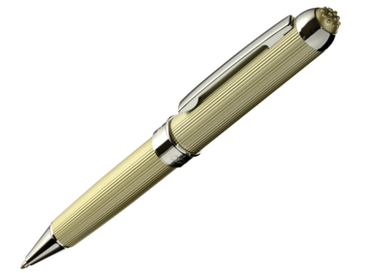
I-PEN
Product Features
Write or draw over any application screen.
Save your inputs and e-mail it.
Compact and light: perfect for laptop users.
Convert handwriting to text.
Annotate Web Pages.

Slide 13
How to Use
Install the driver and application software.
Plug-in the USB connector of into your computer's available USB port.
After successfully installing driver software begin testing by moving it around. When navigating, have it in an upright position for best accuracy and ease.
Switch between Mouse mode and Pen mode.

Slide 14
Applications
Tired of Printing, then signing, then faxes documents just to add a signature? You can input your signature on any document.
Mark and highlight a document for changes in any application. Add handwritten captions on photographs. Write a note right on a web page as if you were marking a newspaper. Then save and send.
Make a point of importance on any Presentation.

Slide 15
Advantages
Smart note taker is reliable and powerful.
It is helpful for blinds that think and write freely.
Smart note taker is used for instructors in presentations.
Easy-to-use wireless connection.
Drawer (Contents outline, library, history).
It is used in presentation also.
It is reliable and powerful.

Slide 16
Disadvantages
Cost of note takers is very high.
Only high class people can afford this type of note takers.

Slide 17
FUTURE SCOPE
Companies had succeeded to make similar products and put them in the market. Putting a newly invented, innovative product in the market is not easy. The prices in the market must be well observed for similar products.

Slide 18
CONCLUSION
The system will try to improve a pen, which helps people get rid of typing problems on computer by the technology, which converts your handwriting to text format on your PC.
The device takes a practical extent since it offers high mobility.
the price of innovation will be reasonable for the sectors that can use it effectively in their business or lessons.

Slide 19
Thanks…!!!!

