Slide 1
www.studymafia.org
Seminar
On
Capital Budgeting
Submitted To: Submitted By:
www.studymafia.org www.studymafia.org
Notes:
1

Slide 2
Content
What is Capital Budgeting?
Process
The Basic Steps of Capital Budgeting
Needs
Capital Budgeting Techniques
Types of Capital budgeting
Nature of Capital Budgeting
Benefits of Capital Budgeting
Limitations
Conclusion

Slide 3
What is Capital Budgeting?
Capital Budgeting, broadly defined as a decision-making process that enables managers to evaluate and recognize projects that are valuable to the company, is usually the dominant mission facing any financial manager and his/her team.
Capital Budgeting is the process by which the firm decides which long-term investments to make. Capital Budgeting projects, i.e., potential long-term investments, are expected to generate cash flows over several years.

Slide 4
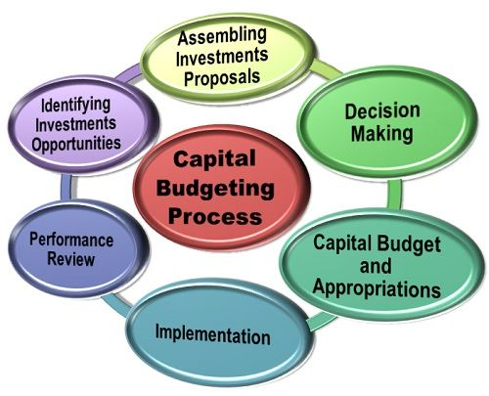
Capital Budgeting Process

Slide 5
The Basic Steps of Capital Budgeting
Capital Budgeting Basics: A company undertakes capital budgeting in order to make the best decisions about utilizing its limited capital.
Identify Potential Opportunities: The first step in the capital budgeting process is to identify the opportunities that you have.
Evaluate Opportunities: Once you have identified the reasonable opportunities, you need to determine which ones are the best.
Cash Flow: Next, you need to determine how much cash flow it would take to implement a given project.

Slide 6
Needs
1. Long-term Implication: Capital expenditure decision affects the company's future cost structure over a long time span.
2. Irreversible Decision: Capital investment decision are not easily reversible without much financial loss to the firm because there may be no market for second-hand plant and equipment and their conversion to other uses may not be financially viable.
3. Long-term Commitments Of Funds: Capital budgeting decision involves the funds for the long-term. So, it is long-term investment decision.

Slide 7
Capital Budgeting Techniques
Payback Period
Net Present Value (NPV)
Accounting Rate of Return (ARR)
Internal Rate of Return (IRR)
Profitability Index (PI)

Slide 8
Types of Capital budgeting
1) Accept reject decisions: all the investment decisions which give more return than the cost of capital they are acceptable while the investment decisions which give less return than the cost of capital they are rejected.
2) Mutually exclusive decisions: these are the decisions which compete with each other which mean the acceptance of one automatically rejects the other decision..
3) Capital rationing or ranking decisions: in case the firm has various profitable investment proposals in that case the firm had only option to rank them as per their profitability and then accept them.

Slide 9
Nature of Capital Budgeting
Capital expenditure plans involve a huge investment in fixed assets.
Capital expenditure once approved represents long-term investment that cannot be reserved or withdrawn without sustaining a loss.
(c) Preparation of coital budget plans involve forecasting of several years profits in advance in order to judge the profitability of projects.

Slide 10
Benefits of Capital Budgeting
Consistency and flexibility
2. Better financial decisions
3. Access risk and uncertainty
4. Analyze long-term repercussions

Slide 11
Limitations
There are certain factors like morale of the employees, good-will of the firm etc.’ which cannot be correctly quantified but which otherwise substantially influence the capital decision.
Urgency is another limitation in the evaluation of capital investment decisions.
Uncertainty and risk pose the biggest limitations to the techniques of capital budgeting.

Slide 12
Conclusion
The fundamental difference between the classical approach to project capital investing and budgeting, with its emphasis on form as described by King, and contemporary practices, is the recognition of the need to employ systems that underpin the delivery of shareholder value.

Slide 13
Reference
www.studymafia.org
www.wikipedia.com
www.google.com

Slide 14
Thanks

