Slide 1
www.studymafia.org
Seminar
On
Low Cost Automation
Submitted To: Submitted By:
www.studymafia.org www.studymafia.org

Slide 2
Content
INTRODUCTION
OBJECTIVE
WORKING
Comparison
Features
ADVANTAGES
DISADVANTAGES
FUTURE SCOPE
CONCLUSION

Slide 3
INTRODUCTION
Growing demand for the saving of electricity.
Failure in power supply causes difficulty and inconvenience.
An automatic emergency lamp that uses LED .
Highly bright due to use of white LEDs.
Turns on when mains supply fails ,turns off when power resumes.
Has own battery charger –stops charging automatically when fully charged.
This project aims to develop most power efficient and user friendly product.

Slide 4
OBJECTIVE
Reduce power consumption by using a low-cost, automatic white LED based emergency lamp using PWM.

Slide 5
BLOCK DIAGRAM
LED ARRAY
PWM USING ASTABLE OPERATION OF 555
BATTERY
TRANSFORMER
BRIDGE RECTIFIER CIRCUIT
REGULATION USING LM317

Slide 6
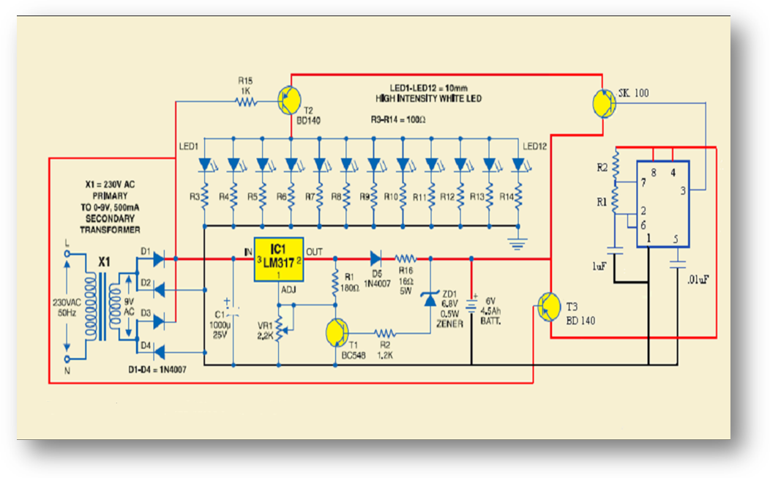
CIRCUIT DIAGRAM

Slide 7
WORKING
The circuit has three sections:
The charger power supply section:
Transformer: steps down(9V,500mA).
Bridge rectifier: rectifies transformer output.
LM317: voltage regulation.
Battery: provides supply when mains fails.
Zener diode: conducts when battery crosses its capacity.
7

Slide 8
555 timer section:
Control the LED section by PWM.
LED driver section:
Build around BD 140.
12 white LEDs connected in parallel.
LED section glows when mains fails.
Made to blink using astable operation of 555.
Appear fulltime ON due to persistence of vision.

Slide 9
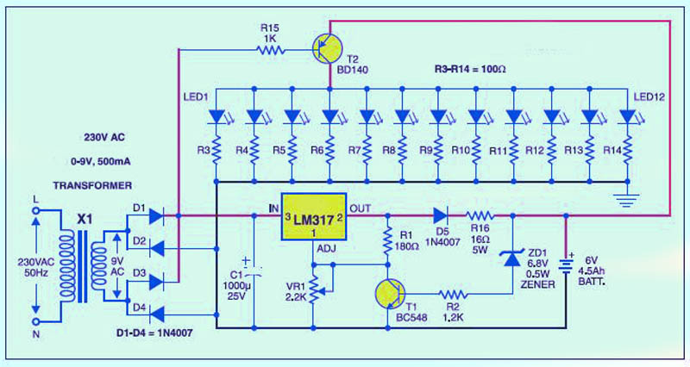
Comparison
Circuit without pwm
Circuit with pwm
Voltage across each LED = 2.96 V. Current through each LED = 2.7 mA. Power consumed by each LED = 7.992mW. Total power consumed by LED array = .095904 W.
Voltage across each LED = 2.74V. Current through each LED = 2.5mA. Power consumed by each LED = 6.85 mW. Total power consumed by LED array = .0822 W.

Slide 10
FEATURES
Simple:
Simple circuit. Components are easily available and low cost.
Automatic:
Automatically switches ON when the mains fails and turns OFF when mains power resumes. Also has its own battery charger which when fully charged stops charging automatically.
Convenient :
Makes our lives simpler , convenient to use.
Economical:
Energy consumption is very less , proves to be more economic for the consumer.

Slide 11
ADVANTAGES AND DISADVANTAGES OF LED
Advantages:
Efficiency: more light per watt than incandescent bulbs.
Color: can emit of an intended color without use of color filters.
Size: very small.
On/off time: light up very quickly.
cycling: can be subjected to frequent on-off cycling.
Dimming: can be dimmed by PWM.

Slide 12
Slow failure: mostly fail by dimming over time, rather than abrupt burn-out of incandescent bulbs.
Life time: long useful life time.
Toxicity: LEDs do not contain mercury, unlike fluorescent lamps.
Disadvantages:
Cost: currently more expensive.
Temperature dependence: performance largely depends on the operating temperature.
Health hazard: cool white LEDs can cause problems to eyes.

Slide 13
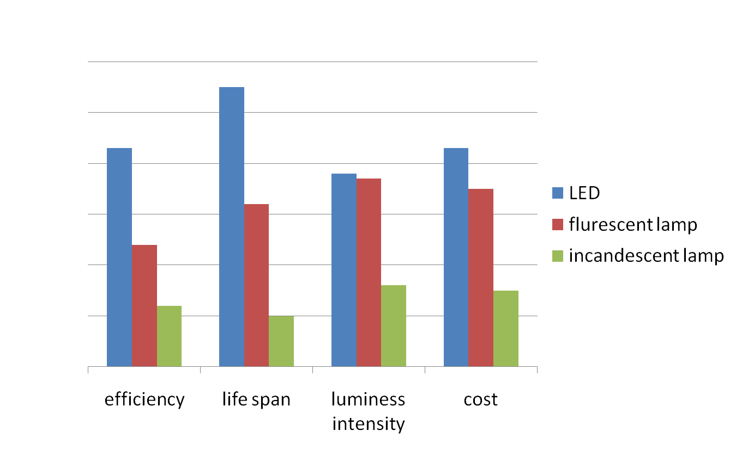
COMPARISON OF LED LAMPS WITH OTHER LIGHTING TECHNOLOGIES

Slide 14
CONCLUSION
The project was concluded to be innovative for the improvement of day today life.
Device also adds a new look to the traditional lamps.
The use of PWM helps us to reduce the wastage of energy.
The cost of implementing this circuit is also very less - an added advantage in using this circuit.

Slide 15
FUTURE SCOPE
We can again modernize this project using PWM.
It is expected that with additional development and growing researches, the PWM will gain more popularity and the cost of these bulbs will eventually decline.
This project can be adopted for mass production as cheap and efficient method.

Slide 16
REFERENCES
www.studymafia.org
www.wikipedia.com
www.google.com

