Slide 1
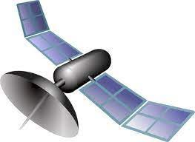
www.studymafia.org
Seminar On
Remote Sensing
Submitted To: Submitted By:
www.studymafia.org www.studymafia.org
Notes:
1

Slide 2
Content
What is remote sensing?
History of Remote Sensing
Process
Applications of Remote Sensing
Components
Advantages
Disadvantages
References

Slide 3
What is remote sensing?
Remote sensing is the art and science of recording, measuring, and analyzing information about a phenomenon from a distance.
Humans with the aid of their eyes, noses, and ears are constantly seeing, smelling, and hearing things from a distance as they move through an environment.
Thus, humans are naturally designed to be remote sensors. In order to study large areas of the Earth’s surface geographers use devices known as remote sensors.

Slide 4
History of Remote Sensing
Aerial photography is the original form of remote sensing (using visible spectrum) started in 1909
Aerial photographic reconnaissance was widely used after 1915 in WWI.
Photogrammetric Engineering, the official monthly publication of the American Society of Photogrammetry, was first published in 1934.
Color infrared photography began 1931, then was widely used in agriculture and forestry.
Development of radar (1930-1940).
During WWII, non-visible spectrum (infrared and radar) were used as tools in remote sensing.

Slide 5
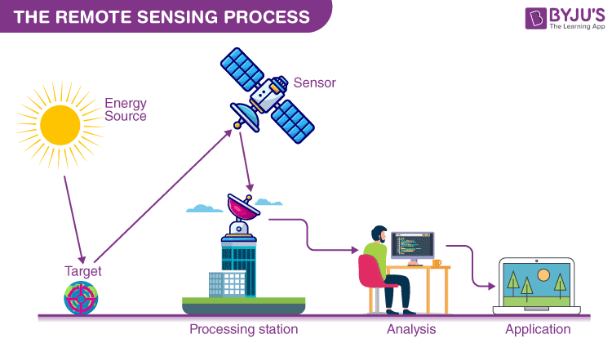
Process

Slide 6
Applications of Remote Sensing
Surface Temperature
Productivity
Suspended Materials

Slide 7
Why is remote sensing important?
- Remote sensing makes it possible to collect data on dangerous or inaccessible areas. - Remote sensing provides real time updates, and does not require active human assistance (i.e. you can collect data at any time, at any frequency, as long as the equipment allows it) - Remote sensing can detect things that are not normally present in the visible spectrum - for example, temperature, or by detecting landforms underneath the surface of the ground or ocean - Remote sensing can scan large areas of land by satellite - much more quickly than a ground survey ever could

Slide 8
Components
Energy Source or Illumination (A)
Radiation and the Atmosphere (B)
Interaction with the Target (C)
Recording of Energy by the Sensor (D)

Slide 9
Advantages
A) Provides data of large areas
b) Provides data of very remote and inaccessible regions
c) Able to obtain imagery of any area over a continuous period of time through which the any anthropogenic or natural changes in the landscape can be analyzed
d) Relatively inexpensive when compared to employing a team of surveyors
e) Easy and rapid collection of data
f) Rapid production of maps for interpretation

Slide 10
Disadvantages
a) The interpretation of imagery requires a certain skill level
b) Needs cross verification with ground (field) survey data
c) Data from multiple sources may create confusion
d) Objects can be misclassified or confused
e) Distortions may occur inanimage due to the relative motion of sensor and source

Slide 11
Reference
www.studymafia.org
www.wikipedia.com
www.google.com

Slide 12
Thanks

