Slide 1
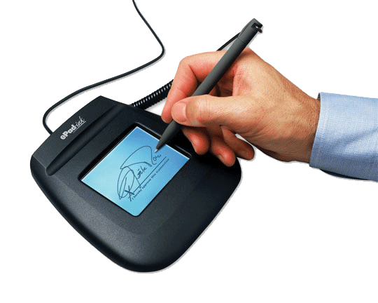
www.studymafia.org
Seminar
On
Digital Signature
Submitted To: Submitted By:
www.studymafia.org www.studymafia.org

Slide 2
Content
Introduction
History
What is Digital Signature
Why Digital Signature
Basic Requirements
How the Technology Works
Approaches

Slide 3
Content
Purpose of Digital Signature
Algorithm of Digital Signature
Challenges and Opportunities
Application
Drawbacks
Conclusion

Slide 4
INTRODUCTION
The authenticity of many legal, financial, and other documents is determined by the presence or absence of an authorized handwritten signature.
Various methods have been devised to solve this problem, but the use of ‘digital signature’ is definitely the best solution amongst them.
A digital signature is nothing but an attachment to any piece of electronic information, which represents the content of the document and the identity of the originator of that document uniquely.

Slide 5
HISTORY
Use of signatures is recorded in the Talmud (fourth century), complete with security procedures to prevent the alteration of documents after they are signed.
The practice of authenticating documents by affixing handwritten signatures began to be used within the Roman Empire in the year AD 439, during the rule of Valentinian III.
It is from this Roman usage of signatures that the practice obtained its significance in Western legal tradition.

Slide 6
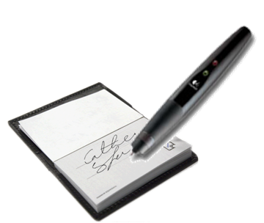
What is digital signature
Hash value of a message when encrypted with the private key of a person is his digital signature on that e-Document.
Digital Signature of a person therefore varies from document to document thus ensuring authenticity of each word of that document.
As the public key of the signer is known, anybody can verify the message and the digital signature.

Slide 7
Why Digital Signatures
To provide Authenticity, Integrity and Non-repudiation to electronic documents
To use the Internet as the safe and secure medium for e-Commerce and e-Governance

Slide 8
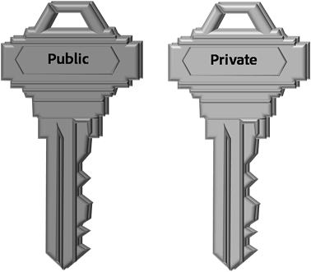
BASIC REQUIREMENTS….
Private Key
The private key is one which is accessible only to the signer. It is used to generate the digital signature which is then attached to the message.
Public Key
The public key is made available to all those who receive the signed messages from the sender. It is used for verification of the received message.

Slide 9
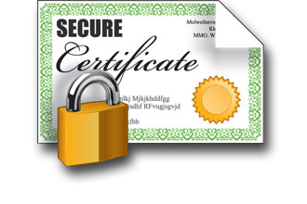
BASIC REQUIREMENTS
Digital Signature Certificate
A subscriber of the private key and public key pair makes the public key available to all those who are intended to receive the signed messages from the subscriber.
But in case of any dispute between the two sides, there must be some entity with the receiver which will allow the receiver of the message to prove that the message was indeed sent by the subscriber of the key pair. This can be done with the Digital Signature Certificate.

Slide 10
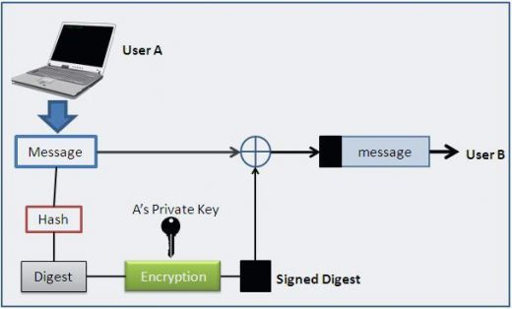
HOW THE TECHNOLOGY WORKS

Slide 11
PURPOSE OF DIGITAL SIGNATURE
Signer authentication
Message authentication
Non-repudiation
Integrity

Slide 12
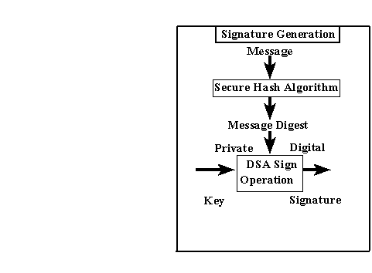
DIGITAL SIGNATURE ALGORITHM….

Slide 13
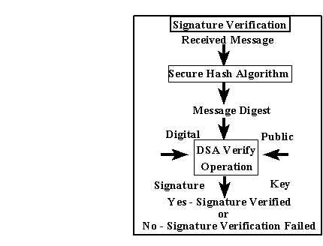
DIGITAL SIGNATURE ALGORITHM….
Digital Signature Verification

Slide 14
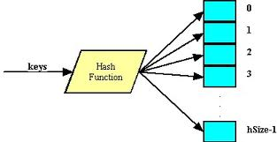
DIGITAL SIGNATURE ALGORITHM
Secure Hash Algorithm

Slide 15
Challenges and Opportunities
Institutional overhead:
The cost of establishing and utilizing certification authorities, repositories, and other important services, as well as assuring quality in the performance of their functions.
Subscriber and Relying Party Costs:
A digital signer will require software, and will probably have to pay a certification authority some price to issue a certificate. Hardware to secure the subscriber's private key may also be advisable.

Slide 16
APPLICATIONS …..
Electronic Mail
Data storage
Electronic funds transfer
Software Distribution

Slide 17
DRAWBACKS
The private key must be kept in a secured manner.
The process of generation and verification of digital signature requires considerable amount of time.
For using the digital signature the user has to obtain private and public key, the receiver has to obtain the digital signature certificate also.

Slide 18
CONCLUSION
Digital signatures are difficult to understand. Digital signatures will be championed by many players that the public distrusts, including national security agencies, law enforcement agencies, and consumer marketing companies.

Slide 19
References
www.wikipedia.com
www.google.com
www.studymafia.org

Slide 20
Thanks…!!!

