Slide 1
www.studymafia.org
Seminar
On
Augmented Reality
Submitted To: Submitted By:
www.studymafia.org www.studymafia.org

Slide 2
Index
Introduction
What is AR?
HISTORY
How is it used?
How does it work?
Applications
Augmented Reality vs. Virtual Reality
Implementation Framework
Advantages
Disadvantages
Issues in Augmented Reality
Challenges
Conclusion
References

Slide 3
Introduction
Augmented Reality (AR) is a growing area in virtual reality research.
The world environment around us provides a wealth of information that is difficult to duplicate in a computer.
This is evidenced by the worlds used in virtual environments.

Slide 4
What is AR?
The process of superimposing digitally rendered images onto our real-world surroundings, giving a sense of an illusion or virtual reality. Recent developments have made this technology accessible using a Smartphone.

Slide 5
HISTORY
The beginnings of AR, as we define it, date back to Sutherland’s work in the 1960s, which used a see-through HMD to present 3D graphics. However, only over the past decade has there been enough work to refer to AR as a research field.
In 1997, Azuma published a survey that defined the field, described many problems, and summarized the developments up to that point.
Since then, AR’s growth and progress have been remarkable.

Slide 6
How is it used?
Augmented reality is hidden content, most commonly hidden behind marker images, that can be included in printed and film media, as long as the marker is displayed for a suitable length of time, in a steady position for an application to identify and analyze it. Depending on the content, the marker may have to remain visible.

Slide 7
How does it work?
Using a mobile application, a mobile phone's camera identifies and interprets a marker, often a black and white barcode image.
The software analyses the marker and creates a virtual image overlay on the mobile phone's screen, tied to the position of the camera.
This means the app works with the camera to interpret the angles and distance the mobile phone is away from the marker.

Slide 8
Applications
Main classes of applications:
Medical
Manufacturing and repair
Annotation and visualization
Robot path planning
Entertainment
Military aircraft

Slide 9
Augmented Reality vs. Virtual Reality
Augmented Reality
System augments the real world scene
User maintains a sense of presence in real world
Needs a mechanism to combine virtual and real worlds
Hard to register real and virtual
Virtual Reality
Totally immersive environment
Senses are under control of system
Need a mechanism to feed virtual world to user
Hard to make VR world interesting

Slide 10
Implementation Framework
Hardware
To make the system to be as lightweight and comfortable as possible, off-the-shelf hardware can be used to avoid the expense, effort, and time involved in building our own.
Software
Software infrastructure Coterie, a prototyping environment that provided language-level support for distributed virtual environments.

Slide 11
Advantages of AR
Can increase knowledge and information
People can share experiences with each other in real time over long distances
Games that provide an even more "real" experience
Things come to life on people's mobile
Form of escapism

Slide 12
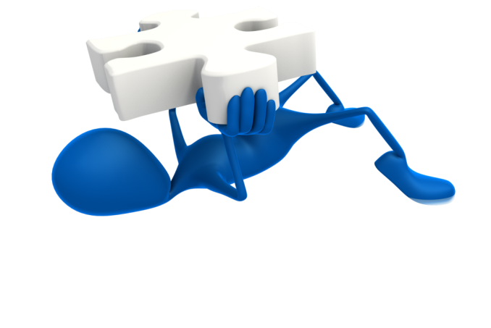
Disadvantages of AR
Spam and Security
Social and Real-Time vs. Solitary and Cached
UX (User Experience): Using AR can be inappropriate in social situations.
Openness: Other people can develop their own layers of content to display

Slide 13
Issues in Augmented Reality
Performance Issues
Real time processing of images can be a challenge and often can slow down augmented reality systems.
Interaction Issues
Users within a mixed environment because of augmented reality have difficulties interacting with the environment as normal.
Alignment Issues
People working in an augmented reality are more sensitive to alignment errors. Proper calibration and alignment with the reference frame of the world is crucial.

Slide 14
CHALLANGES
Technological limitations
User interface limitation
Social acceptance

Slide 15
CONCLUSION
Augmented reality is another step further into the digital age as we will soon see our environments change dynamically either through a Smartphone, glasses, car windshields and even windows in the near future to display enhanced content and media right in front of us.
This has amazing applications that can very well allow us to live our lives more productively, more safely, and more informatively.

Slide 16
References
www.studymafia.org
www.google.com
www.wikipedia.com

Slide 17
Thanks

