Slide 1
StudyMafia.Org
Mechanism of
Respiration
Submitted To: Submitted By:
Studymafia.org Studymafia.org

Slide 2
Table Contents
Definition
Introduction
Mechanism of Respiration
Inspiration
Expiration
Exchange of Gases
Conclusion
2
Notes:
SAY: Before we wrap up the course, let’s review what we have learned today.
During this course, we have
<READ the bullets from the slide.>
GO to next slide.

Slide 3
Definition
The respiratory mechanism is a way of controlling how much carbon dioxide is in the blood. Elevating arterial CO2 or decreasing pH increases the rhythmic stimulation of the respiratory muscles by the medulla.
3
Notes:
SAY: Before we wrap up the course, let’s review what we have learned today.
During this course, we have
<READ the bullets from the slide.>
GO to next slide.

Slide 4
Introduction
Normally control of CO2 is based on the rate and depth of ventilation.
Ventilation is however not synonymous with oxygenation. Ventilation refers only to air moving in and out of the lungs.
If everything else is working the way it should, then oxygenation happens.
However, as we learned in the shunt section, proper ventilation does not ensure oxygenation.
4
Notes:
SAY: Before we wrap up the course, let’s review what we have learned today.
During this course, we have
<READ the bullets from the slide.>
GO to next slide.

Slide 5
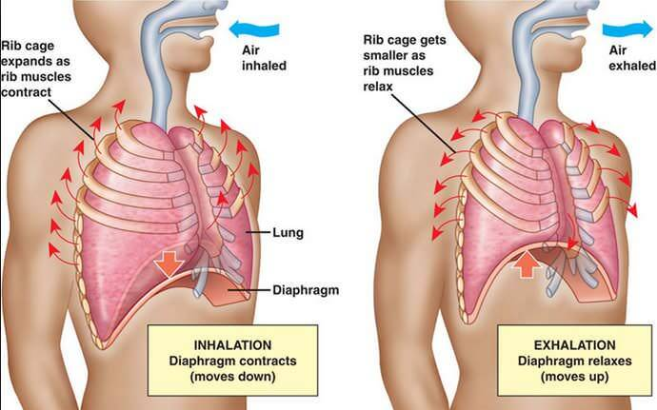
Mechanism of Respiration
5
Notes:
SAY:
The purpose of epidemiology in public health practice is to
discover the agent, host, and environmental factors that affect health;
determine the relative importance of causes of illness, disability, and death;
identify those segments of the population that have the greatest risk from specific causes of ill health; and
evaluate the effectiveness of health programs and services in improving population health.
GO to next slide.

Slide 6
Inspiration
In the process of inspiration, there would be a contraction of muscles attached to the ribs on the outer side which pulls out the ribs and results in the expansion of the chest cavity.
Later, the diaphragm, contracts, moves downwards and expands the chest cavity resulting in the contraction of the abdominal muscles.
The expansion of the chest cavity produces a partial vacuum which sucks air into the lungs and fills the expanded alveoli.
●●●
6
Notes:
SAY:
The purpose of epidemiology in public health practice is to
discover the agent, host, and environmental factors that affect health;
determine the relative importance of causes of illness, disability, and death;
identify those segments of the population that have the greatest risk from specific causes of ill health; and
evaluate the effectiveness of health programs and services in improving population health.
GO to next slide.

Slide 7
Inspiration
The process of intake of atmospheric air is known as inspiration. It is an active process.
When the volume of the thoracic cavity increases and the air pressure decreases, inspiration takes place.
Contraction of external intercostal muscles increases the volume of the thoracic cavity.
Contraction of the diaphragm further increases the size of the thoracic activity. Simultaneously, the lungs expand.
With the expansion of the lungs, the air pressure inside the lungs decreases.
The pressure equalizes and the atmospheric air rushes inside the lungs.
7
Notes:
SAY:
The purpose of epidemiology in public health practice is to
discover the agent, host, and environmental factors that affect health;
determine the relative importance of causes of illness, disability, and death;
identify those segments of the population that have the greatest risk from specific causes of ill health; and
evaluate the effectiveness of health programs and services in improving population health.
GO to next slide.

Slide 8
Expiration
The expiration process is considered once after the gaseous exchange occurs in the lungs and the air is expelled out. This expulsion of air is called expiration.
During this process, muscles attached to the ribs contract, the muscles of the diaphragm and the abdomen relax which leads to a decrease in the volume of the chest cavity and increases the pressure of the lungs, causing the air in the lungs to be pushed out through the nose.
●●●
8
Notes:
SAY:
The purpose of epidemiology in public health practice is to
discover the agent, host, and environmental factors that affect health;
determine the relative importance of causes of illness, disability, and death;
identify those segments of the population that have the greatest risk from specific causes of ill health; and
evaluate the effectiveness of health programs and services in improving population health.
GO to next slide.

Slide 9
Expiration
The process of exhaling carbon dioxide is called expiration. It is a passive process.
It occurs when the size of the thoracic activity decreases and the air pressure outside increases.
Now the external intercostal muscles relax and the internal intercostal muscles contract.
As a result, the ribs are pulled inwards and the size of the thoracic cavity is reduced.
The diaphragm is relaxed and the lungs get compressed.
Consequently, the pressure increases and the air is forced outside.
9
Notes:
SAY:
The purpose of epidemiology in public health practice is to
discover the agent, host, and environmental factors that affect health;
determine the relative importance of causes of illness, disability, and death;
identify those segments of the population that have the greatest risk from specific causes of ill health; and
evaluate the effectiveness of health programs and services in improving population health.
GO to next slide.

Slide 10
Exchange of Gases
The gaseous exchange occurs by diffusion in the alveoli. It depends upon the pressure differences between blood and tissues, or atmospheric air and blood. The exchange of gases takes place at the surface of the alveolus.
The mechanism of breathing has already been explained above. Let us have a look at the steps involved in the exchange of gases.
●●●
10
Notes:
SAY:
The purpose of epidemiology in public health practice is to
discover the agent, host, and environmental factors that affect health;
determine the relative importance of causes of illness, disability, and death;
identify those segments of the population that have the greatest risk from specific causes of ill health; and
evaluate the effectiveness of health programs and services in improving population health.
GO to next slide.

Slide 11
Exchange of Gases
Transport Of Oxygen
Oxygen in the blood is carried to the tissue in two forms- Oxyhaemoglobin- chemical composition of oxygen with haemoglobin, and solution of oxygen in the blood plasma.
The oxygen in the blood combines with haemoglobin when the concentration of oxygen is high in the blood.
Oxyhemoglobin, being unstable, dissociates to release oxygen. Low oxygen, low pH and high temperatures stimulate the dissociation process.
●●●
11
Notes:
SAY:
The purpose of epidemiology in public health practice is to
discover the agent, host, and environmental factors that affect health;
determine the relative importance of causes of illness, disability, and death;
identify those segments of the population that have the greatest risk from specific causes of ill health; and
evaluate the effectiveness of health programs and services in improving population health.
GO to next slide.

Slide 12
Exchange of Gases
Transport Of Carbon dioxide From Tissues To Lungs
Carbon dioxide is transported by three mechanisms:
Some carbon dioxide dissolves in the water of plasma to form carbonic acid.
Carbonic acid ionizes to form bicarbonate ions. The hydrogen ions are catalyzed by the enzyme carbonic anhydrase. Bicarbonate ions combine with sodium and potassium to form sodium bicarbonate and potassium bicarbonate.
Some carbon dioxide combines with haemoglobin for the formation of carbaminohemoglobin.
It is finally carried to the lungs and released out of the body through expiration.
●●●
12
Notes:
SAY:
The purpose of epidemiology in public health practice is to
discover the agent, host, and environmental factors that affect health;
determine the relative importance of causes of illness, disability, and death;
identify those segments of the population that have the greatest risk from specific causes of ill health; and
evaluate the effectiveness of health programs and services in improving population health.
GO to next slide.

Slide 13
Exchange of Gases
Transport Of Carbon dioxide From Tissues To Lungs:
Carbon dioxide is transported by three mechanisms:
Some carbon dioxide dissolves in the water of plasma to form carbonic acid.
Carbonic acid ionizes to form bicarbonate ions. The hydrogen ions are catalyzed by the enzyme carbonic anhydrase. Bicarbonate ions combine with sodium and potassium to form sodium bicarbonate and potassium bicarbonate.
Some carbon dioxide combines with haemoglobin for the formation of carbaminohemoglobin.
It is finally carried to the lungs and released out of the body through expiration.
13
Notes:
SAY:
The purpose of epidemiology in public health practice is to
discover the agent, host, and environmental factors that affect health;
determine the relative importance of causes of illness, disability, and death;
identify those segments of the population that have the greatest risk from specific causes of ill health; and
evaluate the effectiveness of health programs and services in improving population health.
GO to next slide.

Slide 14
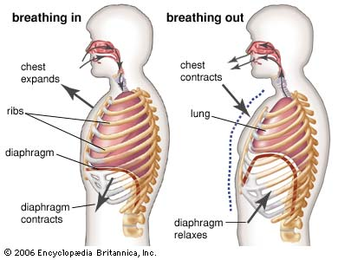
14
Notes:
SAY:
The purpose of epidemiology in public health practice is to
discover the agent, host, and environmental factors that affect health;
determine the relative importance of causes of illness, disability, and death;
identify those segments of the population that have the greatest risk from specific causes of ill health; and
evaluate the effectiveness of health programs and services in improving population health.
GO to next slide.

Slide 15
Conclusion
The mechanism of breathing involves two main processes: inspiration and expiration.
Inspiration occurs when the diaphragm and the external intercostal muscles contract.
Expiration occurs when the diaphragm and the intercostal muscles relax.
15
Notes:
SAY:
The purpose of epidemiology in public health practice is to
discover the agent, host, and environmental factors that affect health;
determine the relative importance of causes of illness, disability, and death;
identify those segments of the population that have the greatest risk from specific causes of ill health; and
evaluate the effectiveness of health programs and services in improving population health.
GO to next slide.

Slide 16
References
Google.com
Wikipedia.org
Studymafia.org
Slidespanda.com

Slide 17
Thanks To StudyMafia.org

